Slide 1
The Mughal Empire
1526-1857

Slide 2
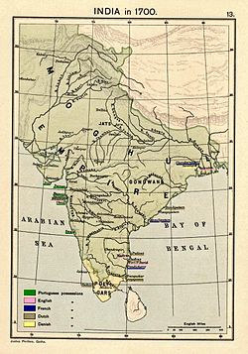
When and Where:
The Mughal Empire lasted from 1526 AD to 1857 AD
The Mughal Empire was Turkic-Mongol in origin
The empire ruled over most of Northern India

Slide 3
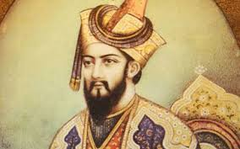
Babur
Founded by Babur (ruled from 1526-1530)
Babur was related to Genghis Khan
Babur’s base was in Kabul, Afghanistan
By the time he died in 1530, he ruled over all of Northern India

Slide 4
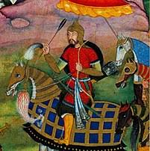
Humayun
Babur’s son
Ruled from 1530-1540
Lost control of empire to Afghan rebels

Slide 5
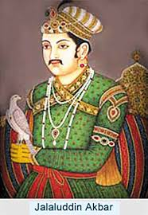
Akbar
Grandson of Babur
Regained control of empire; ruled from 1556-1605
Considered to be the greatest Mughal emperor

Slide 6
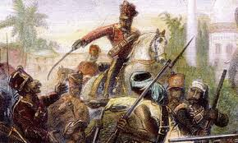
Fall of Mughal Empire
During Muhammad Shah’s rule (1719-1748), the empire began to break up
After his death, the next emperor lost control of the empire
The last emperor was exiled by the British after his involvement with the Indian Mutiny of 1857-1858
This brought the end of the Mughal Empire

