Slide 1
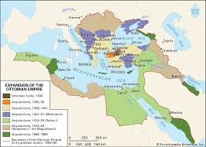
Ottoman Empire
SS 07.06.03.02

Slide 2
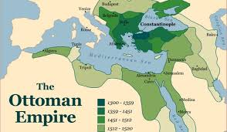
Rise of the Ottomans:
The Ottoman Empire was created by Turkish tribes in Anatolia (Asia Minor)
Existed from 1300 AD to 1922 AD

Slide 3
Ten Minute History - The Rise of the Ottoman Empire (Short Documentary)
Watch the video and answer the questions in your packet

Slide 4
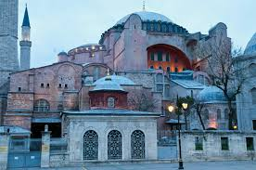
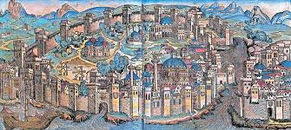
Constantinople...Istanbul… Hmmm?
In 1453 the Ottomans captured the Byzantine city, Constantinople, and renamed it Istanbul
The city was highly fortified and difficult to capture
The capturing of the city was important to the Ottomans because they were able to prove their military power and skills

Slide 5
🎶 Istanbul was Constantinople 🎶
THEY MIGHT BE GIANTS "Istanbul (Not Constantinople)"

Slide 6
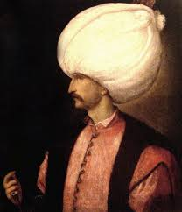
Suleiman the Magnificent
Ottoman Empire gained more power under Suleiman the Magnificent than any other previous leader
Helped Turkish culture flourish
Following his death, the Ottoman Empire began to decline

Slide 7
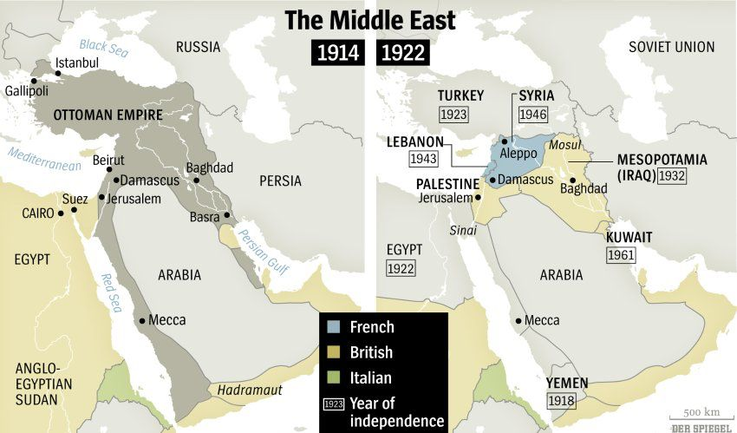
Decline and Collapse
The Ottomans began losing territory from the 1500’s - 1700’s
During the 1800’s the Ottoman Empire grew weaker due to rebellions within the empire
Following World War I, the Ottoman Empire officially came to an end with the Treaty of Sevres

