Slide 1
African Crisis and Genocides
11.05.04.02, 11.05.05.02, 11.07.02.02

Slide 2
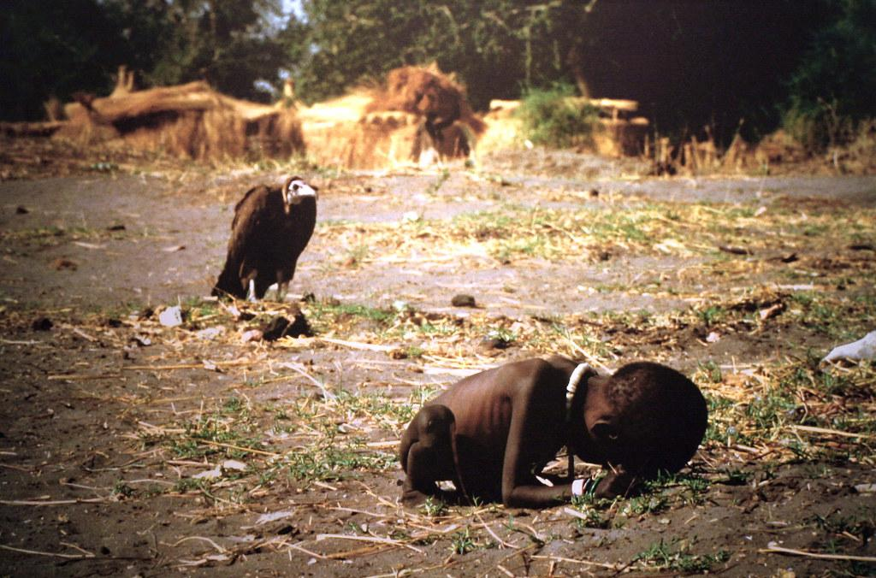
Crisis in Africa: Famine
Africa is currently facing the worst food crisis since 1945. Millions could die in the coming months.
The collision of climate change, population growth and regional conflict has created massive food shortages across multiple countries in Africa. While the cause varies from country to country, the needs are largely the same—immediate provision of food and water, as well as long-term solutions that address the root causes.

Slide 3
Crisis in Africa: Famine
Kenya: Due to a collision of drought and population growth, nearly 4 million Kenyans are now food insecure.
Burundi: Water deficit, pests and plant diseases have sharply increased food shortages throughout Burundi.
Malawi: Cycles of massive flooding followed by prolonged droughts have destroyed crops, livestock and houses in southern and central Malawi.
South Sudan: Regional conflict has displaced 1.85 million South Sudanese, creating competition for scarce resources, including food.
Sudan: Violence in the Darfur region continues to force many Sudanese to abandon their homes, disrupting their ability to produce or buy food.

Slide 4
African Crisis: AIDS
AIDS is a disease in which there is a severe loss of the body's cellular immunity, greatly lowering the resistance to infection and malignancy.
Using the earliest known sample of HIV, scientists have been able to create a 'family-tree' ancestry of HIV transmission, allowing them to discover where HIV started.
Their studies concluded that the first transmission of SIV to HIV in humans took place around 1920 in Kinshasa in the Democratic Republic of Congo (DR Congo).
The same area is known for having the most genetic diversity in HIV strains in the world, reflecting the number of different times SIV (comes from chimps) was passed to humans. Many of the first cases of AIDS were recorded there too.

Slide 5
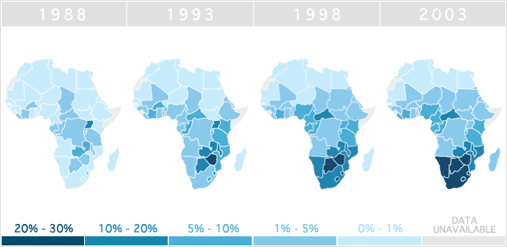

Slide 6
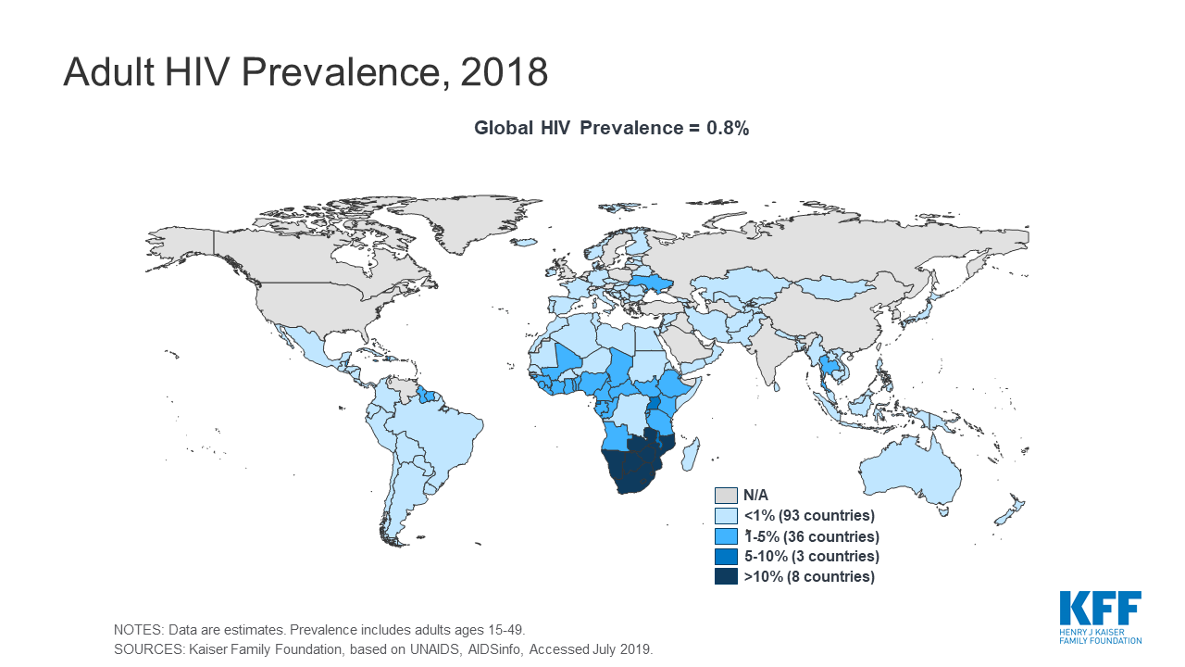

Slide 7
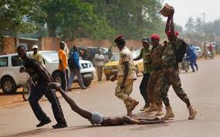
African Crisis: Civil War
South Sudan: 2013, Sudan People Liberation Movement (SPLM) against Sudan People Liberation Movement in Opposition (SPLM-O). Fight over power, control of natural resources, and ethnicities.
Congo War: 1998-present, rebel group known as the March 23 Movement (M23), want political power.
Libyan Civil War: 2014-present, new Libyan government is working with the U.S. government in Libya is trying to gain control over militia such as ISIS.
Somali Civil War: 1991-present, weak central government against Al-Qaeda rebels. The U.S. is aiding the Somali government in “anti-piracy” training.

Slide 8
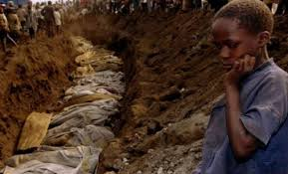
African Crisis: Genocide
Genocide is the deliberate killing of a large group of people, especially those of a particular ethnic group or nation.

Slide 9
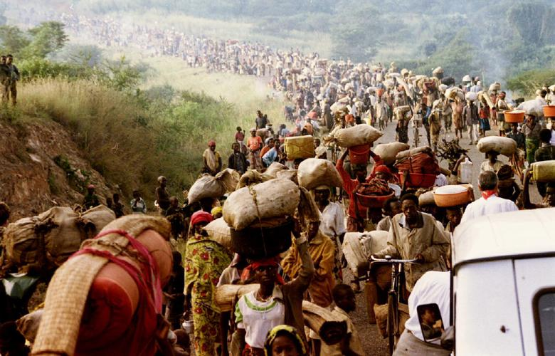
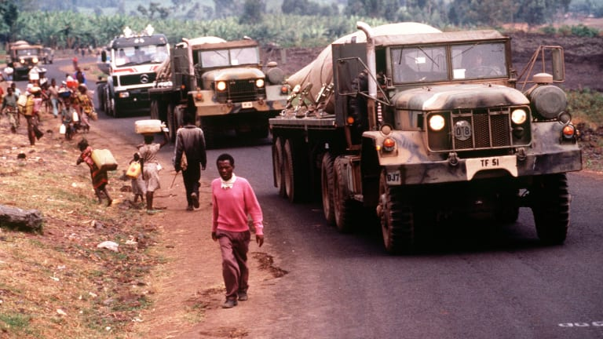
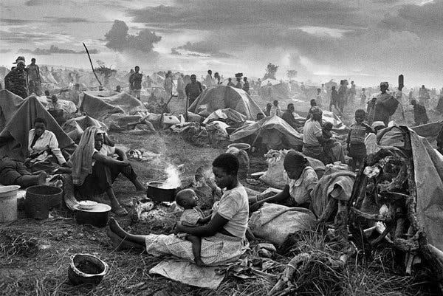
African Genocide: Rwanda
1994
https://www.youtube.com/watch?v=SVnOGsJY5RQ

Slide 10
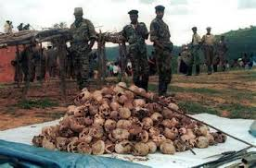
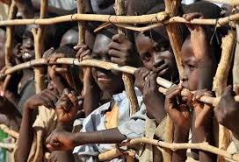
African Genocide: Darfur
The Darfur Genocide was the mass slaughter and rape of Darfuri men, women, and children in Western Sudan.
The killings began in 2003.
The killings were done by Arab militias.
The militias would destroy the Darfurians’ homes, burn their villages, loot economic resources, pollute water sources, and murder, rape, and torture civilians.
As of today 480,000 people have been killed and 2.8 million have been displaced.

Slide 11
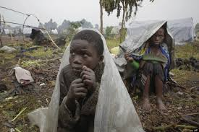
African Genocide: Congo
Since 1996, the Democratic Republic of Congo (DR Congo) has been embroiled in violence that has killed as many as 6 million people.
First Congo War occurred in 1996 and the Second Congo War occurred in 1998. Fighting over ethnicities, Hutus and Tutsi.
It is estimated that over 6 million have died as a result of the conflict. In 2008, an estimated 45,000 people were dying each month. The death toll is due to widespread disease and famine; reports indicate that almost half of the individuals who have died are children under the age of 5.
The long and brutal conflict in the DRC has caused massive suffering for civilians, with estimates of millions dead either directly or indirectly as a result of the fighting. There have been frequent reports of weapon bearers killing civilians, and destroying property.
Those who are not subject to violence must contend with poverty, famine, and disease. Hundreds of thousands of people have been impoverished by the violence. Infant and child mortality rates are extremely high as a result of famine and malnutrition. An estimated 3.8 million people have been displaced within the DRC and 2 million have become refugees in neighboring Burundi, Rwanda, Tanzania, and Uganda.

Slide 12
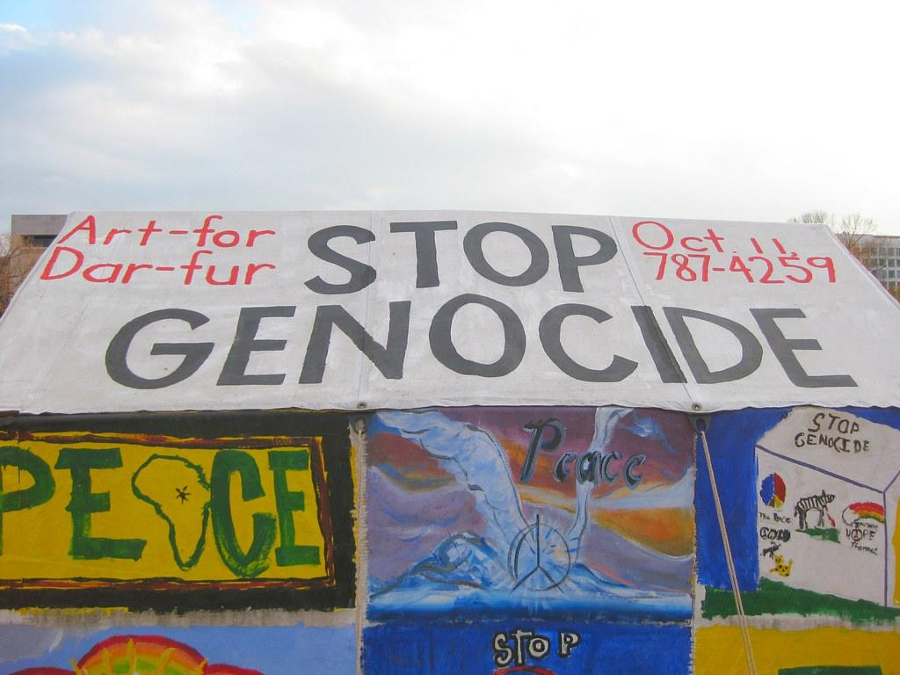
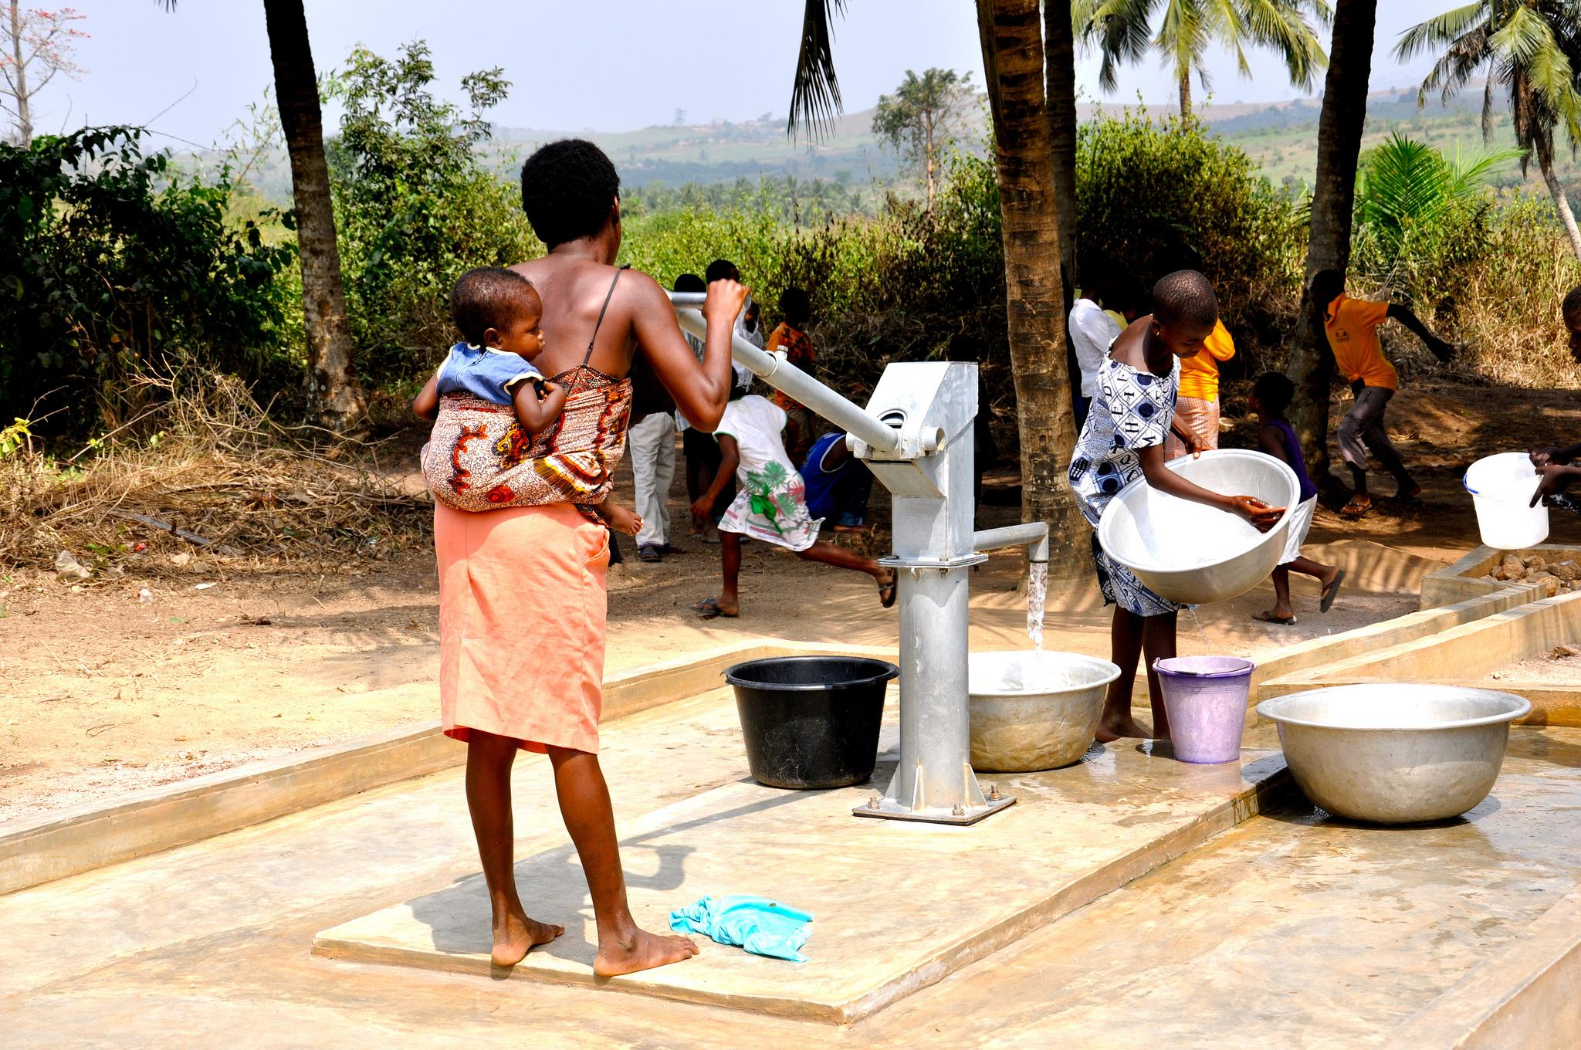
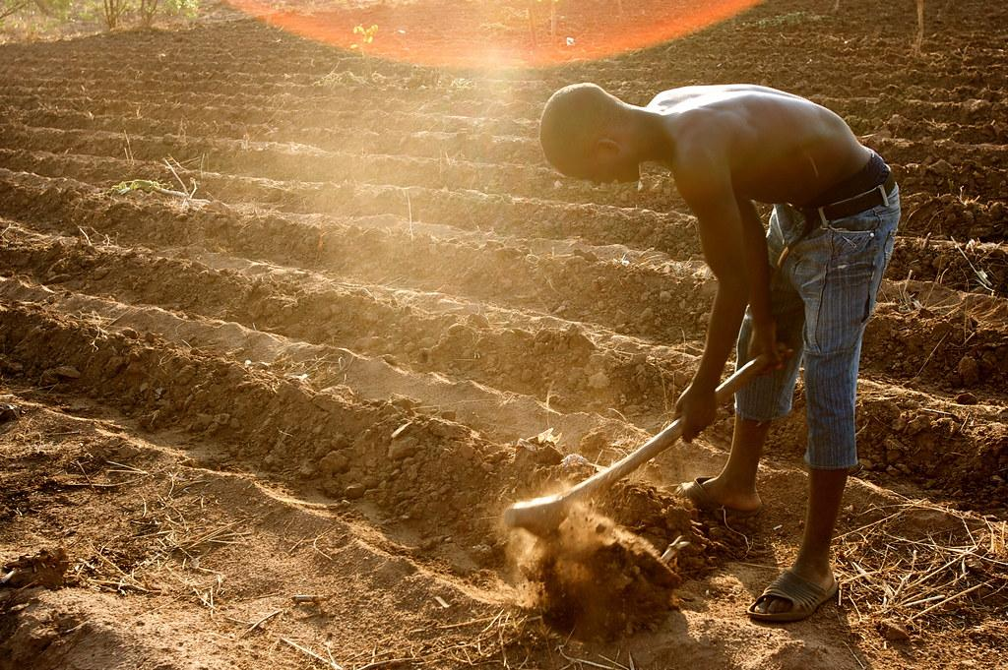
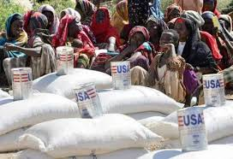
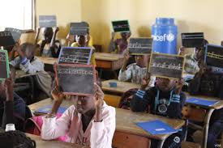
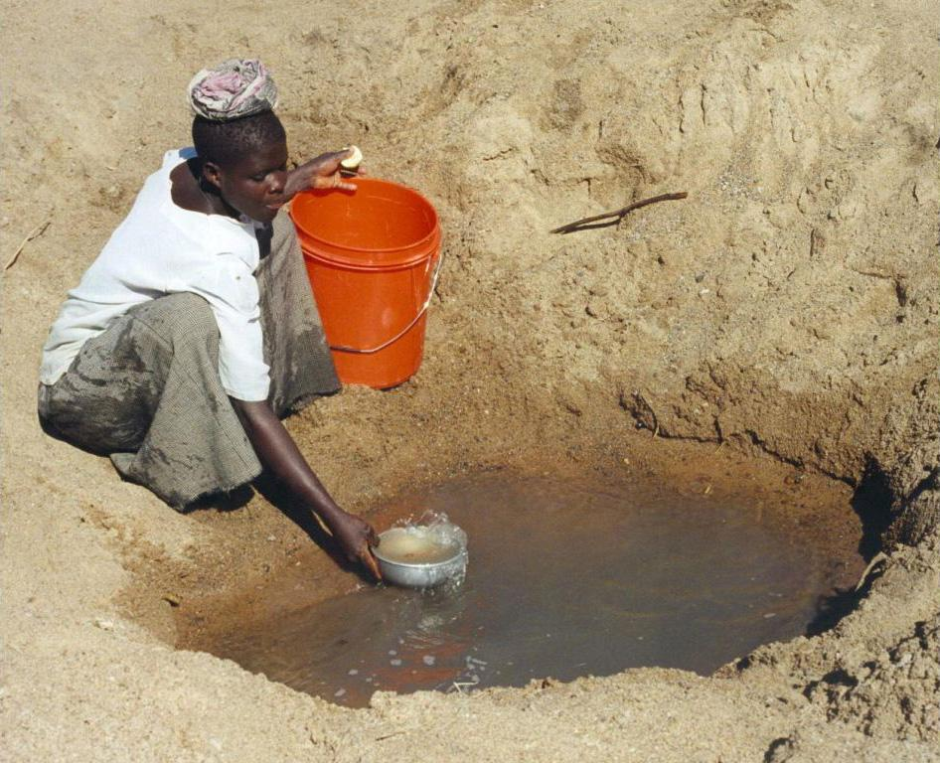
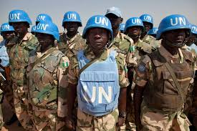
Is there a solution to the African Crisis?

