Slide 1
Suez and Panama Canals
11.05.04.02

Slide 2
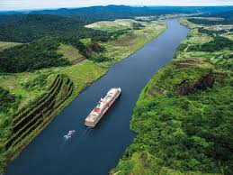
What is a canal?
an artificial waterway constructed to allow the passage of boats or ships inland or to convey water for irrigation.
Examples: The Erie Canal, Panama Canal, Suez Canal

Slide 3
How did the Suez Canal come to be?
In the 1800s, Egypt was a semi-independent province of the Ottoman empire, making great strides toward reform. Its success was due to Muhammad Ali (not the boxer).
Muhammad Ali was an ambitious soldier who was appointed governor of Egypt by the Ottomans.
Ali used the opportunity created by Napoleon’s invasion and the civil war that followed to seize power in 1805.

Slide 4
Muhammad Ali Introduces Reforms
Muhammad Ali is sometimes called the “father of modern Egypt.” He introduced a number of political and economic reforms, including improving tax collection, reorganizing the landholding system, and backing large irrigation projects to increase farm output.
Ali also brought Western military experts to Egypt to help him build a well-trained, modern army. He conquered the neighboring lands of Arabia, Syria, and Sudan.
Before he died in 1849, he had set Egypt on the road to becoming a major Middle Eastern power.

Slide 5
Building the Suez Canal
Muhammad Ali’s successors lacked his skills, and Egypt came increasingly under foreign control. In 1858, a French entrepreneur, Ferdinand de Lesseps, organized a company to build the Suez Canal. European nations gained power over the Ottomans by extending loans at high interest rates.
In 1875, the ruler of Egypt was unable to repay loans he had contracted for the canal and other projects. To pay his debts, he sold his shares in the canal. The British bought the shares, gaining a controlling interest in the canal.

Slide 6
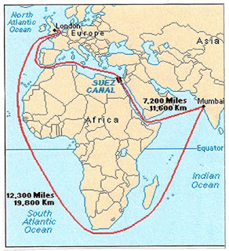

Slide 7
How did the Panama Canal come to be?
The United States had a growing influence upon the Latin American countries.
Mexico was trying to build stable governments across North America. Latin American nations began to feel threatened by the “Colossus of the North”.

Slide 8
The Monroe Doctrine
In the 1820s, Spain plotted to recover its American colonies. Britain opposed any move that might close the door to trade with Latin America. British leaders asked American President James Monroe to join them in a statement opposing any new colonization of the Americas.
Monroe wanted to avoid having an “entangling alliance” with Britain, due to past issues (America wanting Independence from this nation). President Monroe issued the Monroe Doctrine in 1823.

Slide 9
What does the Monroe Doctrine say?
“The American continents are henceforth not to be considered as subjects for future colonization by any European powers.”
The United States lacked the military power to enforce the doctrine. But with the support of Britain's strong navy, the doctrine discouraged European interference.
For more than a century, the Monroe Doctrine would be the key to United States policy in the Americas.

Slide 10
The United States interferes in Latin America
American investments in Latin America grew in the early 1900s. Citing the need to protect those investments, in 1904 the United States issued the Roosevelt Corollary to the Monroe Doctrine.
Under this policy, the United States claimed “international police power” in the Western Hemisphere.
When the Dominican Republic could not to pay their debts, the U.S. sent troops to the country.
Americans collected custom duties, paid off debts, and remained for years.

Slide 11
Resentment for the Americans
Under the Roosevelt Corollary and the President William Howard Taft’s policy of Dollar Diplomacy, American companies continued to invest in the countries of Latin America. To protect those investments, the United States sent troops to Cuba, Haiti, Mexico, Honduras, Nicaragua, and other countries in Central America and the Caribbean.
As a result, like European powers in Africa and Asia, the United States became the target of increasing resentment and rebellion.

Slide 12
Building the Panama Canal
From the late 1800s, the U.S. had wanted to build a canal across Central America. Panama was the proposed site. However, Panama belonged to Colombia, which refused to sell the United States land for the canal.
In 1903, the United States backed a revolt by Panamanians against Colombia. The Panamanians quickly won independence and gave the U.S. control of the land to build the canal.

Slide 13
Breaking Ground in Panama
Construction began in 1904. Engineers solved many difficult problems in the course of building the canal.
The Panama Canal opened in 1914, cutting the distance of a sea journey between such cities as New York and San Francisco by thousands of miles.

Slide 14
Poor Image of the Canal
To people in Latin America, the canal was another example of “Yankee imperialism.” Nationalist feeling in the hemisphere was often expressed as anti-Americanism.
Panama did not gain complete control over the canal until 2000. It now forms a vital part of the Panamanian economy.

Slide 15
