Slide 1
Rise and History of Islam
07.06.03.04

Slide 2
Rise of Islam- Muhammad
Muhammad was born in 570 CE in Mecca
He was born into a noble family
He was visited by an angel, Gabriel, who said Muhammad was a prophet of God
Muhammad question Gabriel, but eventually believed him and began spreading Islam

Slide 3
Mecca Battles
Muhammad was pushed out of Mecca in 622 CE- this becomes known as the Hijra
His migration from Mecca to Medina is the start of the Islamic calendar
Between 622-630 CE the Muslims and the Quraysh tribe battle over Mecca
Muhammad and the Muslims eventually win back Mecca

Slide 4
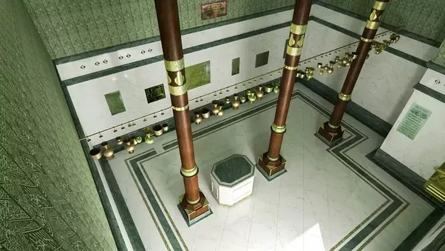
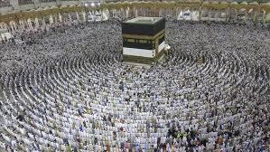
Muhammad’s Death and After
Muhammad died in 632 CE without naming a successor- so the Muslims had to decide
After his death, the Muslims began conquering more land
Kaaba in Mecca

Slide 5
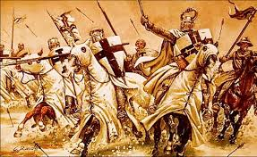
The Crusades
The Crusades were a series of wars fought between European Christians and Muslims
The Christians and Muslims fought over Jerusalem, otherwise known as the holy land
The Crusades lasted from 1095 to 1492

