Slide 1
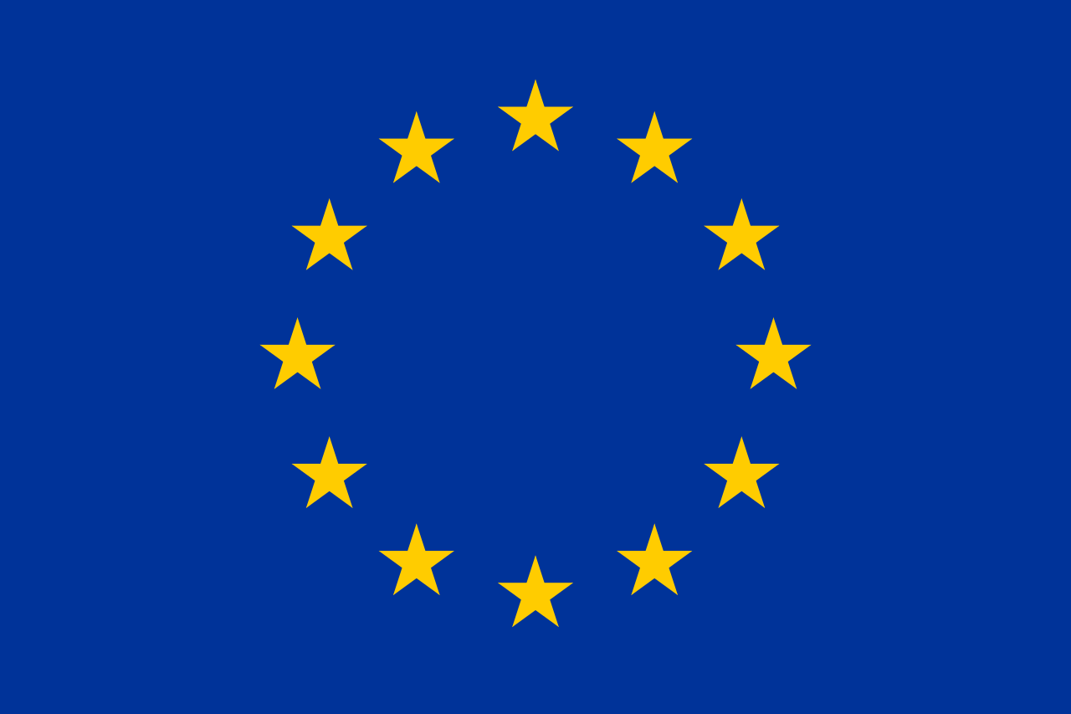
The European Union
11.08.06.02

Slide 2
How did the European Union (EU) come to be?
In 1945, the European Union was set up with the aim of ending the frequent and bloody wars between neighbors, which culminated in the Second World War.

Slide 3
What countries founded the EU?
The six founding countries are Belgium, France, Germany, Italy, Luxembourg and the Netherlands

Slide 4
Economic foundation for EU
The 1950s are dominated by a cold war between east and west. Protests in Hungary against the Communist regime are put down by Soviet tanks in 1956. In 1957, the Treaty of Rome creates the European Economic Community (EEC), or ‘Common Market’.

Slide 5
A period of economic growth
The 1960s is a good period for the economy, helped by the fact that EU countries stop charging custom duties when they trade with each other. They also agree joint control over food production, so that everybody now has enough to eat - and soon there is even surplus agricultural produce.

Slide 6
More countries join the EU
Denmark, Ireland and the United Kingdom join the European Union on 1 January 1973, raising the number of Member States to nine.

Slide 7
Unified currency
The euro is now the new currency for many Europeans. During the decade more and more countries adopt the euro.
The political divisions between east and west Europe are finally declared healed when no fewer than 10 new countries join the EU in 2004, followed by Bulgaria and Romania in 2007.

Slide 8
The EU Economy
In terms of the total value of all goods and services produced (GDP), it is bigger than the US economy. EU GDP in 2017:
€15.3 trillion

Slide 9
Trade in the EU
With just 6.9 % of the world's population, EU trade with the rest of the world accounts for some 15.6 % of global imports and exports.

Slide 10
Employment rate within the EU
https://europa.eu/european-union/about-eu/figures/economy_en

Slide 11
EU Beneficial or Not?
https://www.youtube.com/watch?v=XxutY7ss1v4

