Slide 1
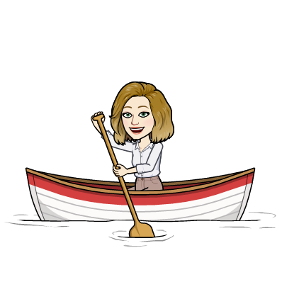
Age of Exploration
7th Grade Social Studies
Period 7

Slide 2
What was the European Exploration?
European Exploration was a time when a major change occurred. This is also called a turning point.

Slide 3
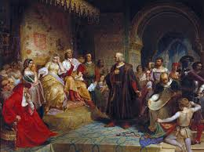
What was life like before the Europeans explored?
Made up of small kingdoms
Small, dense population (that means disease)
Compared to Asian countries, Europe was pretty weak
Not as much technology as Asia

Slide 4
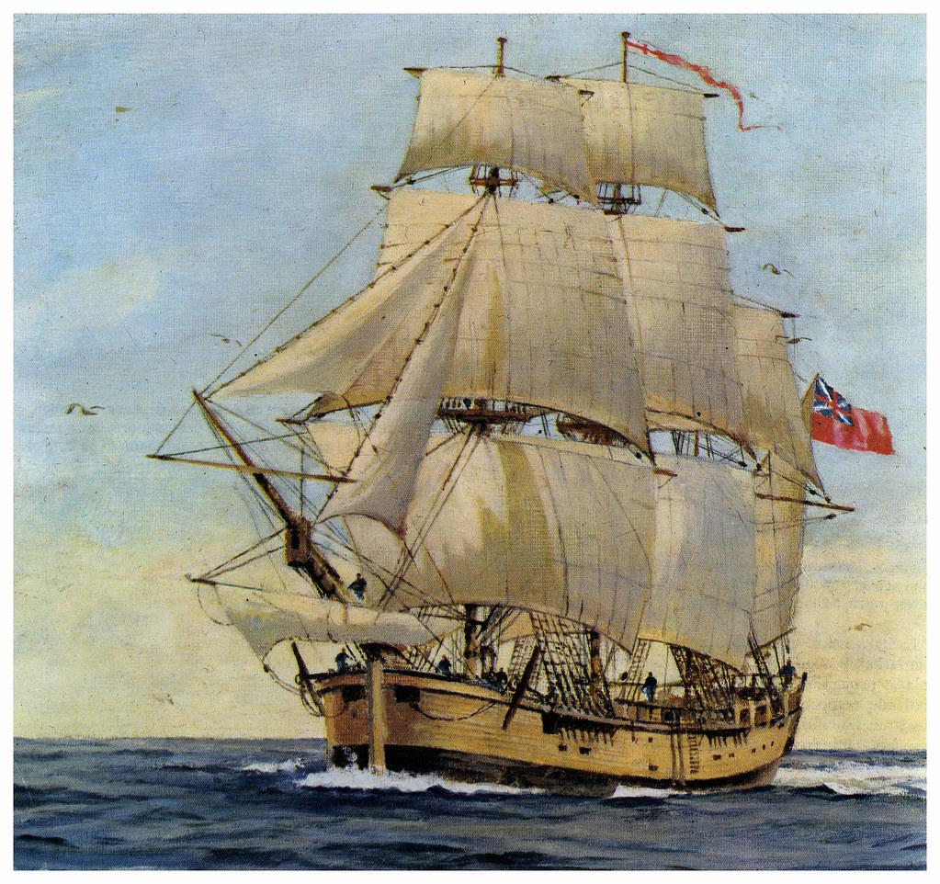
What was life like after the Europeans explored?
Large kingdoms that stretched across the world
Larger population
Strong militaries and navys
Technologically advanced

Slide 5
Where are some places you think the Europeans explored?

Slide 6
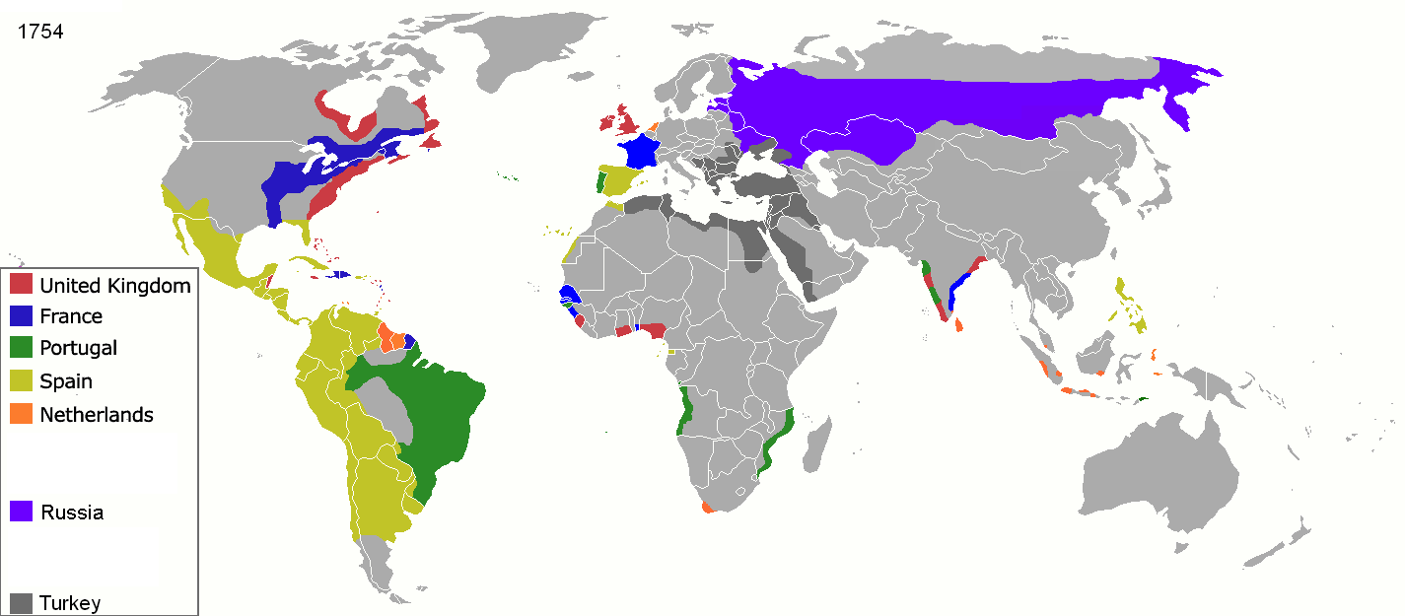

Slide 7
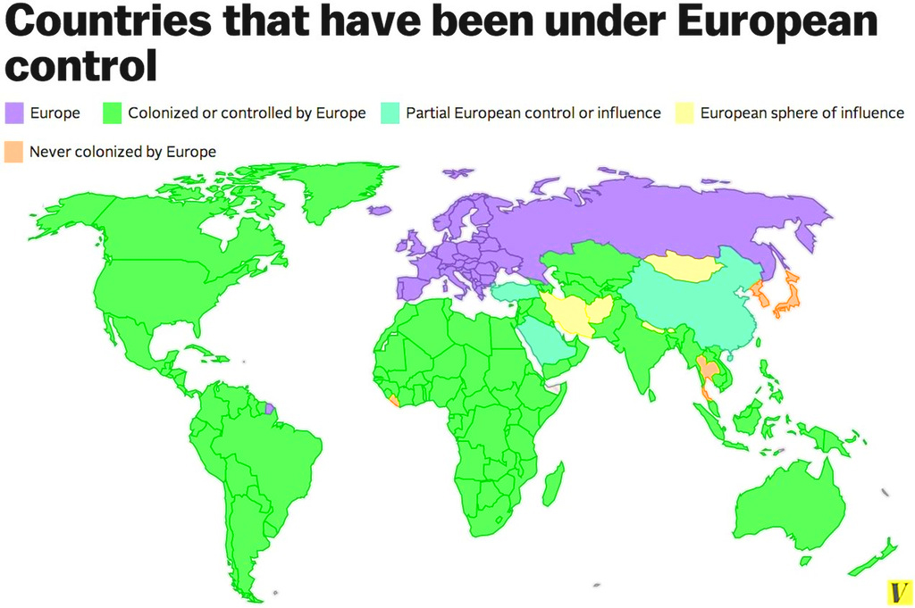

Slide 8
What caused Europeans to want to travel to other countries?
A desire for trade
The Renaissance- a rebirth of Europe, caused new ways of thinking
Powerful kings & queens, also known as monarchs
These rulers pushed for Europeans to explore and colonize new lands
But why?

Slide 9
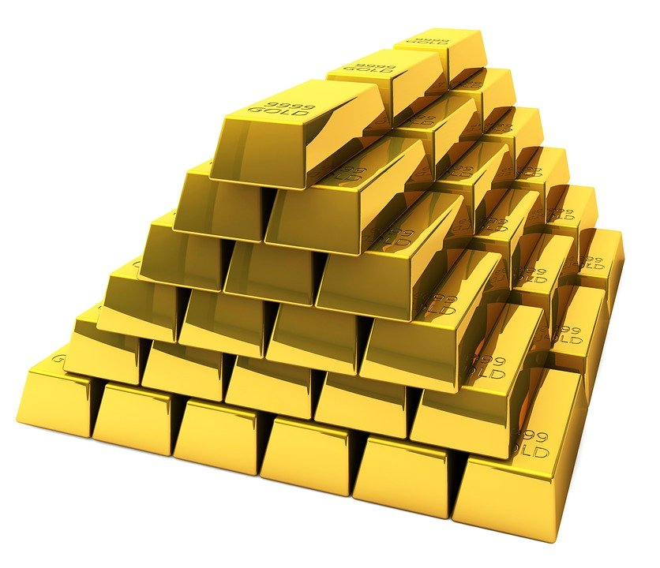
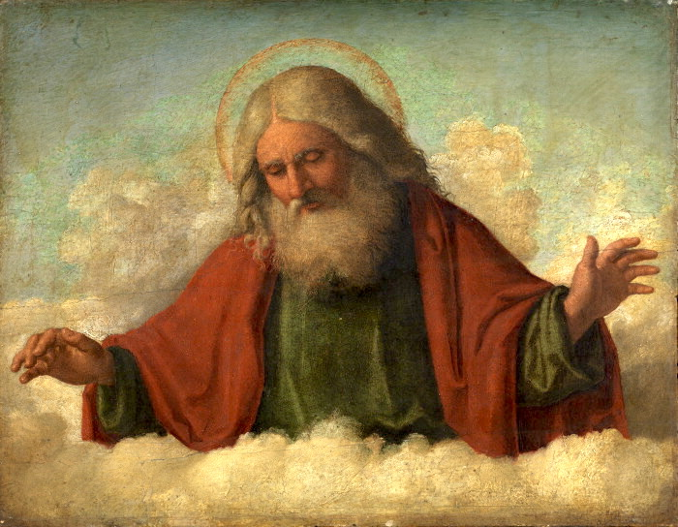
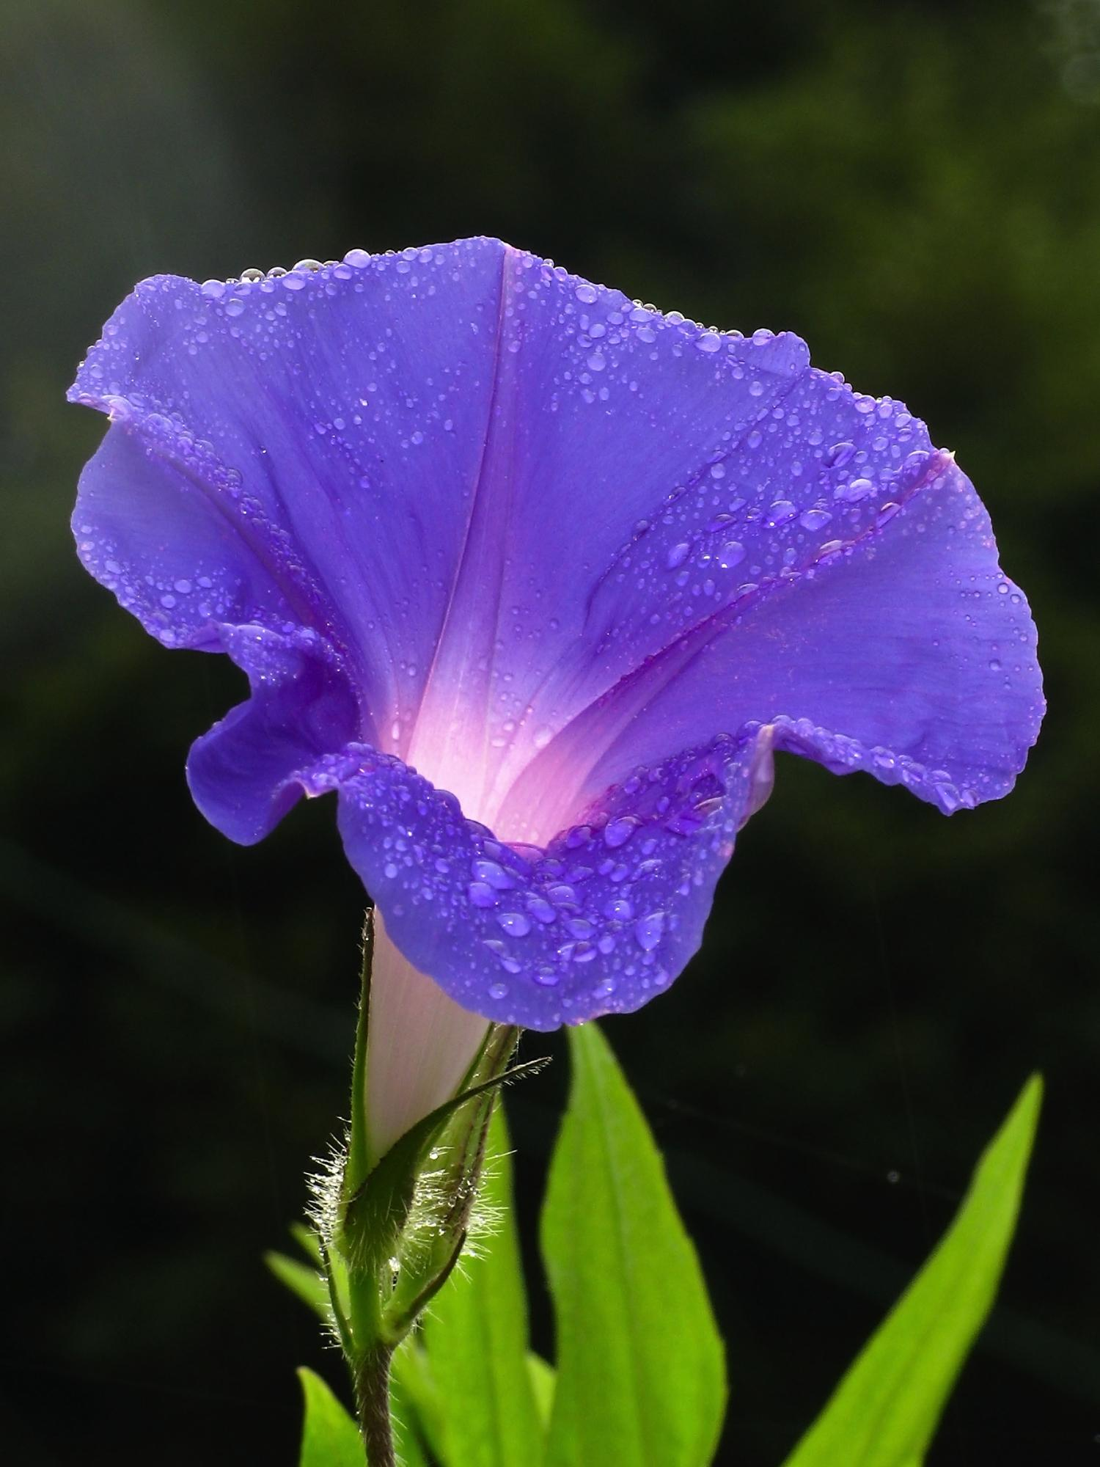
They wanted the 3 G’s
Gold-Europeans wanted to gain access to the spice, silk, and sugar trade. They wanted to find new sources of gold and silver so they could be wealthy.
God-they wanted to convert people to Christianity and spread their religion.
Glory-desire to learn about the world and gain adventure, fortune and fame.

Slide 10
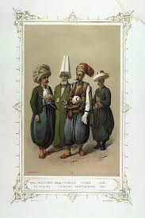
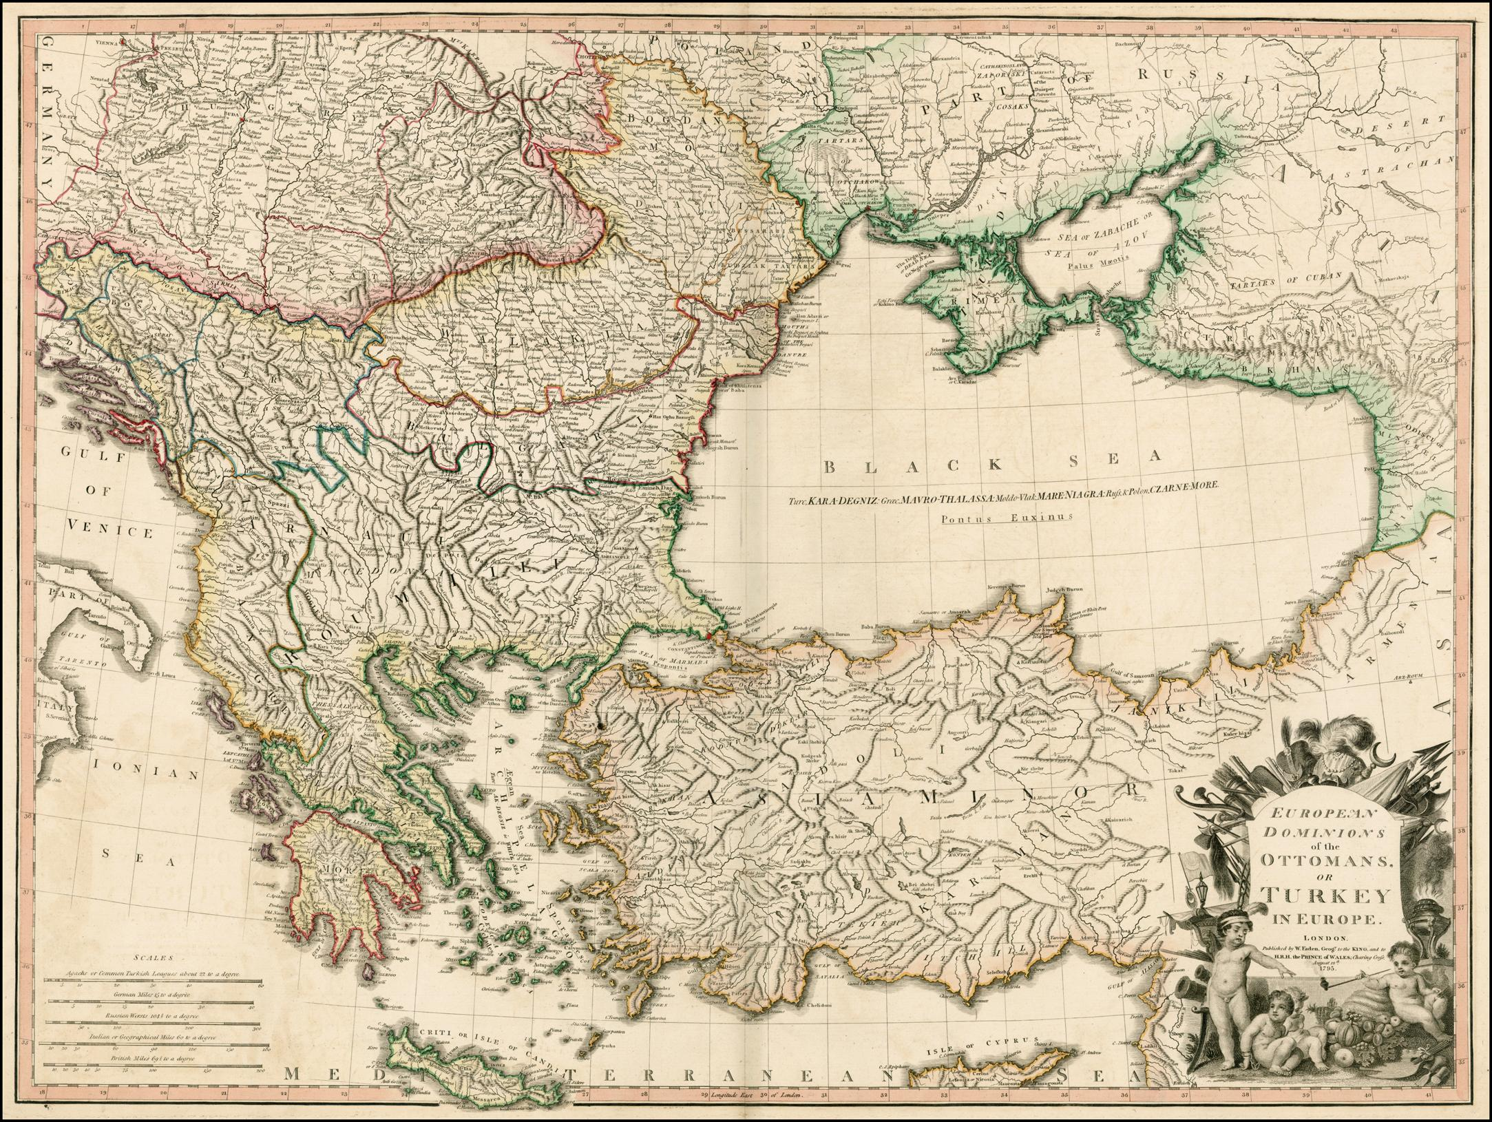
The Ottoman Empire

Slide 11
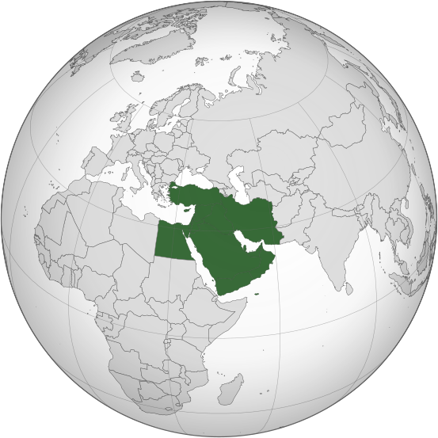
Ottoman Empire location
The Ottoman Empire was located in the Middle East.

Slide 12
The Ottoman’s (Turks) religion
The Ottoman’s (Turks) religion was mostly Islam.
European religion was mostly Christianity.

Slide 13
Religious Differences
Because of these religious differences, it made trade difficult for the Europeans in the Middle East and Asia.

Slide 14
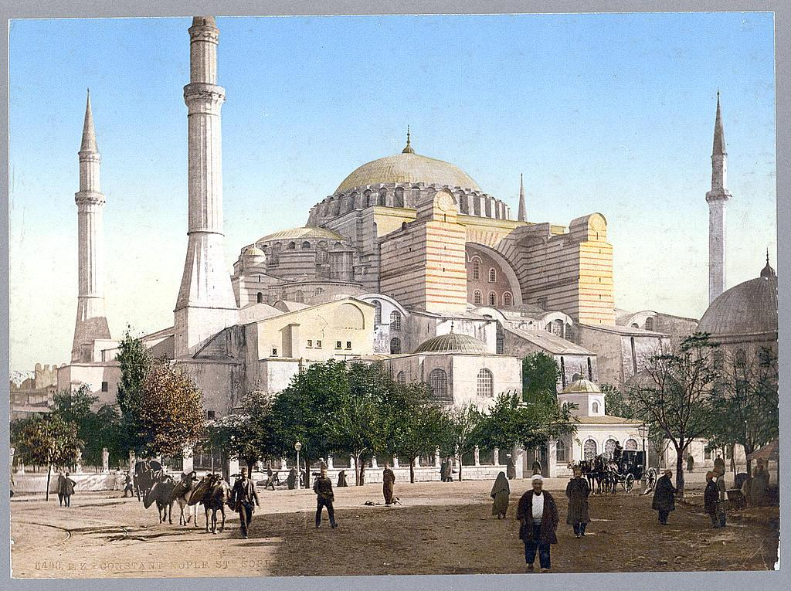
The Turks Have Control
The Turks took control of a major trading city called Constantinople.

Slide 15
The Turks (still) Have Control
When the Turks took control of the city of Constantinople, they blocked off trade routes between Europe and Asia.

Slide 16
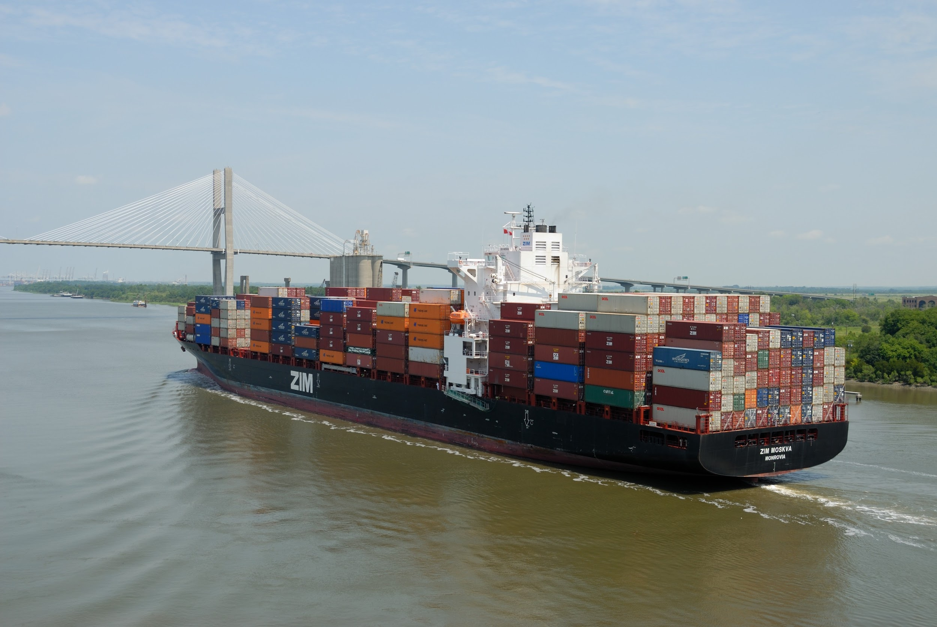
“The Turks are closing off trade routes, what are we going to do?!?”-European trader
The Turks closing off the trade routes between Europe and Asia forced the Europeans to find an all-water route to Asia.

Slide 17
Activities
https://exploration.marinersmuseum.org/resources/
Game:
http://exploration.marinersmuseum.org/wp-content/themes/agesofex/games/merchants/

Slide 18
Age of Exploration: New Technologies

Slide 19
Who helped inspire/introduce new technologies to the explorers?

Slide 20
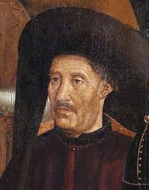
Prince Henry the Navigator
Prince Henry the Navigator set up a school that encouraged exploration and the study of improvements in navigation.
Was NOT a sailor or a navigator, but he sponsored MANY explorations.

Slide 21
What were the new technologies that came from the Age of Exploration?

Slide 22
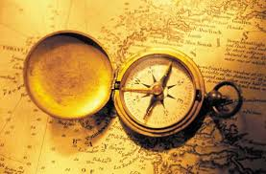
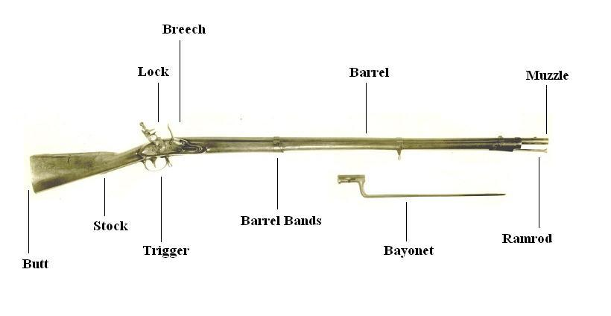
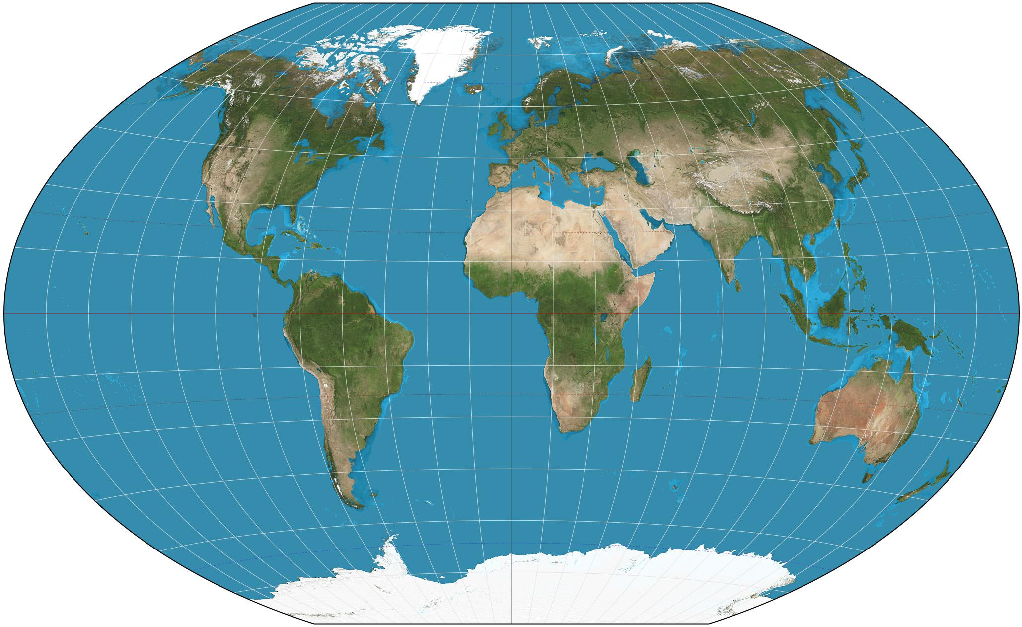
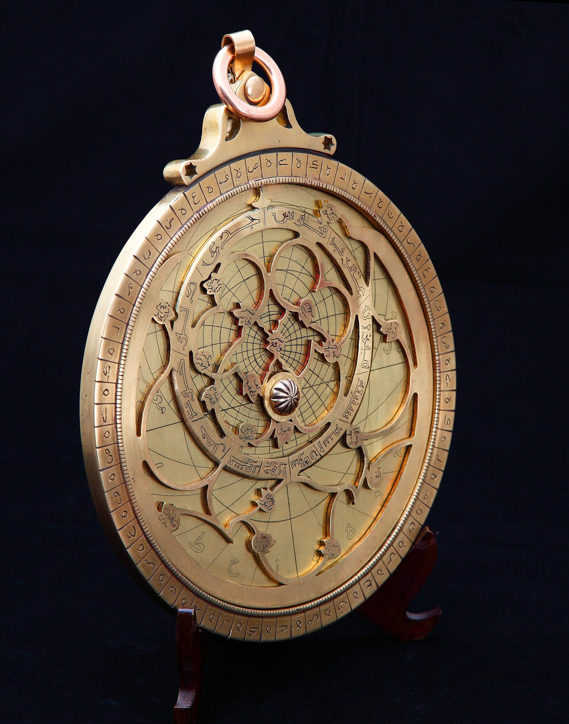
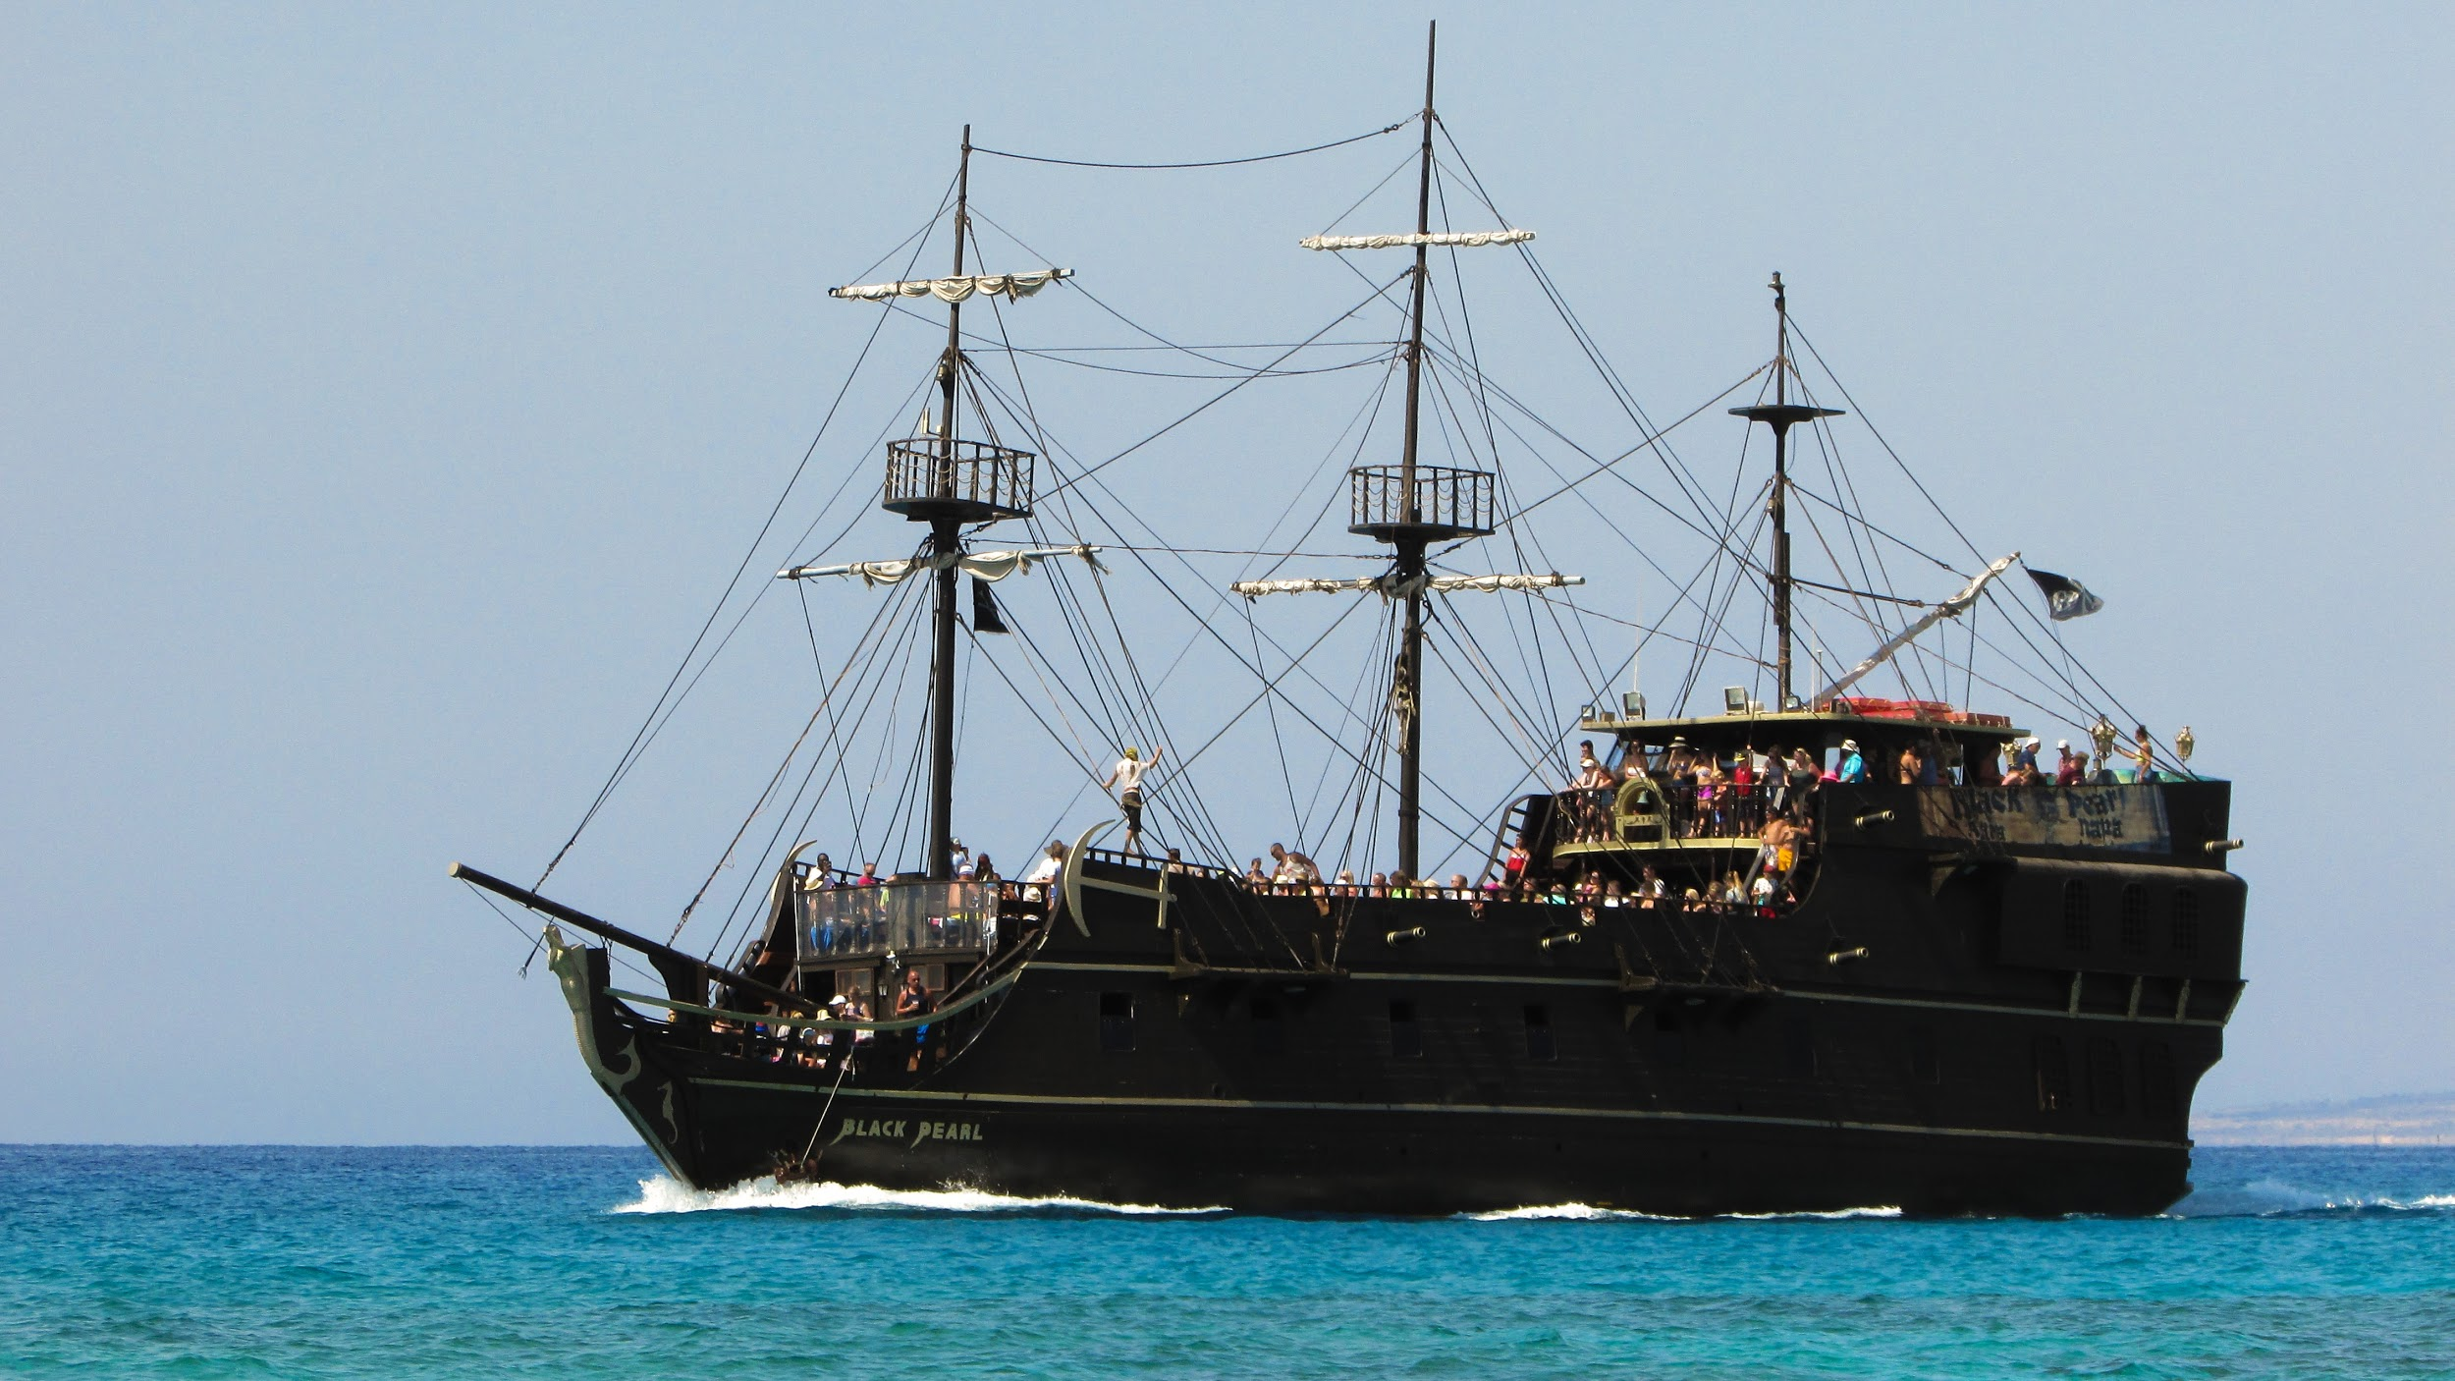
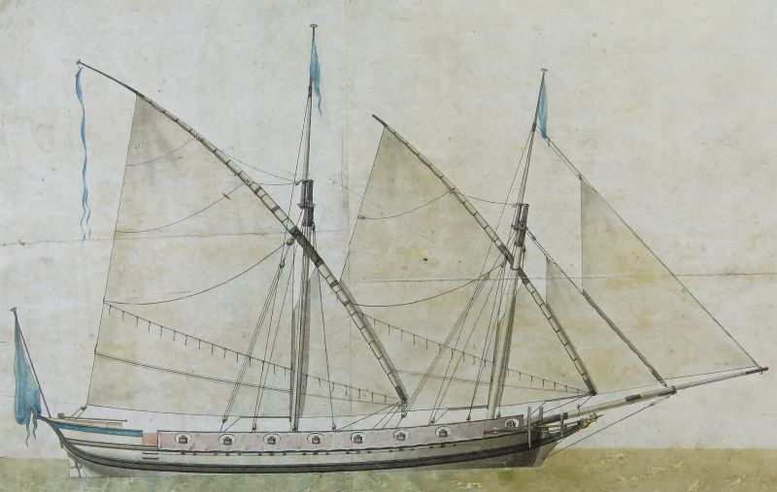
New Technologies from the Age of Exploration

Slide 23
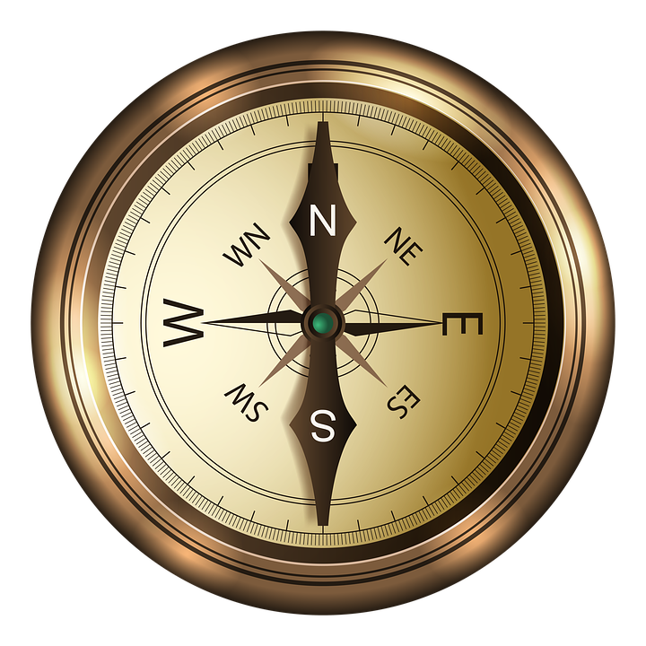
Magnetic Compass
Gave direction for explorers

Slide 24
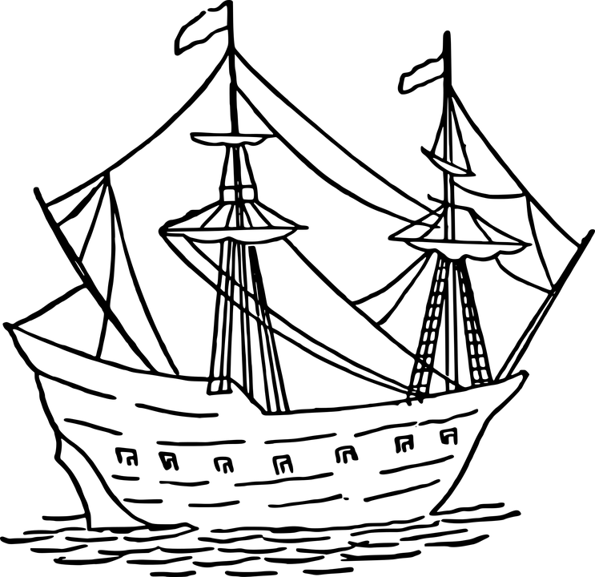
The Caravel Ship
Easy travel close to shore

Slide 25
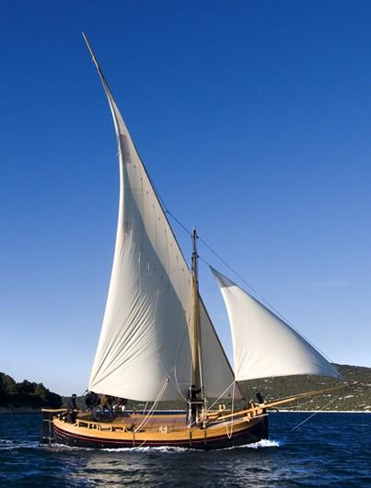
The Lateen Sail
Allowed ships to sail into the wind

Slide 26
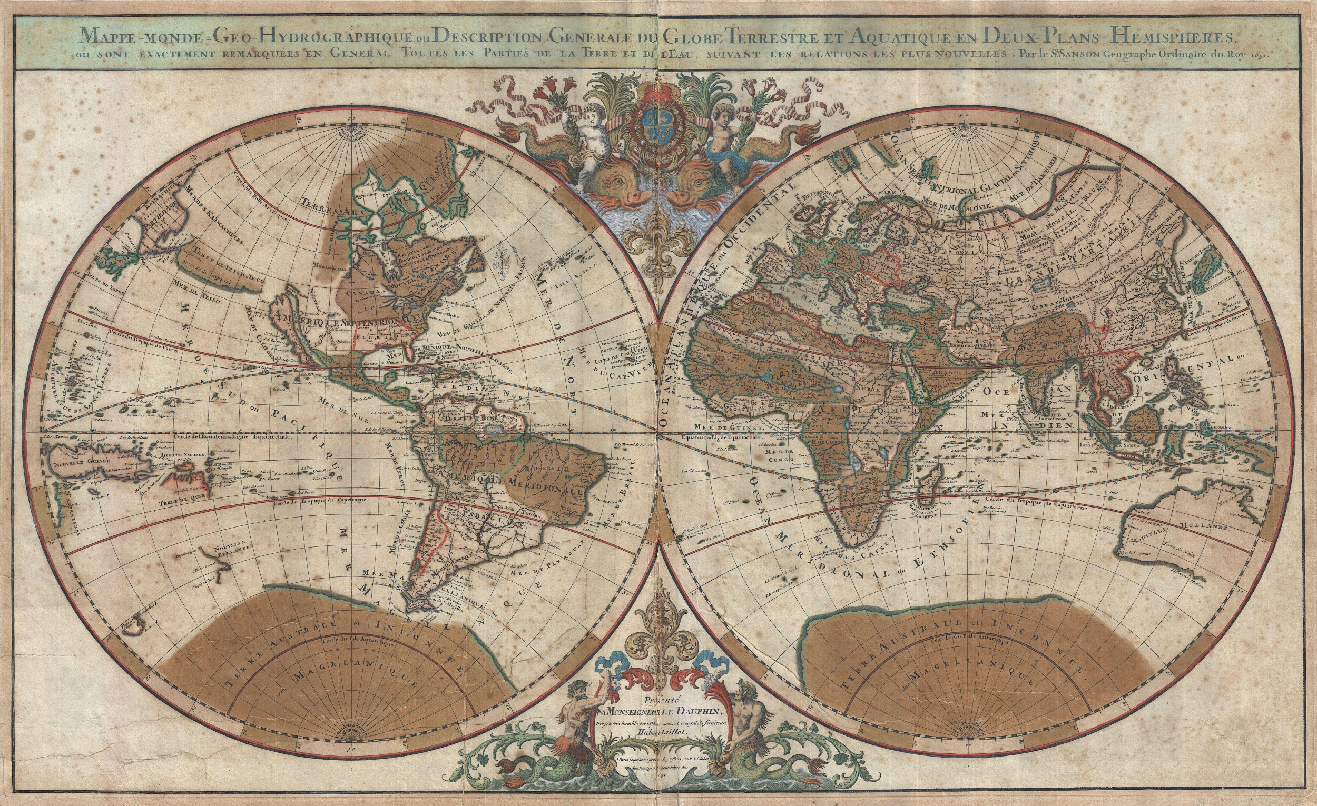
Improved Maps
Helped explorers know where they are going

Slide 27
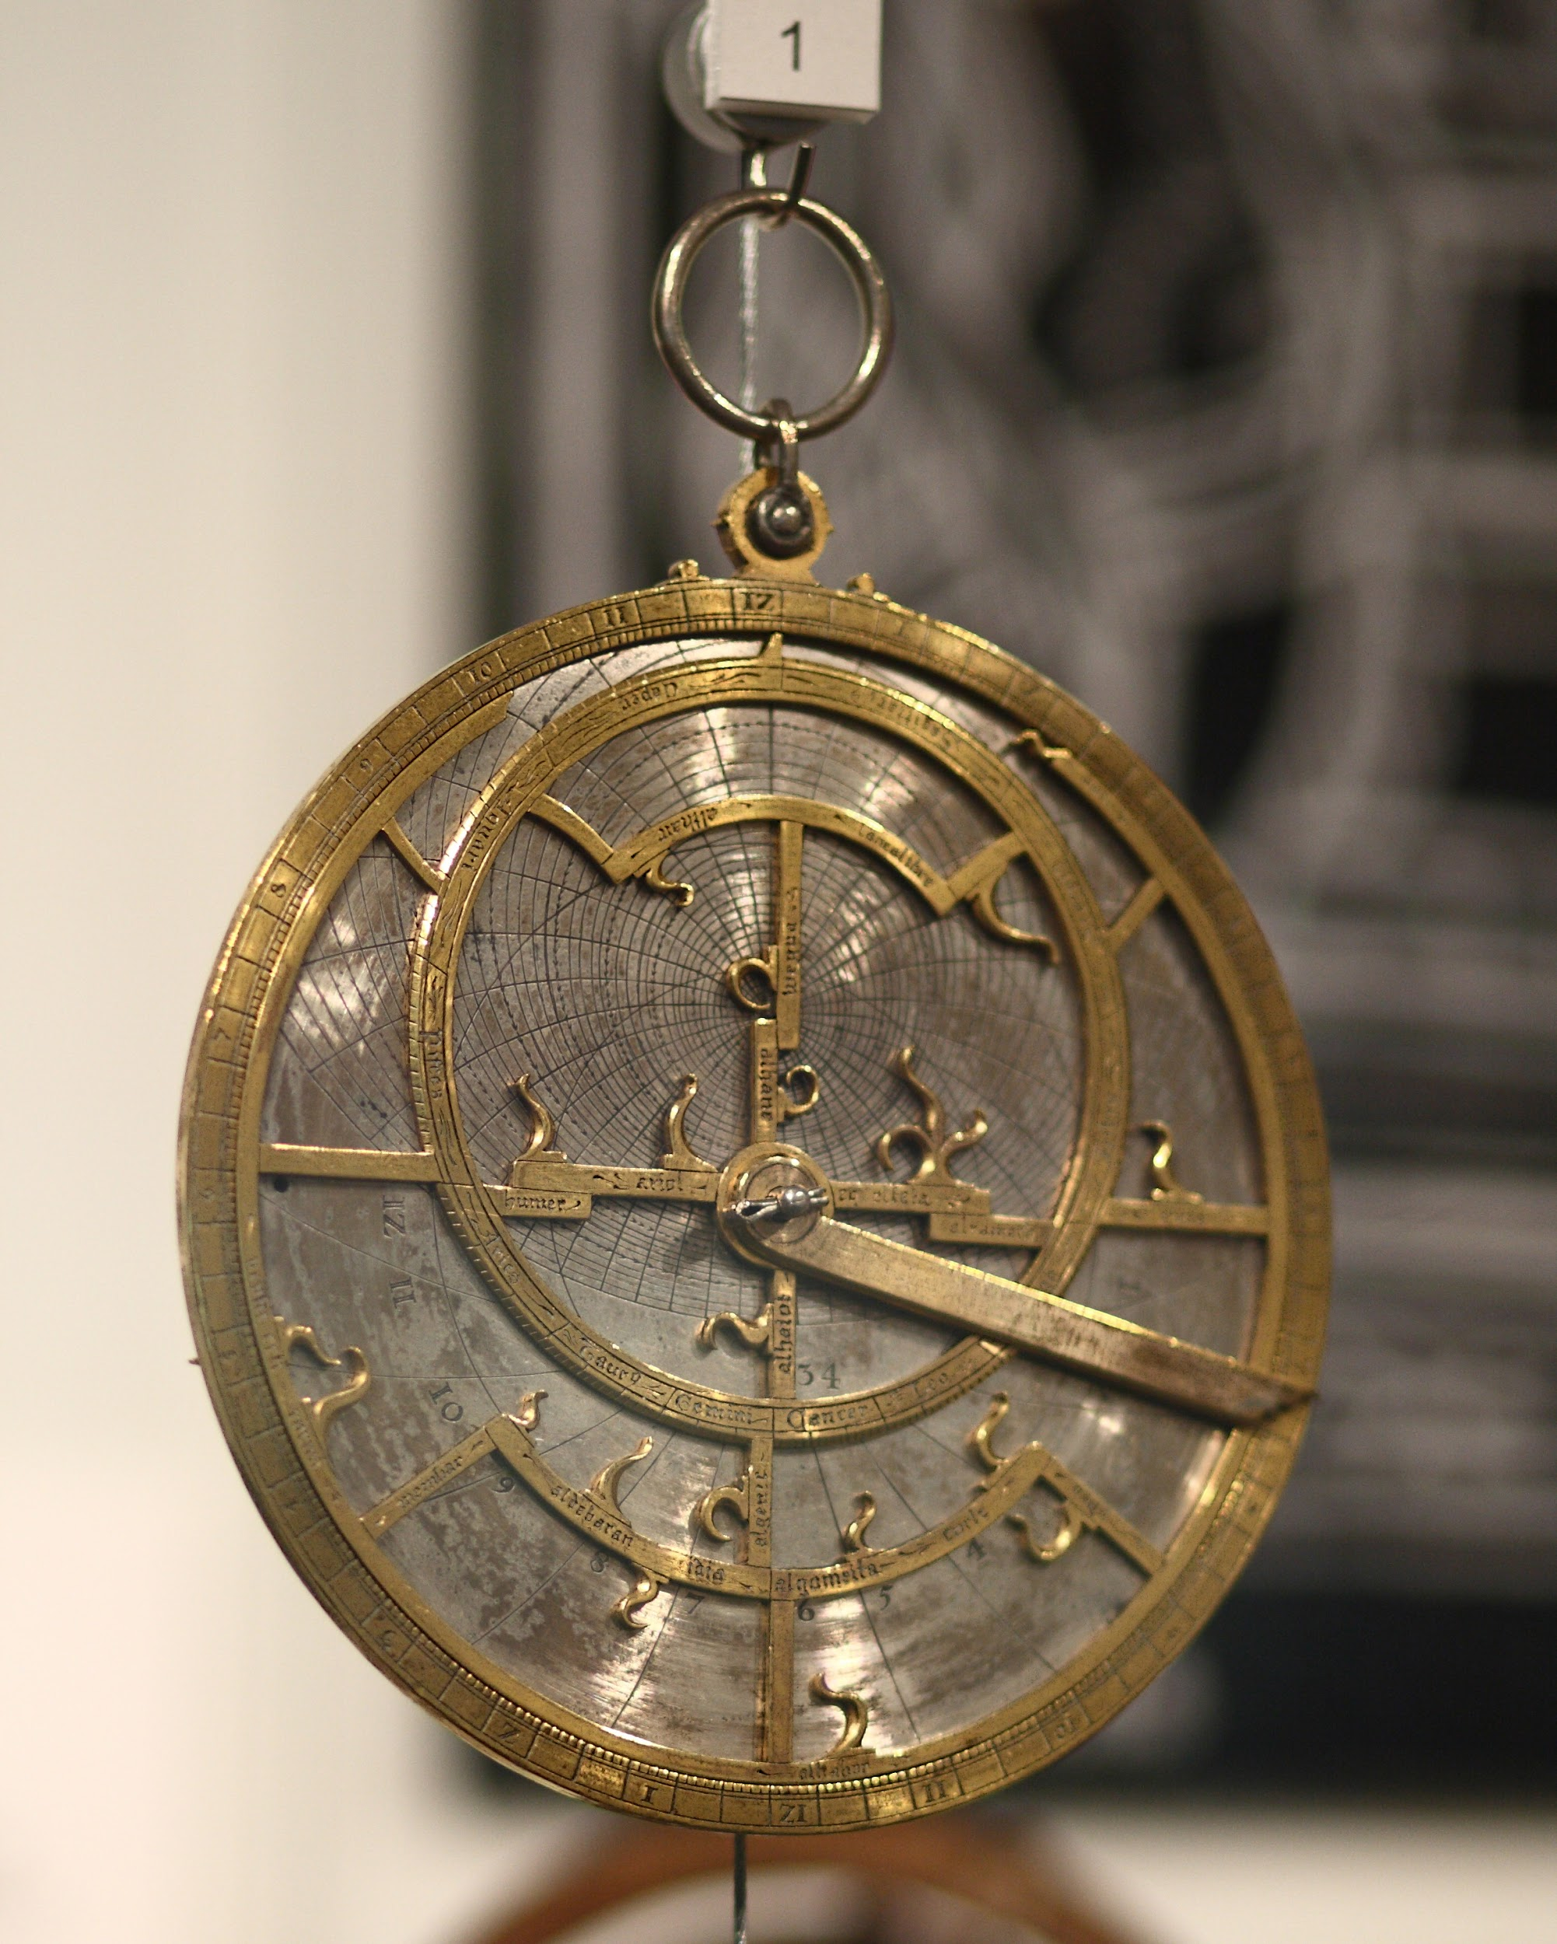
The Astrolabe
Helped explorers know their location. Tells them their latitude on the map

Slide 28
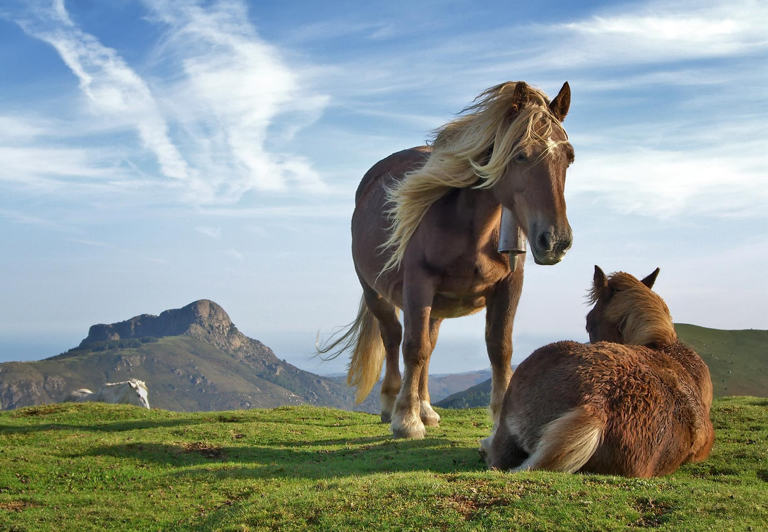
Weapons
Europeans had guns, metal weapons, armor and horses

Slide 29
What were some impacts/effects of the Age of Exploration?

Slide 30
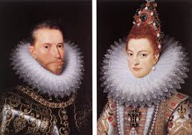
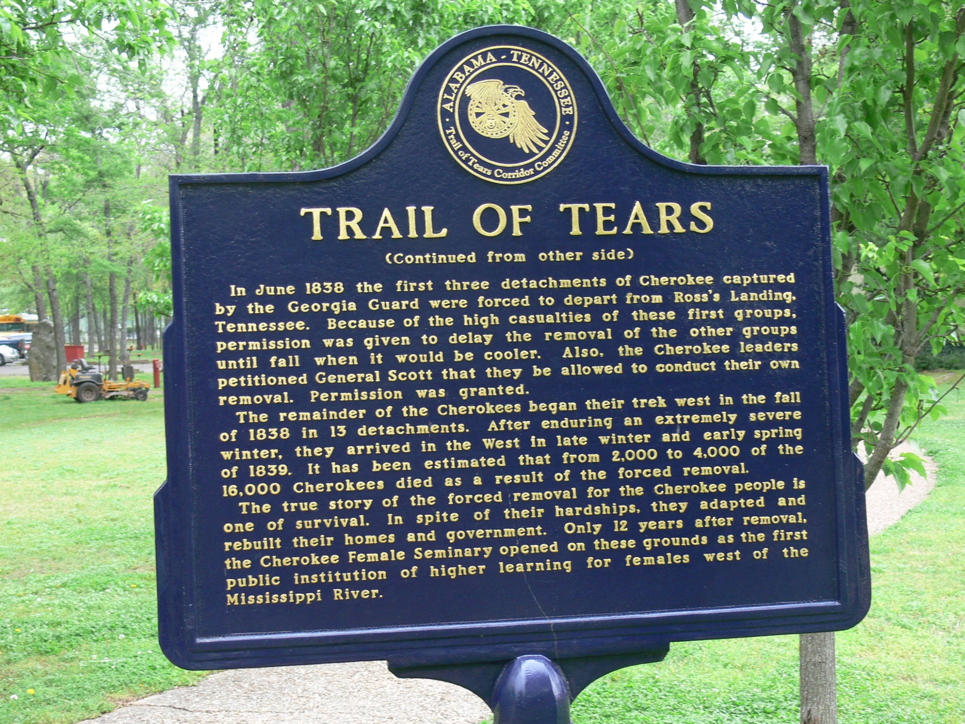
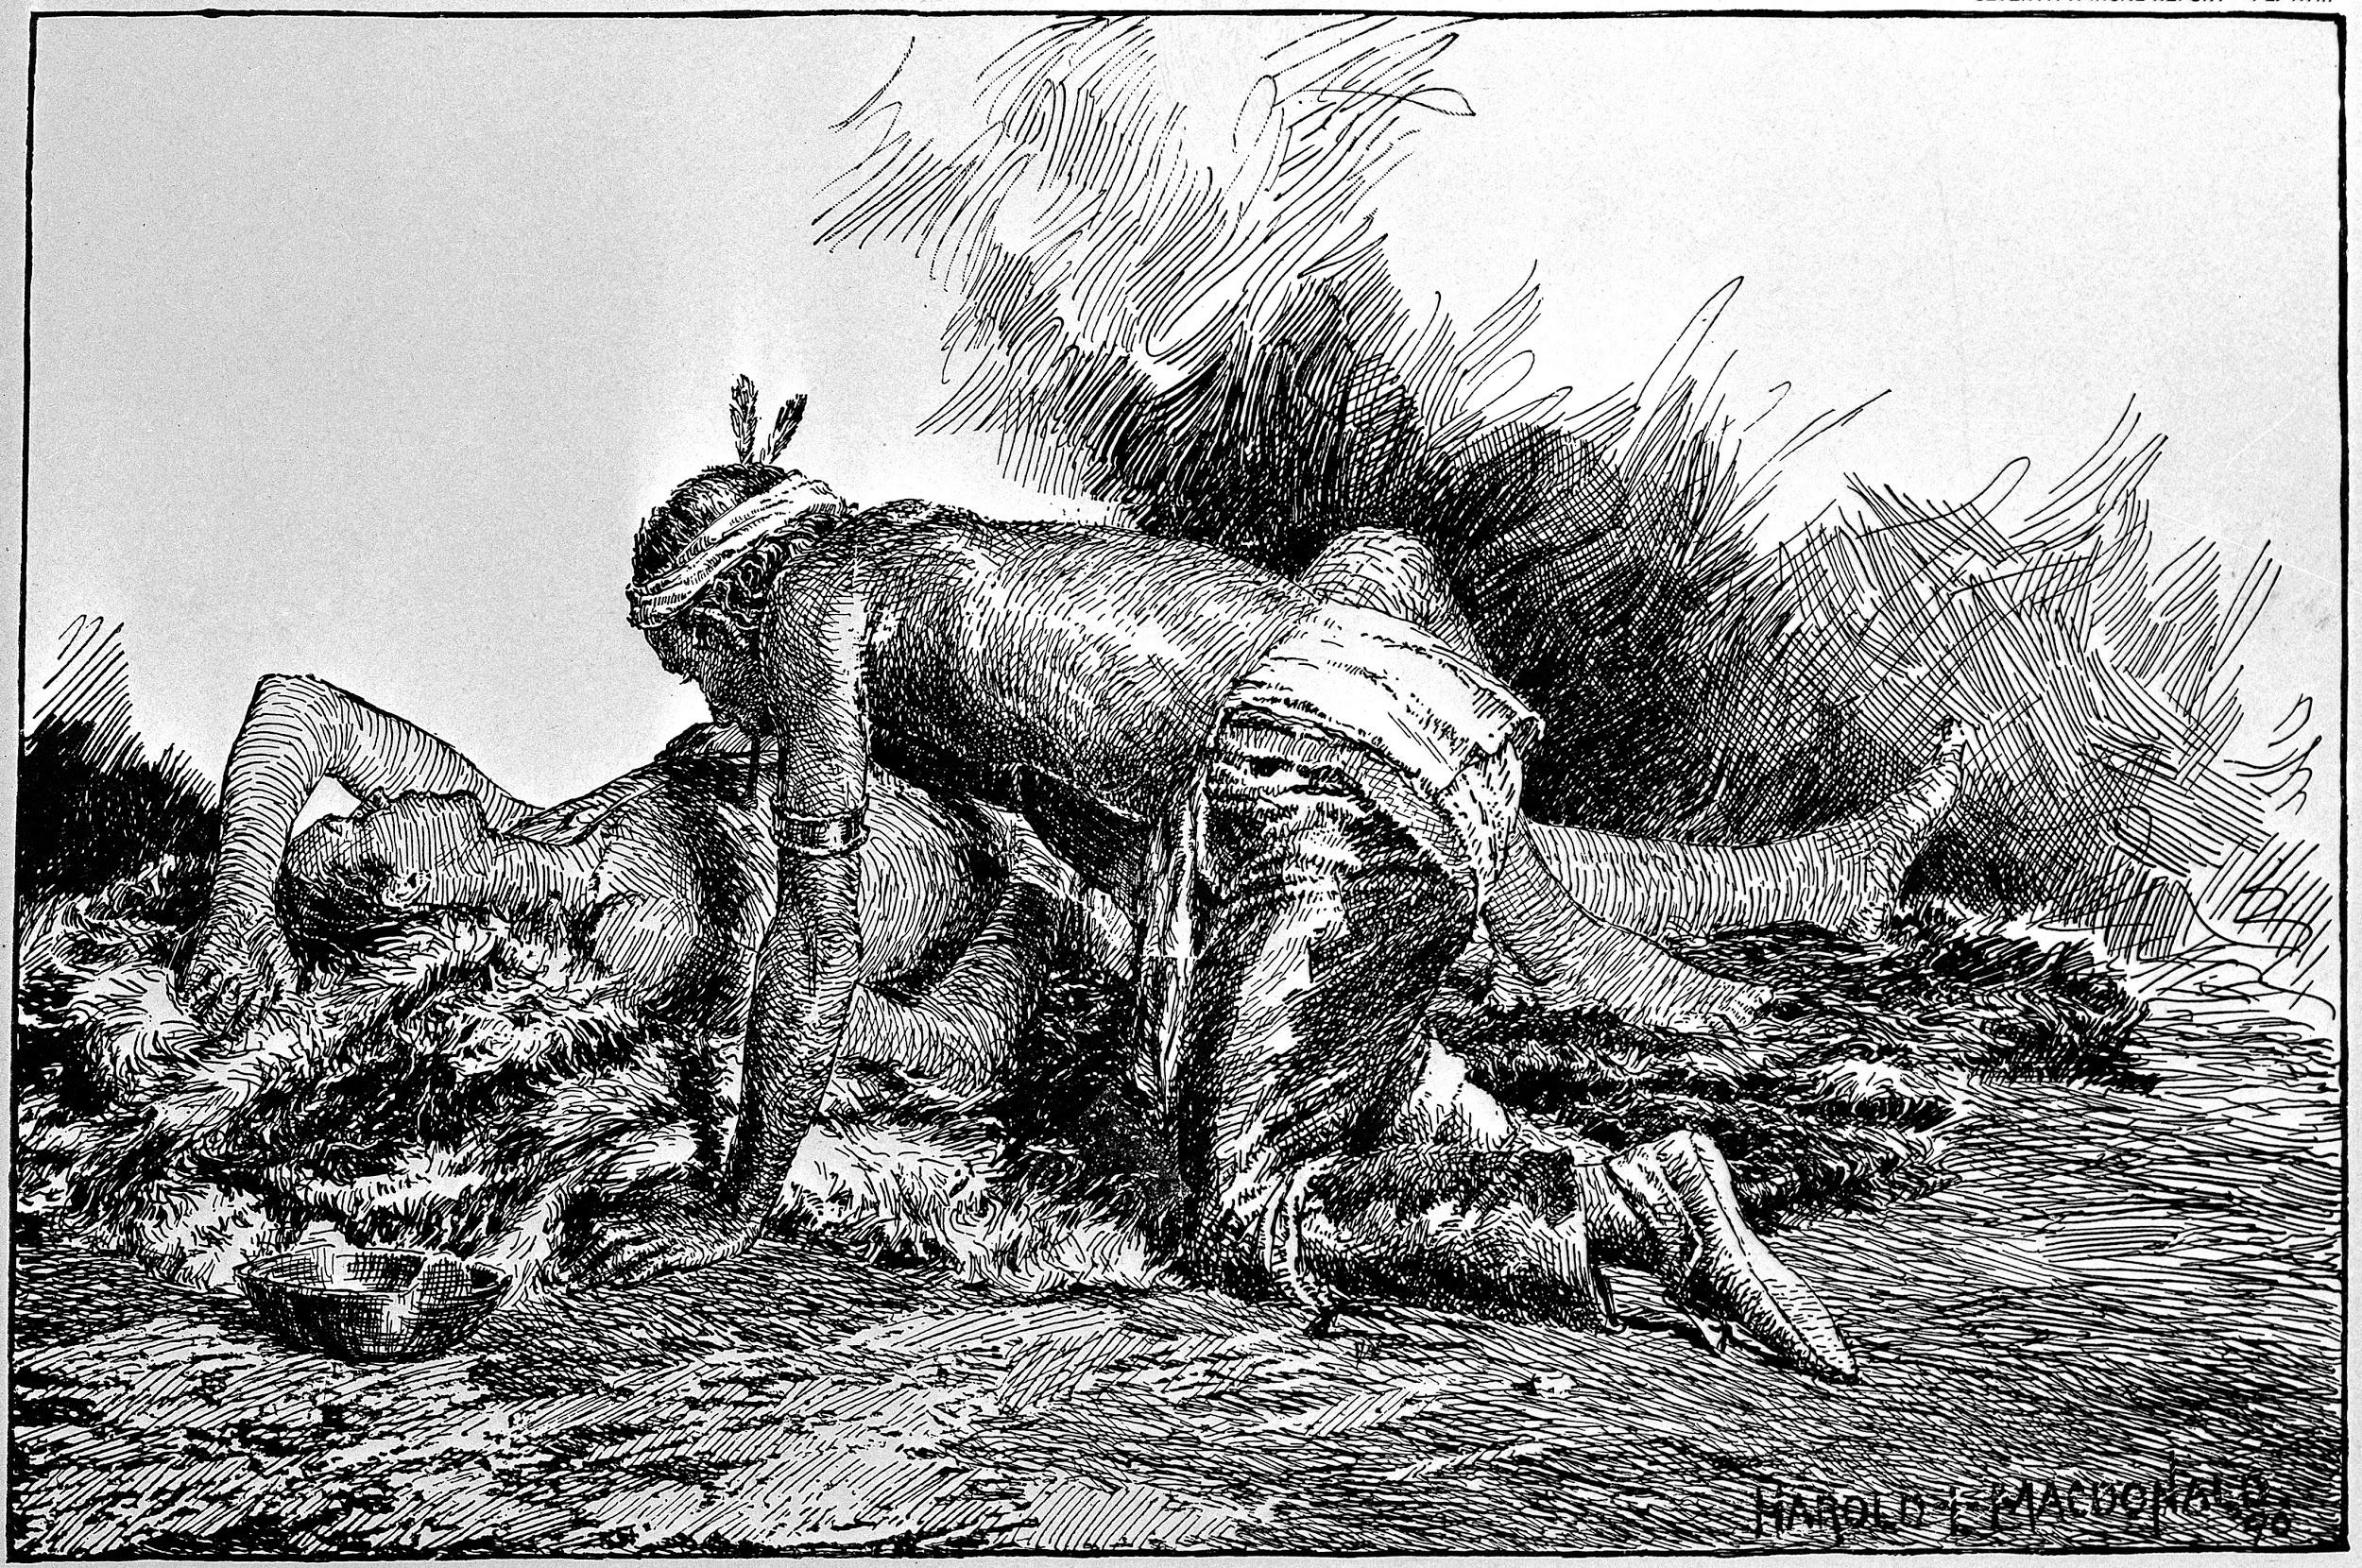
Effects/Impacts of the Age of Exploration

Slide 31
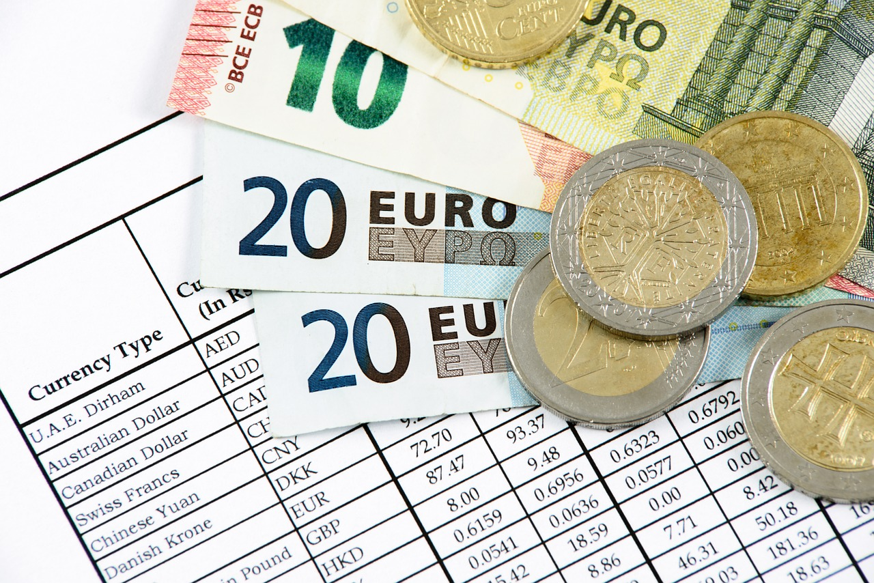
Europe Gets Rich
Europe becomes the most wealthy and powerful continent in the world.

Slide 32
Native Americans Pay the Price
Native Americans groups lost their lives and land at the expense of the Europeans.

Slide 33
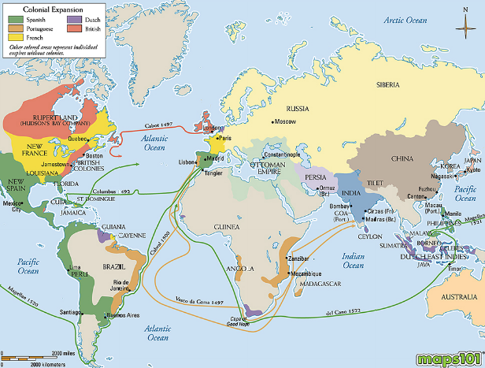

Slide 34
The English and the Native Americans
https://www.youtube.com/watch?v=TTYOQ05oDOI

Slide 35
Age of Exploration: The Explorers

Slide 36
Who was an early discoverer of the Americas?

Slide 37
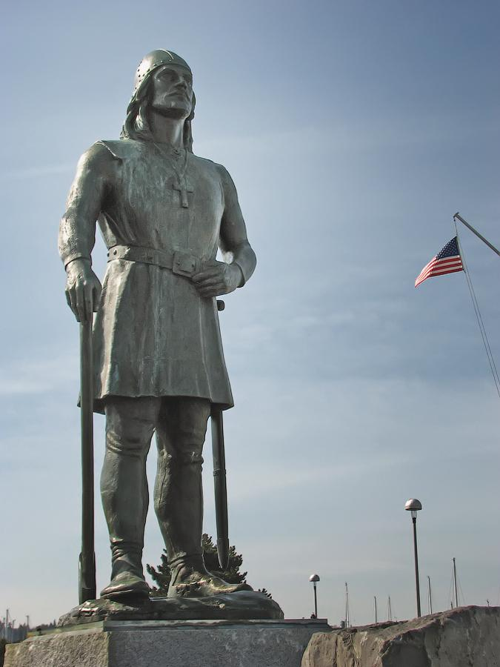
Leif Erikson
Leif Erikson was a Viking from Europe.
In 1000 CE he discovered part of North America and named it Vineland.
Vineland is modern-day Newfoundland.

Slide 38
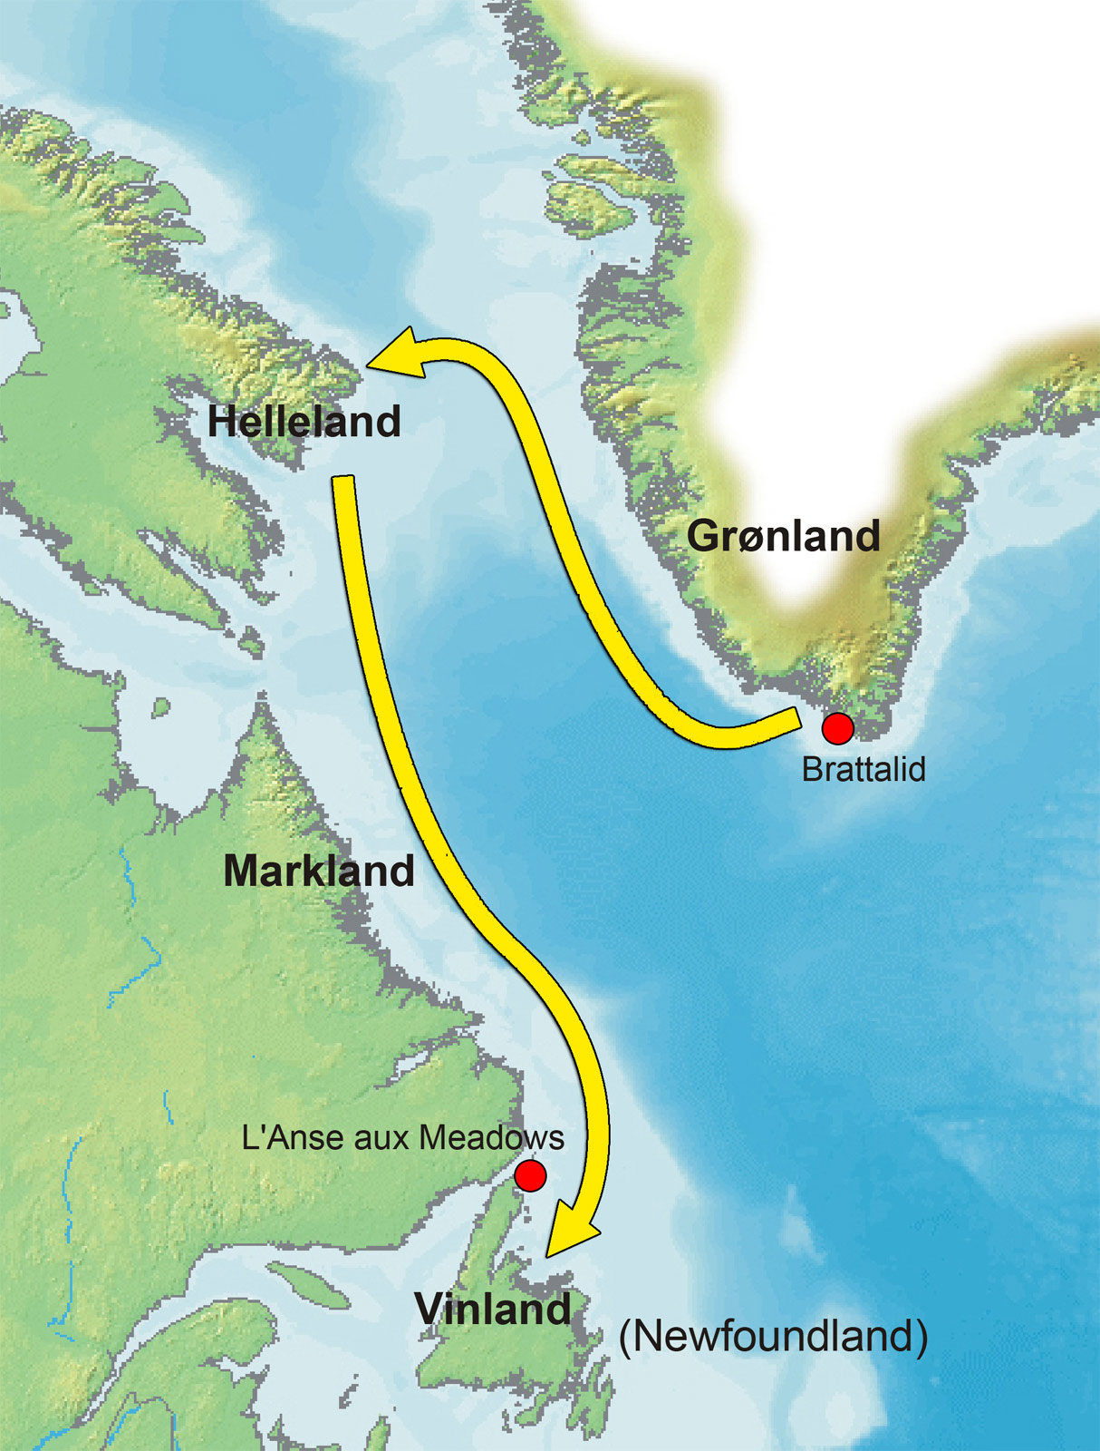
Leif Erikson Route

Slide 39
Who were the later European Explorers?

Slide 40
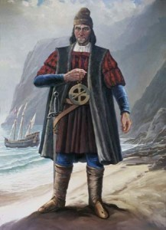
Portuguese Explorer: Bartolomeu Dias
Bartolomeu Dias was the first to sail around the southern tip of Africa.
Bartolomeu Dias sailed around the southern tip of Africa in 1487.

Slide 41
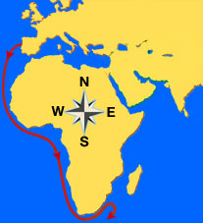
Bartolomeu Dias route

Slide 42
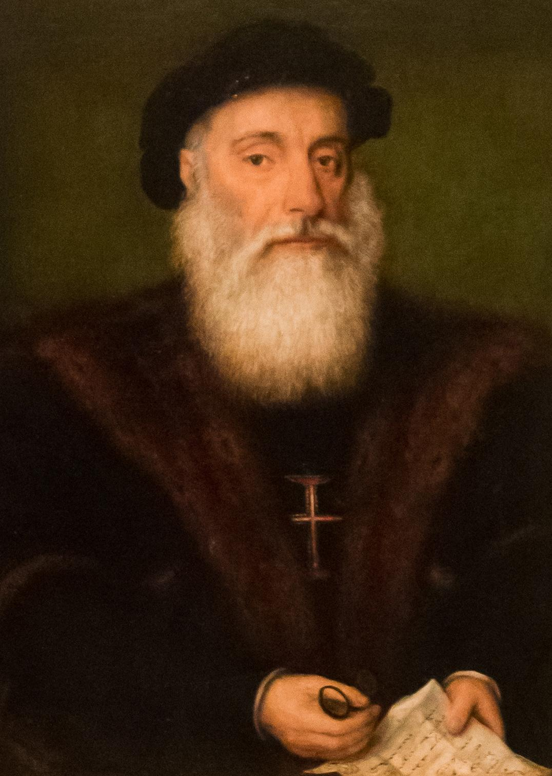
Portuguese Explorer: Vasco da Gama
Vasco da Gama discovered an all-water trade route from Portugal to India.
Vasco da Gama discovered the trade route from Portugal to India in 1497.

Slide 43
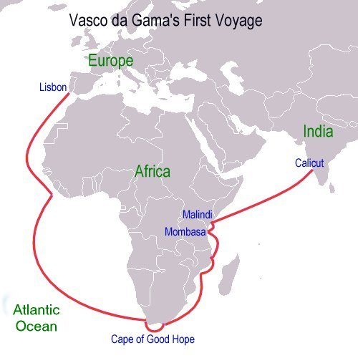
Vasco da Gama route

Slide 44
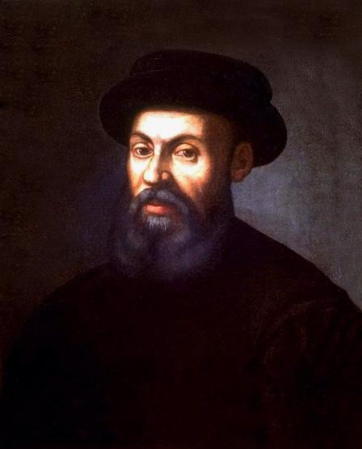
Portuguese Explorer: Ferdinand Magellan
Ferdinand Magellan looked for an Atlantic-Pacific passage.
Ferdinand Magellan had the first exploration that Circumnavigated, which means circle, the world.
Ferdinand Magellan’s voyage (trip) took place in 1519-1522.

Slide 45
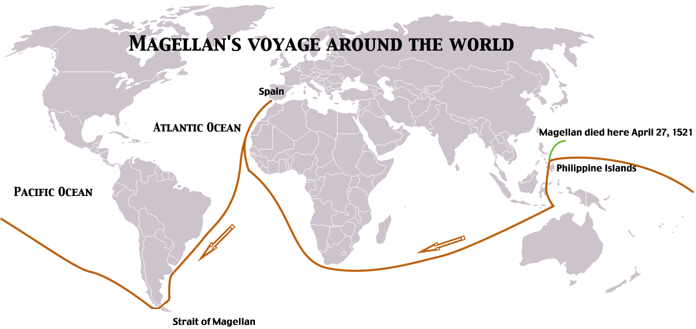
Ferdinand Magellan route

Slide 46
What is so important about the Portuguese and Spanish explorers?

Slide 47
The Portuguese and Spanish Explorers
The Portuguese and Spanish (from Spain) explorers were important because they were the first to find new trade routes around Africa and to the Americas.

Slide 48
What did the Portuguese do to find the Americas?

Slide 49
The Portuguese sailors explore
The Portuguese sailors explored the coast of Africa in attempt to find a water route to Asian trade.

Slide 50
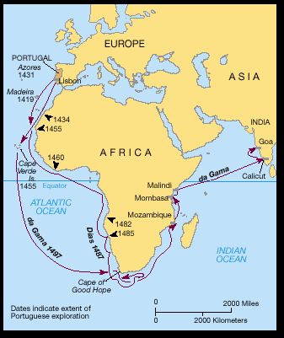
The Portuguese route

Slide 51
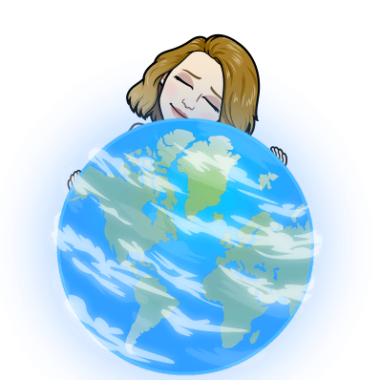
Other Europeans Explore the Americas
Italians
English

Slide 52
Who were the Italian Explorers?

Slide 53
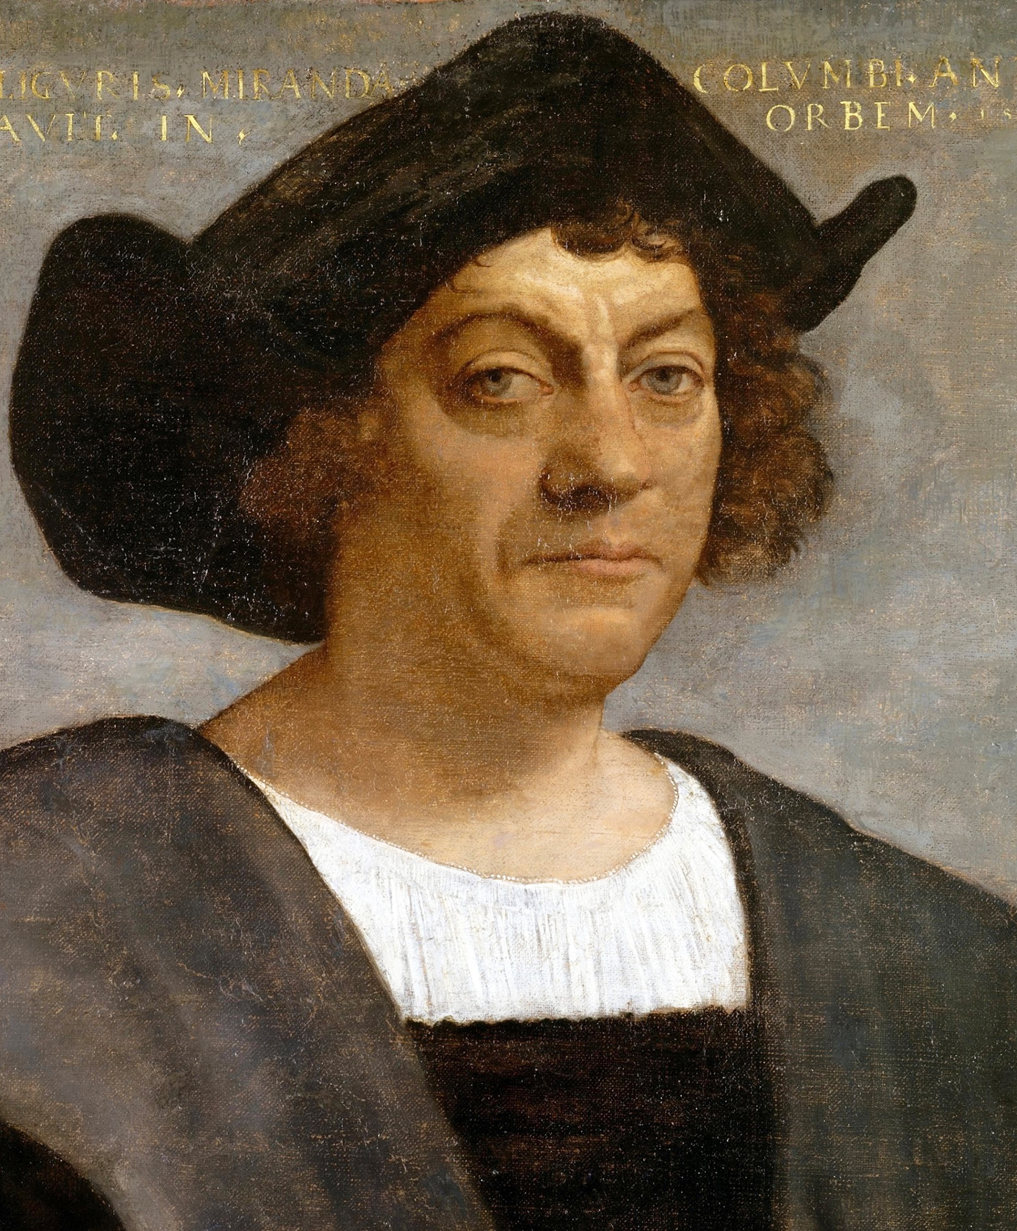
Italian Explorer: Christopher Columbus
Christopher Columbus was an explorer for Spain.
He was looking for a trade route to Asia to the West of Europe.
Christopher Columbus was the first European to discover the Americas and return to Europe to tell the story.
Christopher Columbus landed in Jamaica and thought it was Japan.

Slide 54
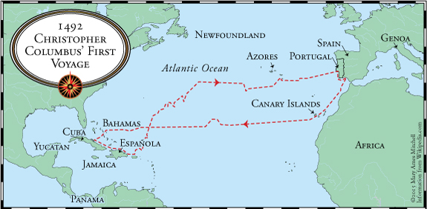
Christopher Columbus route

Slide 55
Italian Explorer: Amerigo Vespucci
Amerigo Vespucci was an explorer for Spain during the years of 1499-1502.
Amerigo Vespucci explored parts of South America.
While exploring, Amerigo Vespucci sent letters to a German cartographer (map maker), about his findings.
The German cartographer named these lands after Amerigo Vespucci, and they stuck. He called these new lands the Americas.

Slide 56
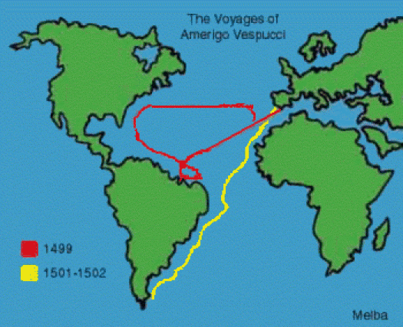
Amerigo Vespucci route

Slide 57
Who discovered the United States and Canada?

Slide 58
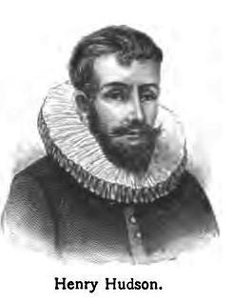
North American Explorer: Henry Hudson
Henry Hudson was an English explorer who explored the Arctic Ocean, New York, the Hudson River, and Hudson Bay.
While Henry Hudson was on his voyage, he came across a lot of ice that caused his voyage to stop.
Henry Hudson’s crew rebelled against him and kicked him off the ship onto a small boat.
After the rebellion from the crew, Henry Hudson was never seen again.

Slide 59
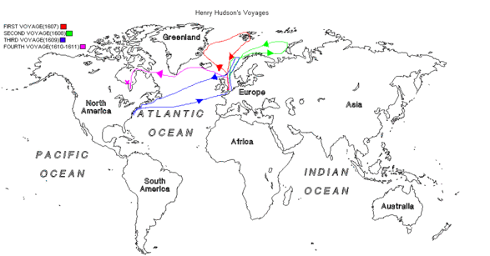
Henry Hudson route

Slide 60
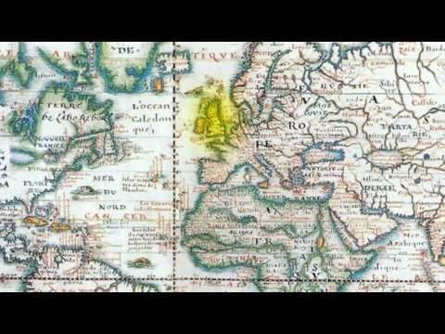

Slide 61
What happened after these lands were discovered?

Slide 62
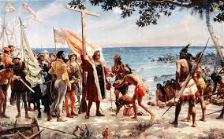
The Conquering Begins
After these new lands were being discovered that were full of natural resources, more Europeans to control get these new lands.

Slide 63
Who started conquering the Americas?

Slide 64
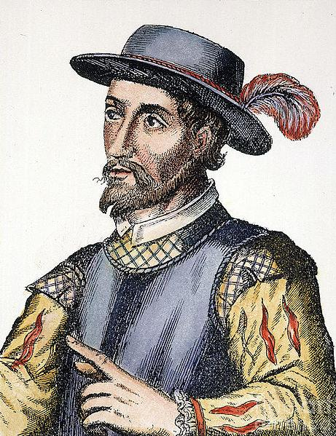
American Conqueror: Ponce de Leon
Ponce de Leon was a Spanish Conquistador.
Ponce de Leon landed in Florida in 1513.
Ponce de Leon was searching for gold and the Fountain of Youth.

Slide 65
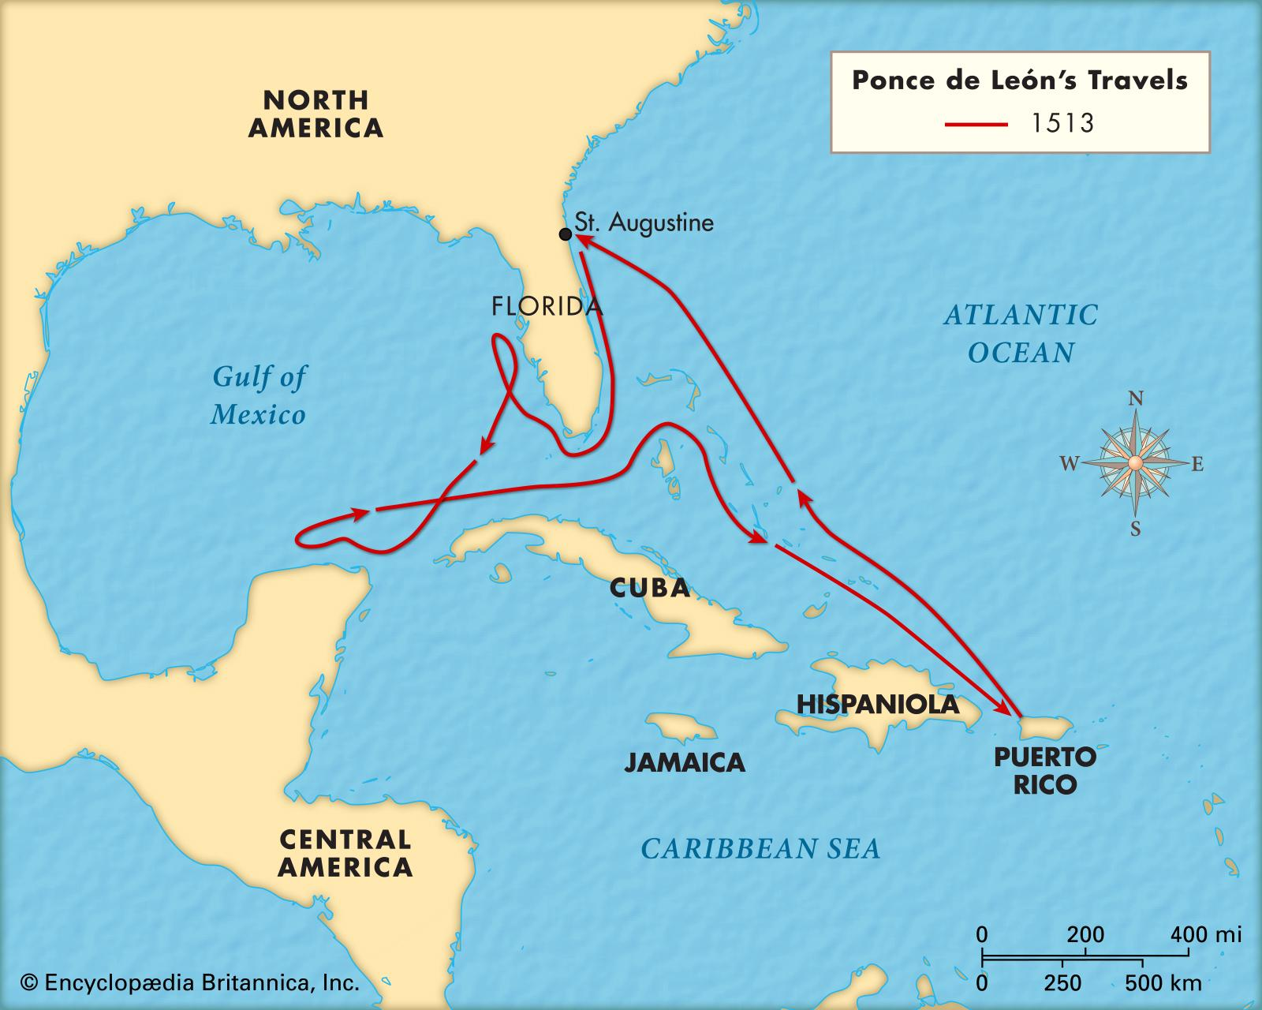
Ponce de Leon’s route

Slide 66
American Conqueror: Hernando Cortes
Hernando Cortes was a Spanish Conquistador.
Hernando Cortes landed in Mexico in 1519.
Hernando Cortes conquered the Aztecs and took their land.

Slide 67
Hernando Cortes route

Slide 68
Hernando Cortés and the Aztecs

Slide 69
Hernando Cortés and the Aztecs
https://www.youtube.com/watch?v=1P_euomdHOU

