Slide 1
The Columbian Exchange
Social Studies 7

Slide 2
What was the “Columbian Exchange”?

Slide 3
The Columbian Exchange
The “Columbian Exchange” refers to the vast exchange, or trading, of people, plants, animals, ideas and diseases that was caused by the Age of Exploration.

Slide 4
What kind of things were exchanged on the “Columbian Exchange”?

Slide 5
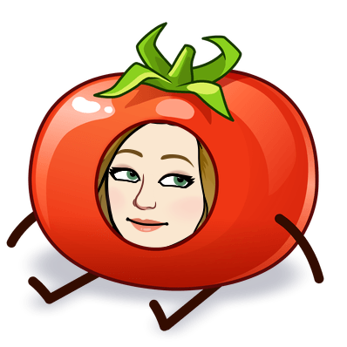
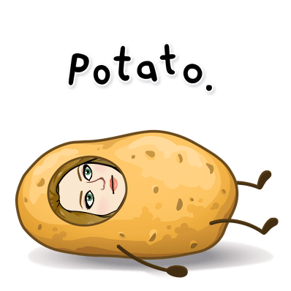
New goods went to Europe
Corn, Maize
Potatoes
Tobacco
Tomatoes

Slide 6
New Goods Come to the Americas
Horses
Cows
Sugar Cane
Diseases

Slide 7
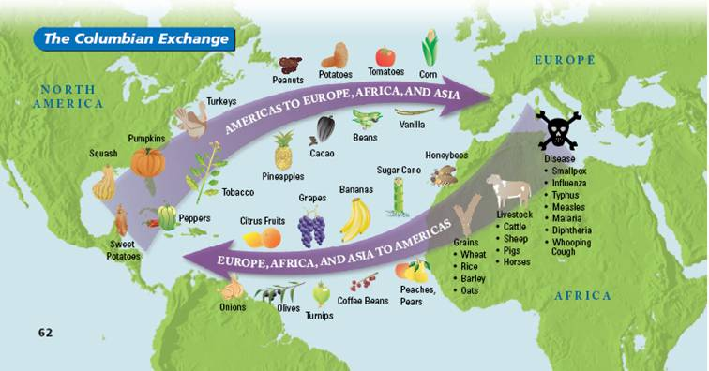
The Columbian Exchange

Slide 8
The Columbian Exchange Video
https://www.youtube.com/watch?v=HQPA5oNpfM4&t=62s

Slide 9
What were some things that were given to Europe from America in the “Columbian Exchange”?

Slide 10
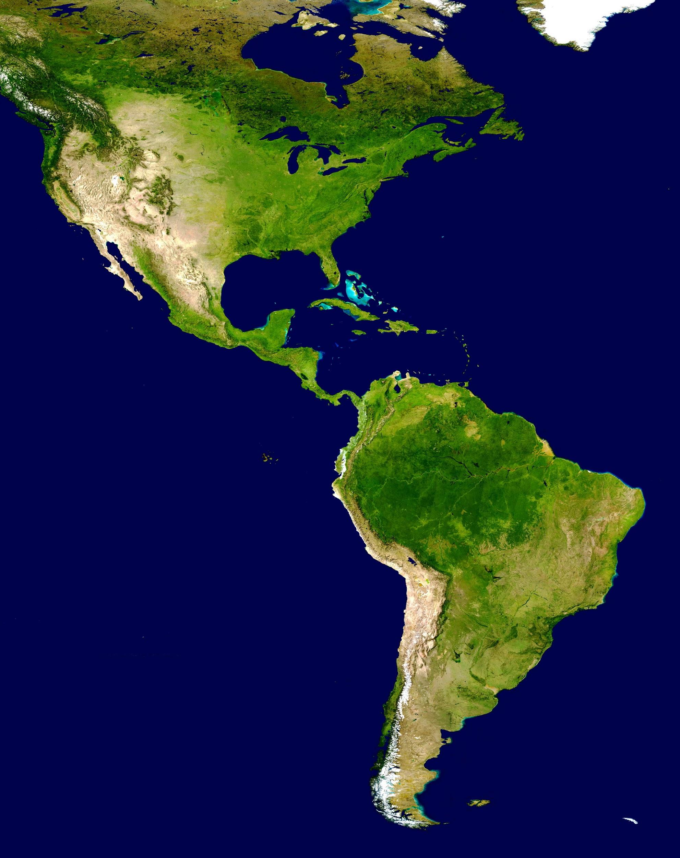
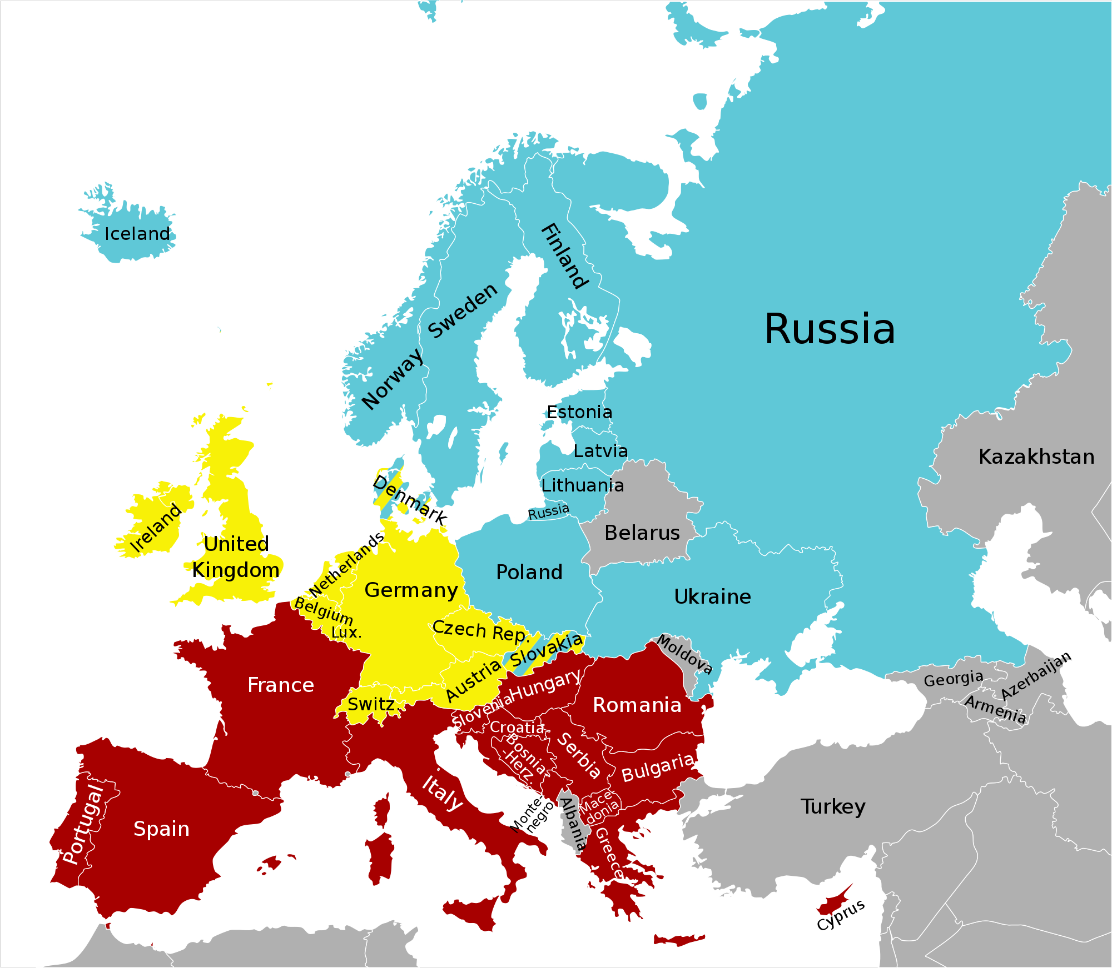
From the Americas to Europe
Squash | Pumpkin | Cassava, Yuca (Woody shrub) | Maize (corn)
Turkey | Pineapple | Vanilla | Avocado
Cocoa | Tomato | Sweet Potato | Tobacco
Peanut | Peppers | Quinoa | Potato + Syphilis

Slide 11
From Europe to the Americas
Olives Onions | Turnip Peach | Honeybee Malaria | Measles Smallpox
Grape Citrus Fruits | Pear Sheep | Sugar Cane Horse | Guns
Cattle Flu | Typhus Whooping Cough | Wheat Coffee Beans | Rice Oats
Diphtheria | Banana | Pigs | Barely

Slide 12
What were the impacts of the “Columbian Exchange” on the Americas?

Slide 13
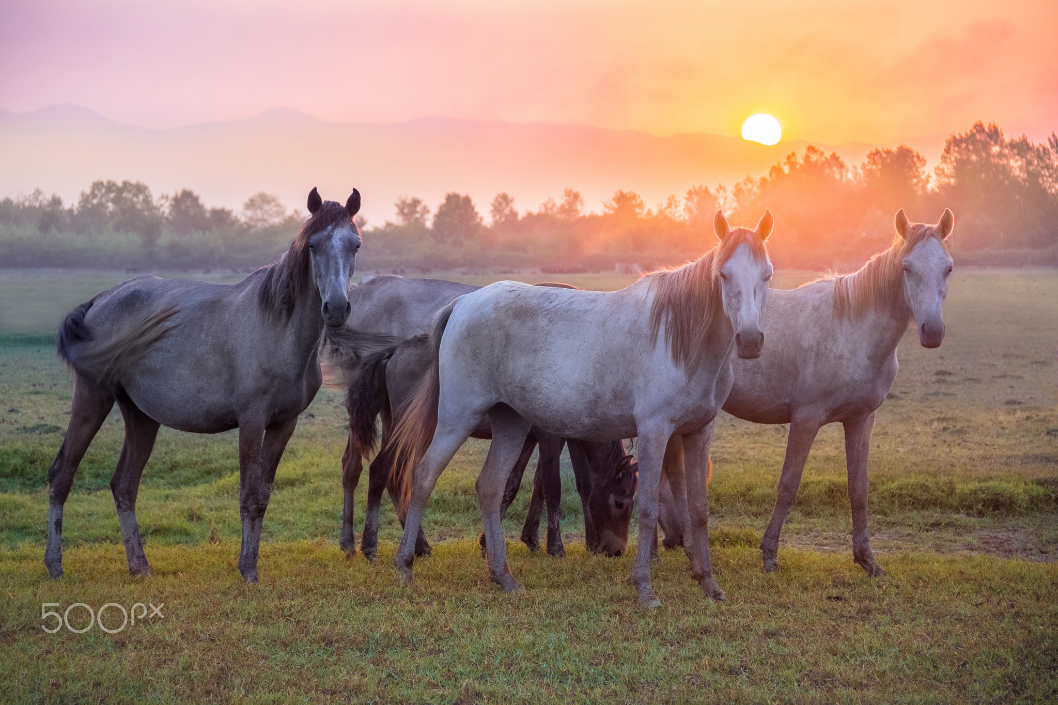
America gets Horses
Horses gave Europeans superior technology over the Native Americans.
Horses were like the modern-day tanks, they were a huge advantage in warfare.
Wild horses make their way to the Great Plains, and the Native Americans tame them and use them for hunting.

Slide 14
Animals get Domesticated
Domesticated animals like pigs and cows are brought from Europe.
This was very important to Native Americans and future European settlers because they have an abundance of FOOD.
Pigs and cows can reproduce quickly, leaving everyone with enough food.
The diet of people changed in America.

Slide 15
Europe Gets a Little Sweeter, America gets sour
Sugar cane is grown in the Americas and bought and sold in Europe.
Sugar cane became a very important cash crop.
To meet the demands from Europe, the Europeans in the Americas used Native Americans as slaves to work on the sugar cane fields.

Slide 16
What were the impacts of the “Columbian Exchange” on Europe?

Slide 17
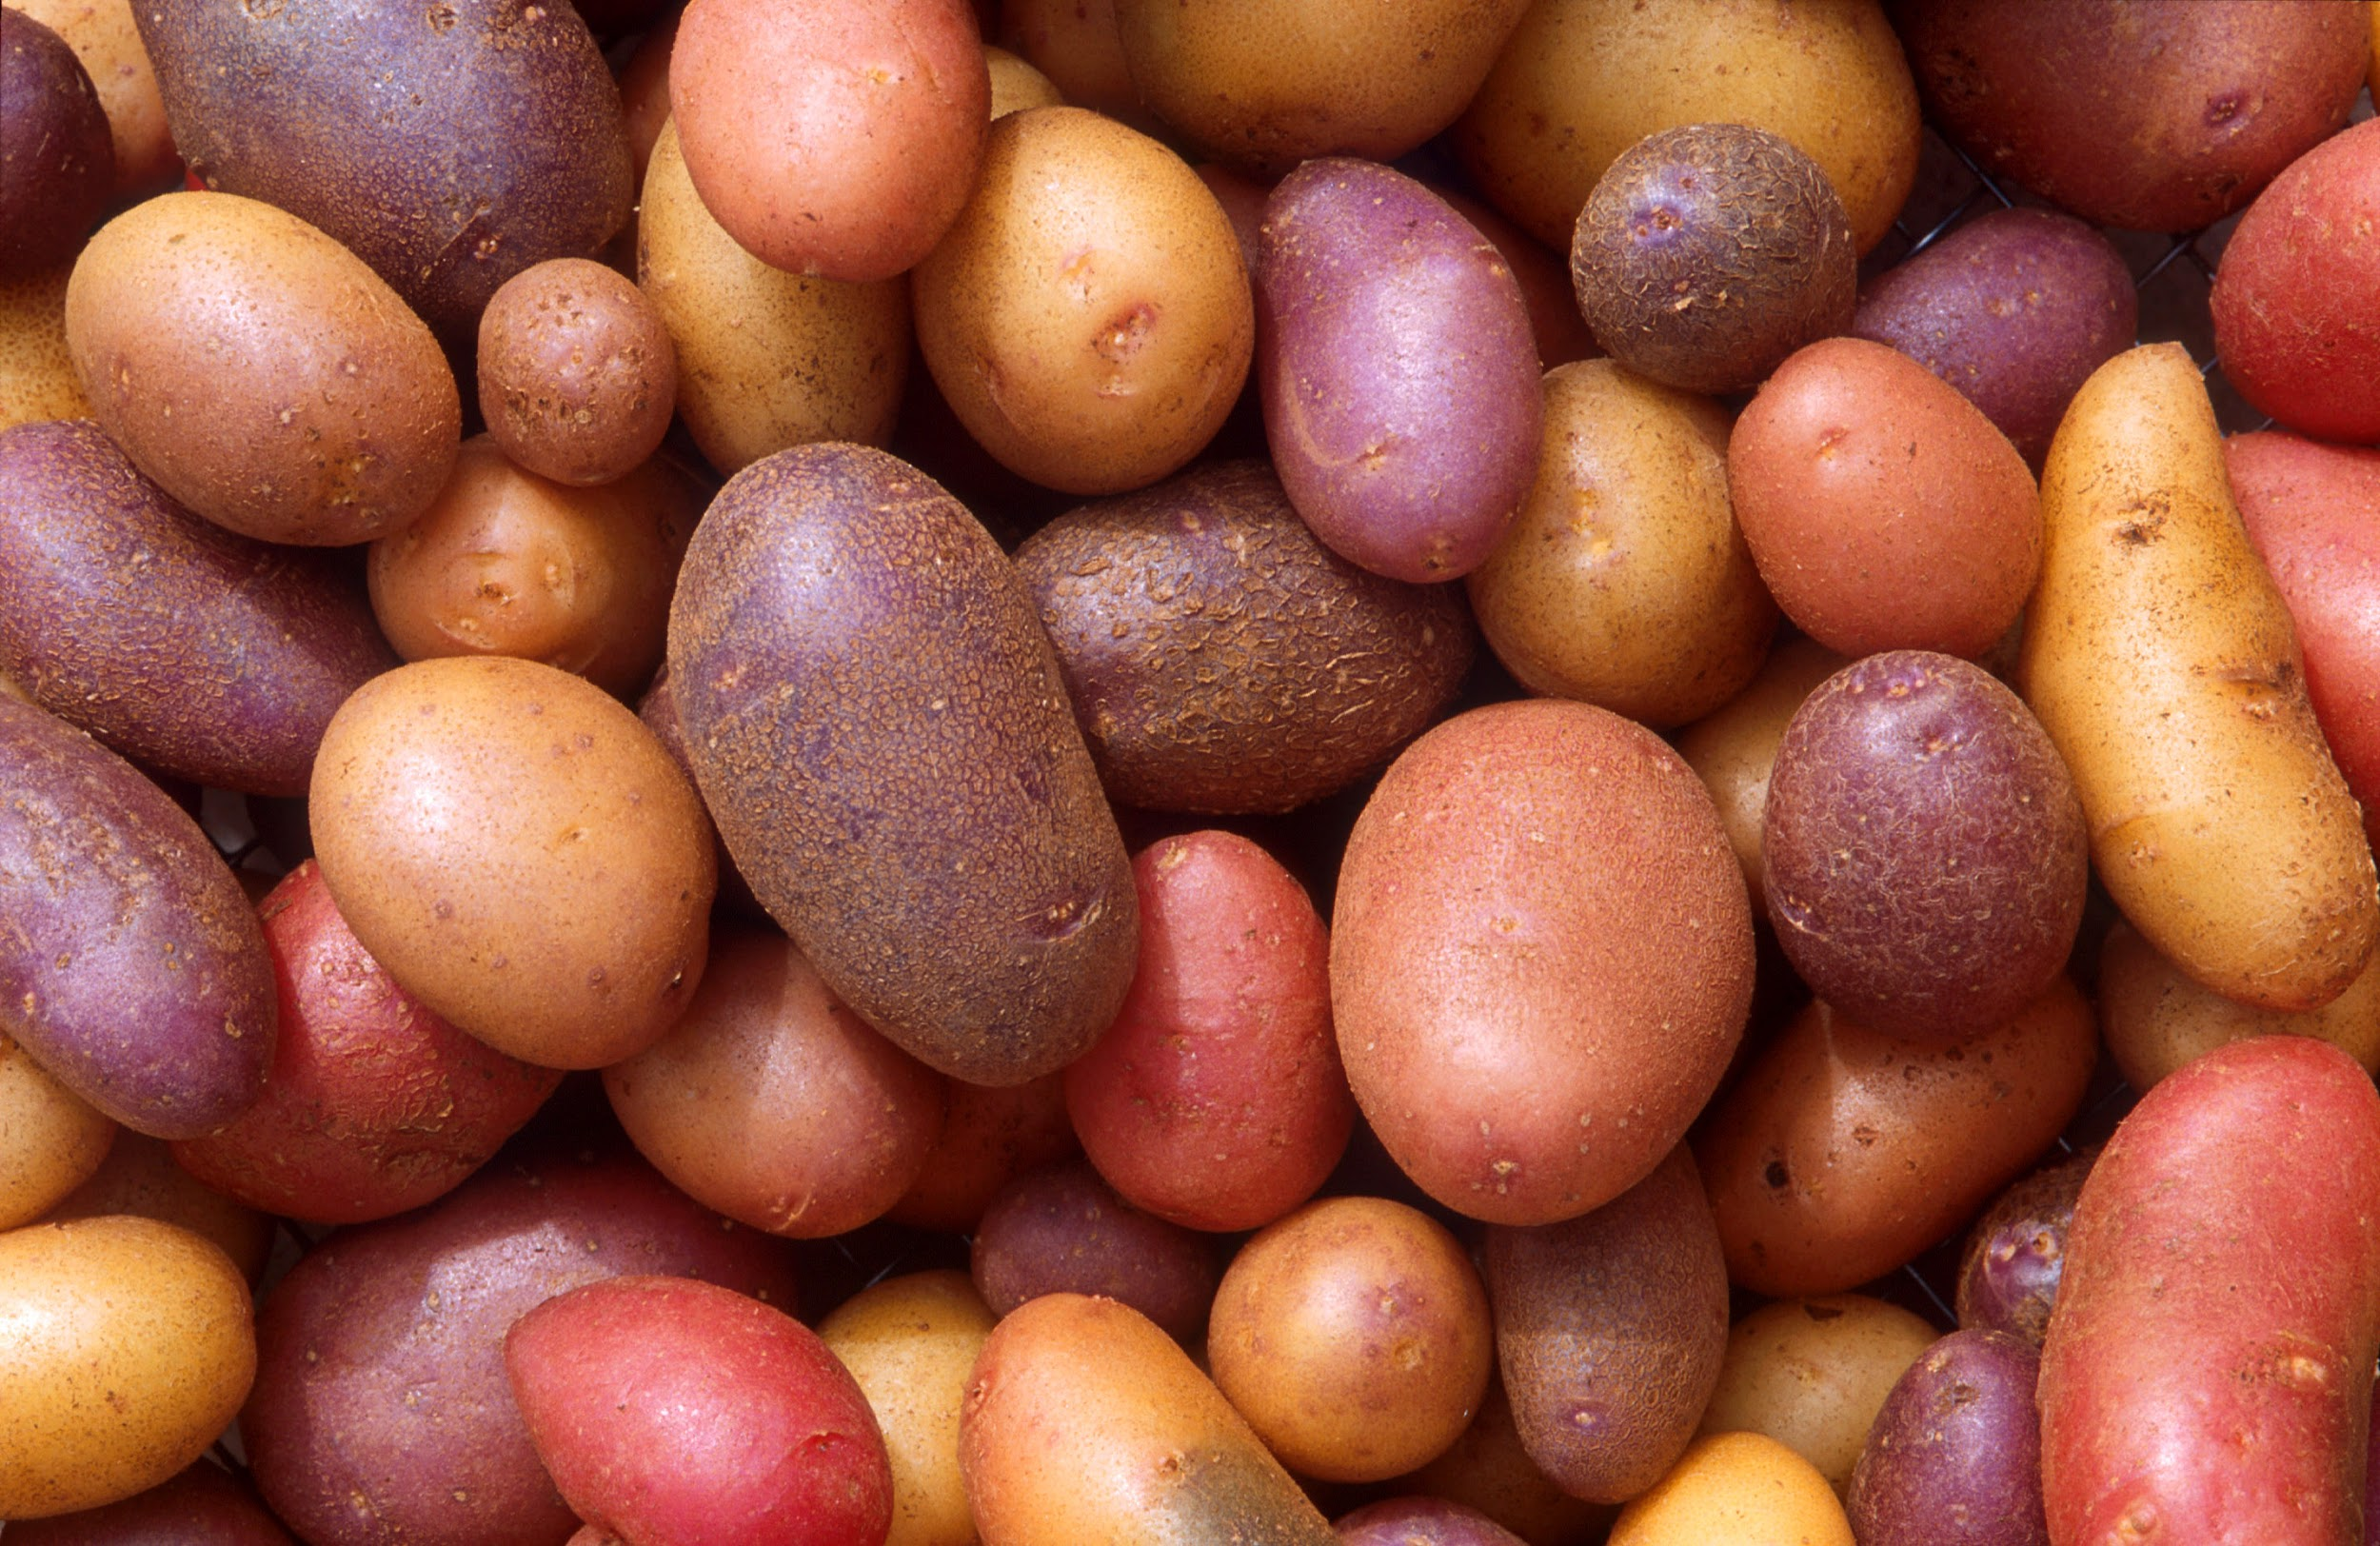
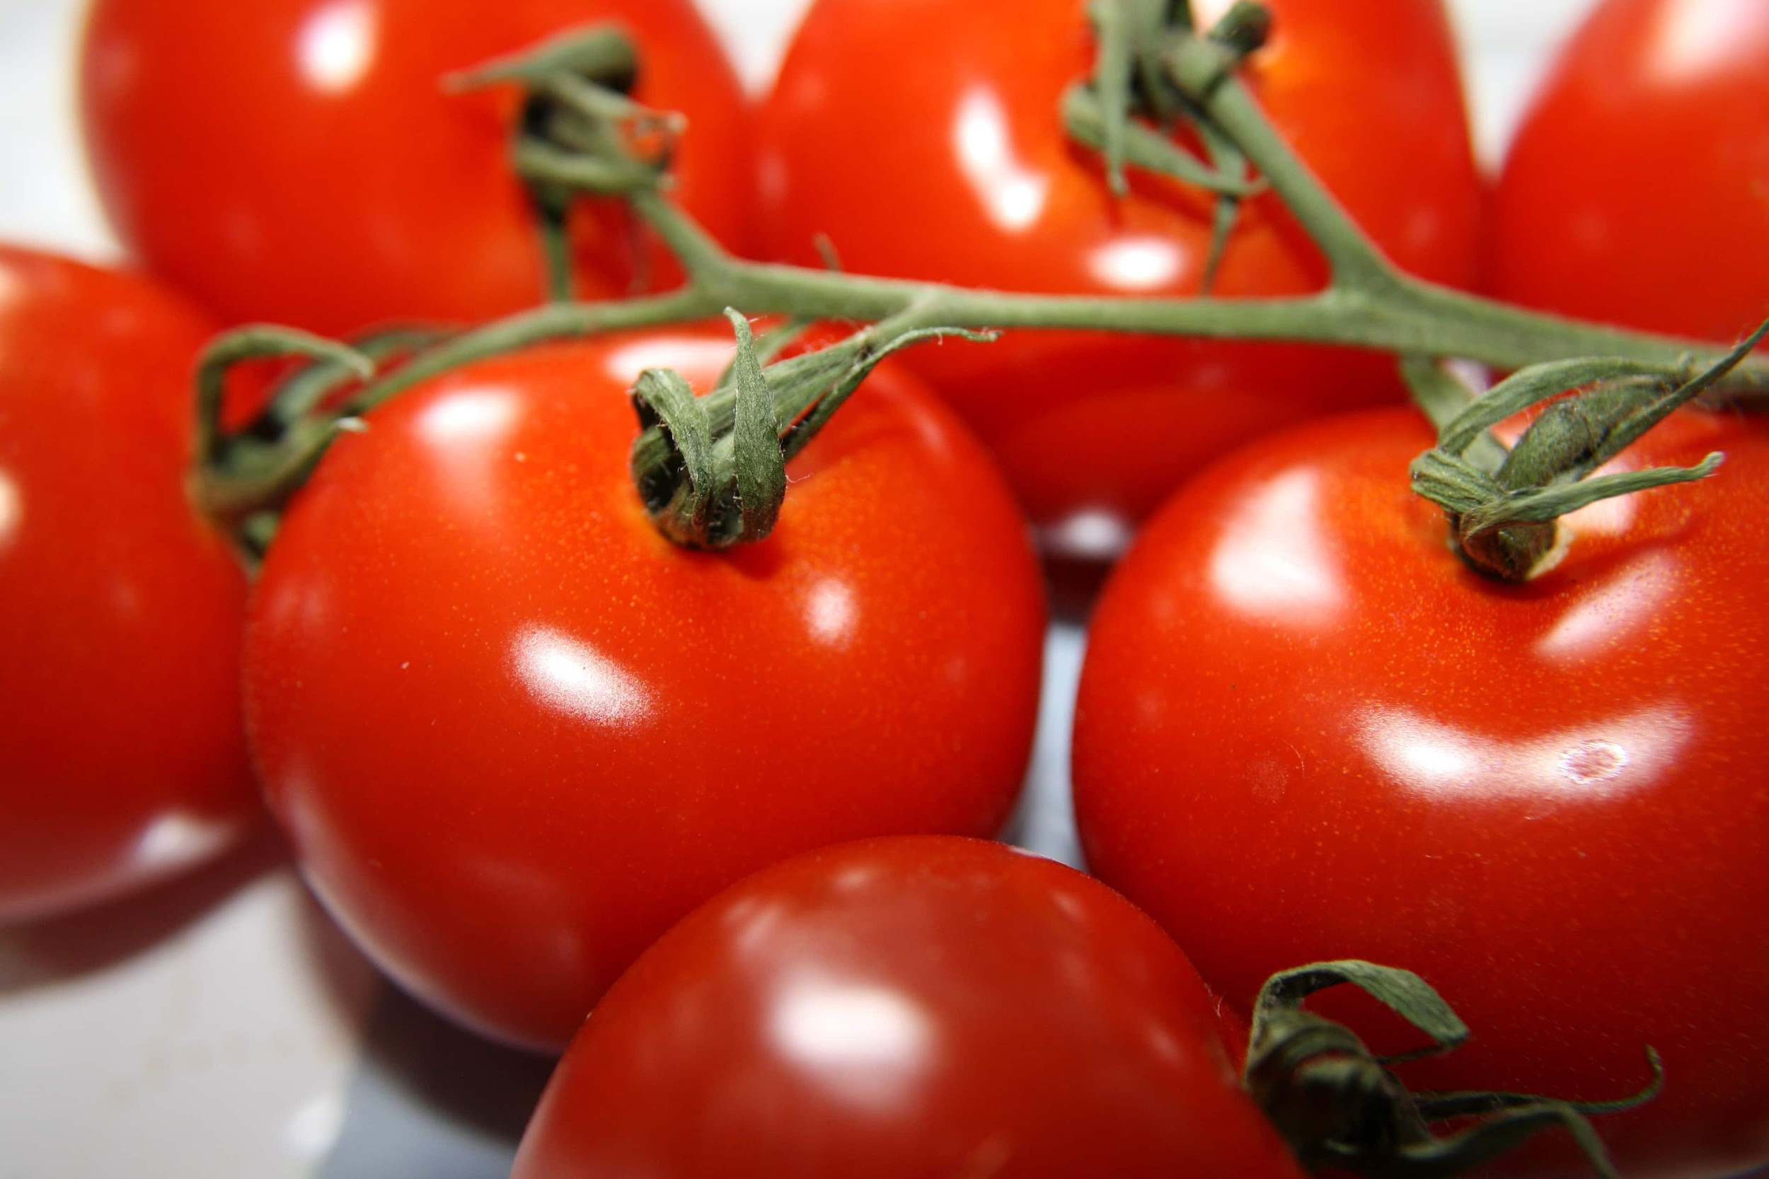
Europe adds new foods to the table
Europe gets corn, potatoes and tomatoes from the Americas.
These crops became important crops to Europe and they were grown throughout Europe.
Created an explosion of population throughout the continent.

Slide 18
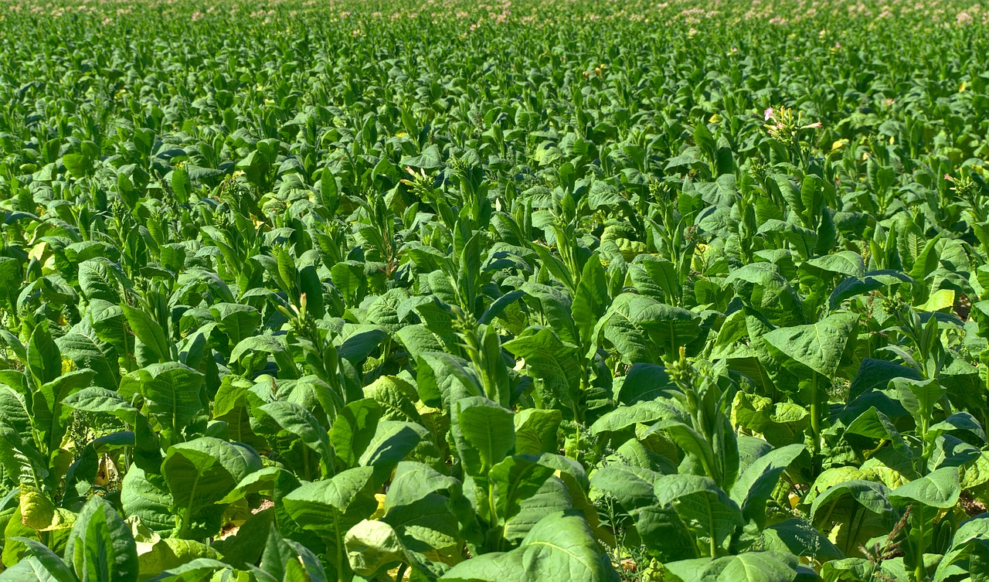
Europe gets tobacco from the Americas
Tobacco became an important cash crop to Europe.
It was trade and sold across Europe.
The European merchants made a fortune off the selling of tobacco.

Slide 19
What was the end result of the “Columbian Exchange”?

Slide 20
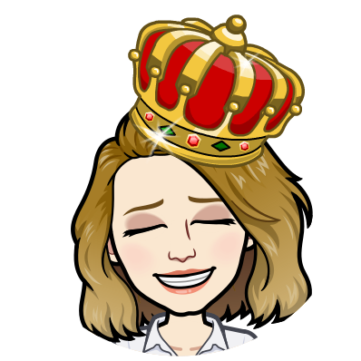
The End Result of the Columbian Exchange
Europeans-became the richest and most powerful civilizations for centuries.
Native Americans-died from diseases, they were conquered by the Europeans, and they were killed or enslaved.

