Slide 1
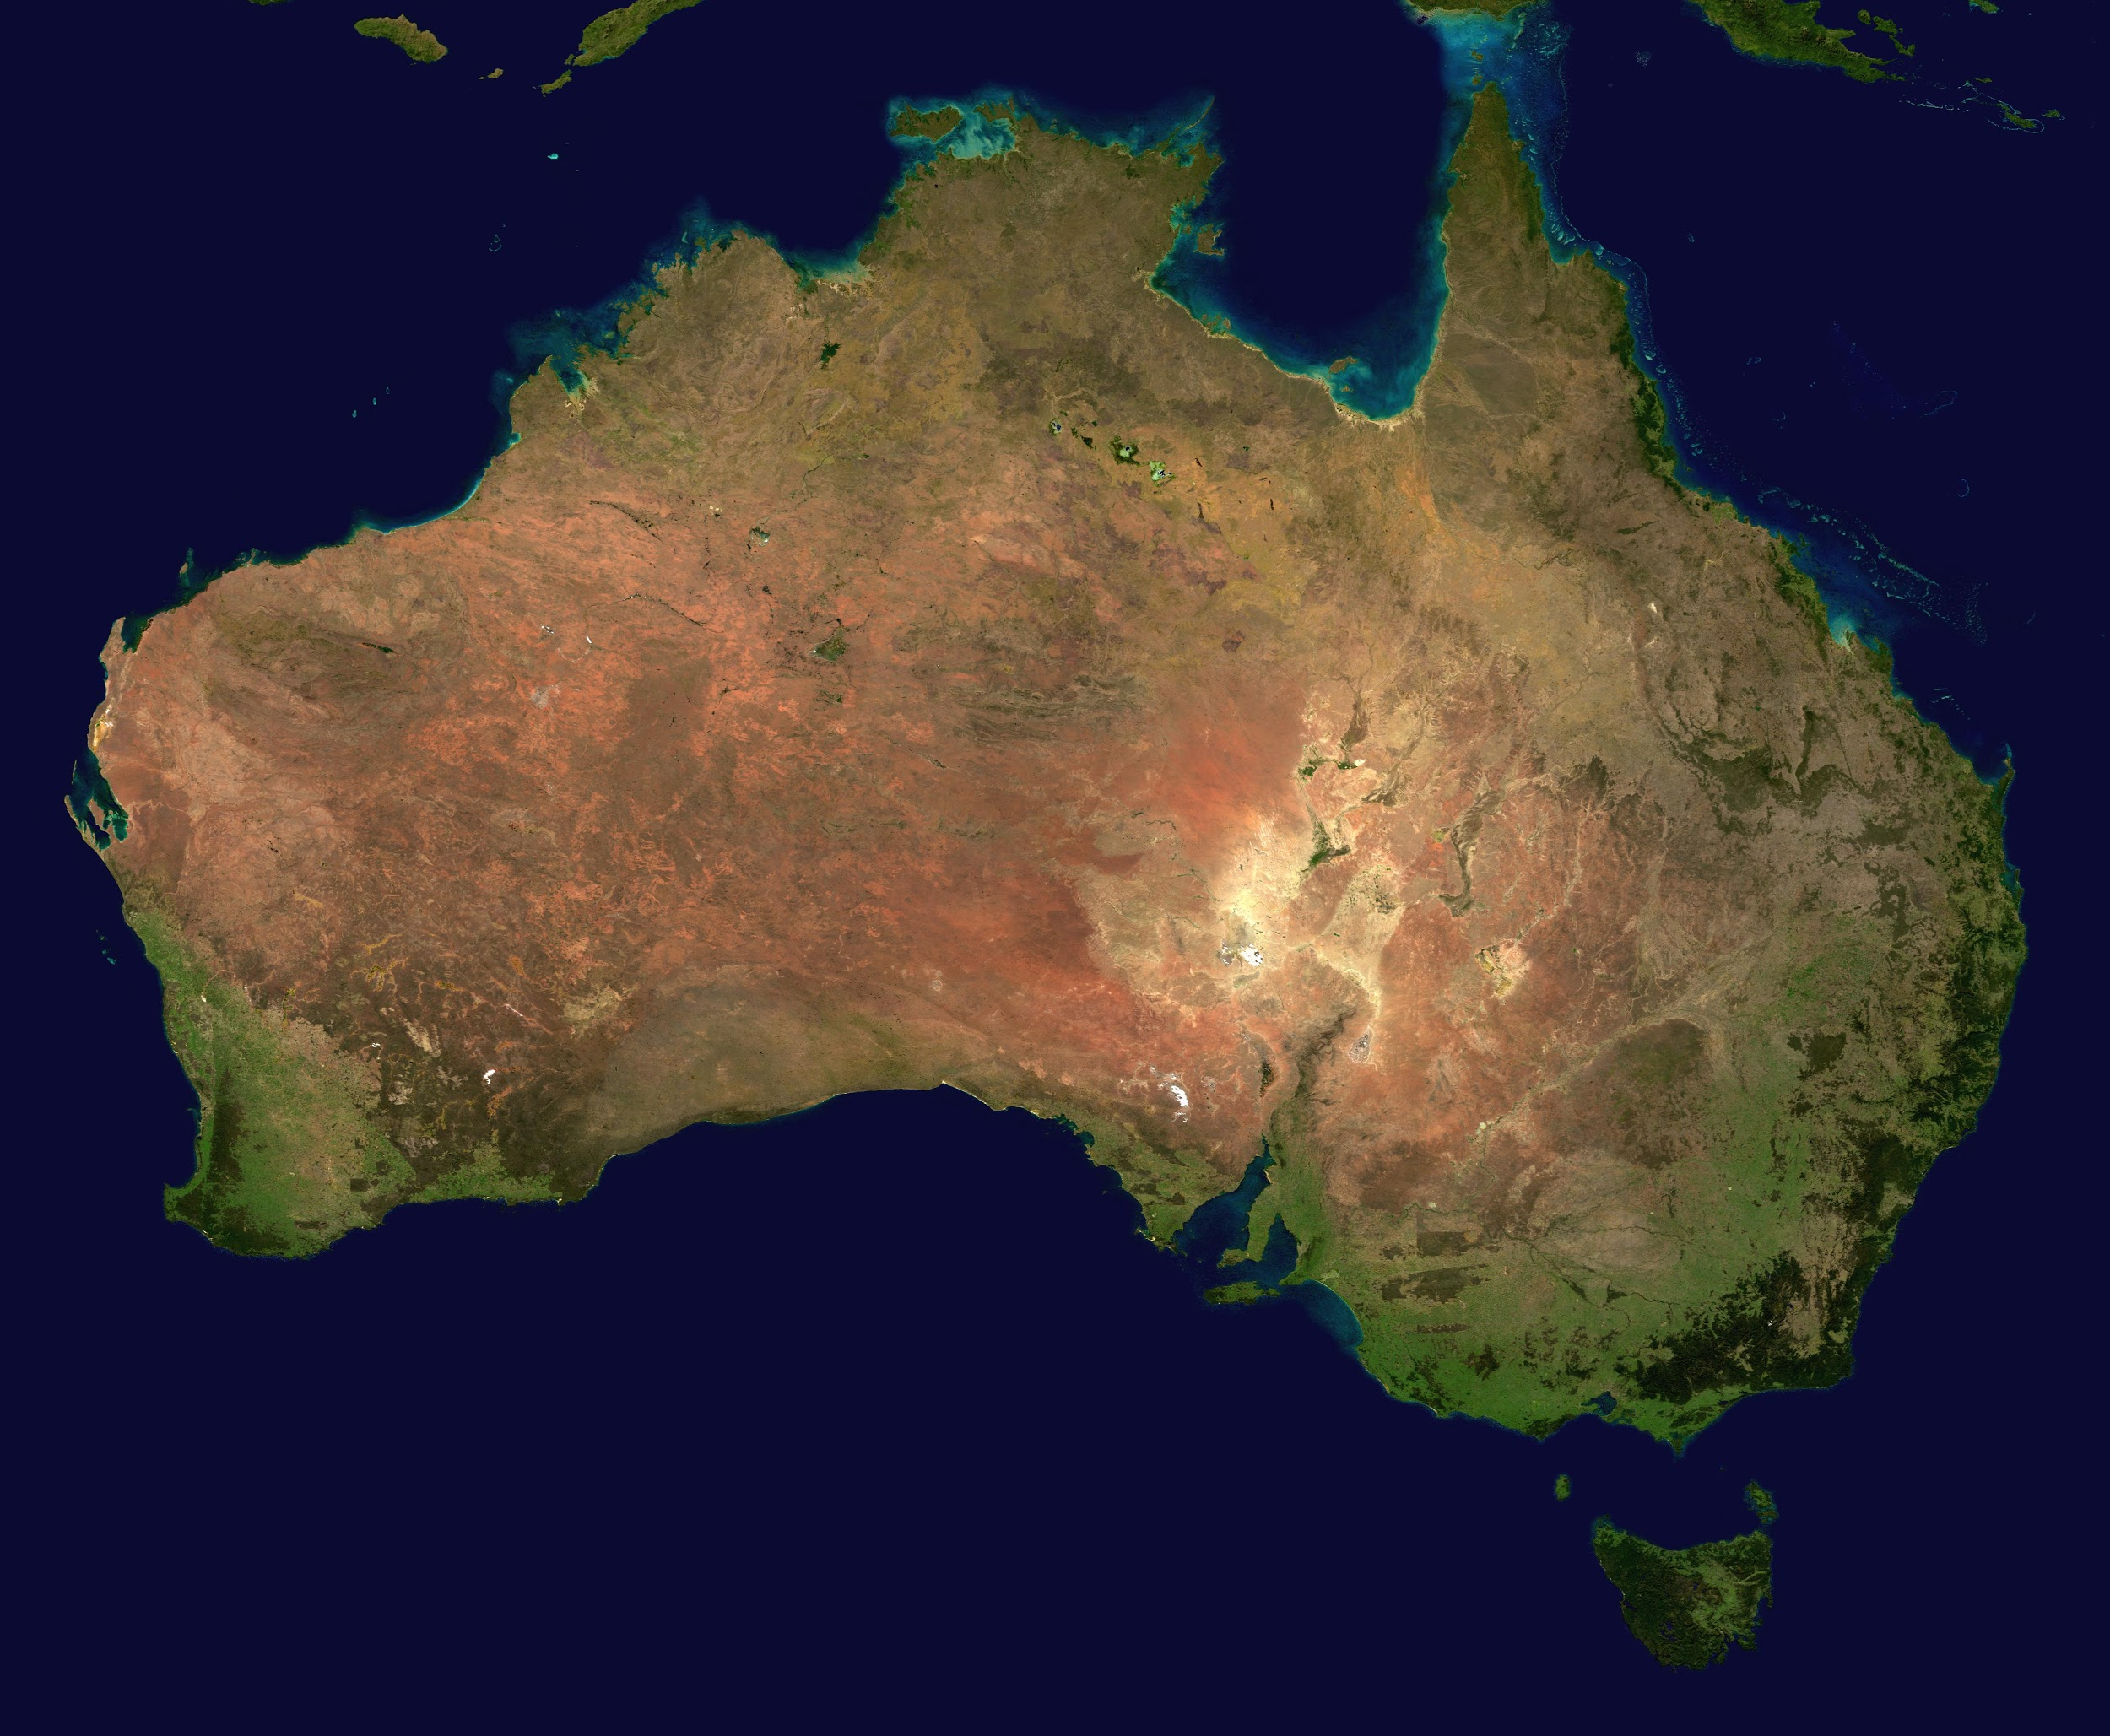
Australian Colonization
11.05.03.02

Slide 2
Europeans in Australia
The Dutch in the 1600s were the first Europeans to reach Australia.
In 1770, Captain James Cook claimed Australia for Britain. For a time, however, Australia remained too distant to attract European settlers.

Slide 3
The First Settlers
Like most regions claimed by imperialist powers, Australia had long been inhabited by other people. The first settlers had reached Australia perhaps 40,000 years earlier, probably from Southeast Asia, and spread across the continent.
These indigenous people were called Aborigines, a word used by Europeans to denote the earliest people to live in a place. Today, many Australian Aborigines call themselves Kooris.
They were isolated from the larger world and lived in small hunting and food-gathering bands, much as their Stone Age ancestors had.
Aborigines groups spoke as many as 250 district languages. When white settlers arrived in Australia, the indigenous population suffered disastrously.

Slide 4
A Penal Colony
During the 1700s, Britain had sent convicts to its North American colonies, especially to Georgia. The American Revolution closed that outlet. Prisons in London and other cities were jammed.
To fill the need for prisons, Britain made Australia into a penal colony, or a place where convicted criminals are sent to be punished. The first British ships, carrying about 700 convicts, arrived in Botany Bay, Australia, in 1788.
Those who survived the grueling eight-month voyage faced more hardships on shore. Many were city dwellers with no farming skills. Under the brutal discipline of soldiers, work gangs cleared lands for settlement.

Slide 5
The Colonies Grow
In the early 1800s, Britain encouraged free citizens to emigrate to Australia by offering them land and tools. A prosperous wool industry grew up as settlers found that the land and climate suited sheep herding.
In 1851, a gold rush in eastern Australia brought a population boom. Many gold hunters stayed on to become ranchers and wheat farms. As the newcomers settled in, they thrust aside or killed the Aborigines.

Slide 6
Achieving Self-Government
Australia was made up of separate colonies scattered around the continent. Britain worried about interference from other European powers. To counter this threat and to boost development, it responded to Australian demands for self-rule.
In 1901, Britain helped the colonies unite into the independent commonwealth of Australia. The new country kept its ties to Britain by recognizing the British monarch was its head of state.
The Australian constitution drew on both British and American models.

Slide 7
https://www.youtube.com/watch?v=GS1072MshS0

