Slide 1
The Rise and Fall of the Persian Empire

Slide 2
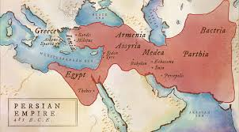
Background:
Name given to several dynasties in modern-day Iran
In power from 6th century BC to 12th century BC
Founded by Cyrus the Great around 550 BC
Eventually fell to Alexander the Great

Slide 3
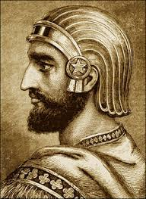
Cyrus the Great
Cyrus the Great defeated nearby kingdoms such as Media, Lydia, and Babylon
He made Persia a world superpower
The Persian Empire united one government in three important sites- Mesopotamia, Egypt’s Nile River, and India’s Indus Valley

Slide 4
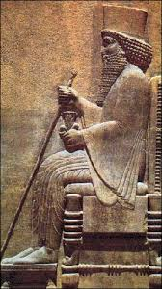
Darius the Great
4th king, ruled over the Persian Empire when the empire was at its largest
Introduced standard currency, weights, measures, and made Aramaic the official language

Slide 5
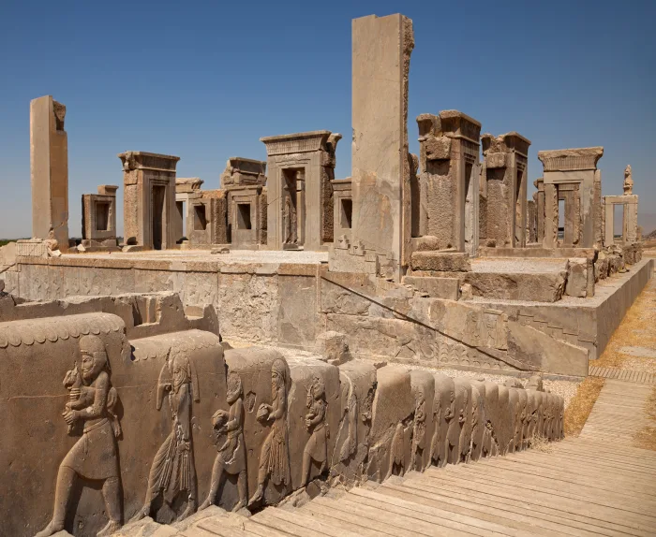
Capital
The capital of the Persian Empire was Persepolis (southern Iran)
It was built on massive terraces

Slide 6
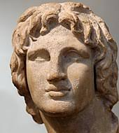
Fall of the Persian Empire
The Persian Empire began to decline after they failed to invade Greece in 480 BC
The invasion was expensive and led to heavier taxes on the Persian people
The Persian Empire fell to Alexander the Great of Macedon in 330 BC
Alexander the Great

