Slide 1
Northern VS Southern Soldiers in the Civil War
What made them think differently?

Slide 2
Civil War
The Civil War took place from 1861-1865
The North and the South could not agree on whether or not slaves should be freed
The North wanted slavery to end
The South wanted to keep slavery

Slide 3
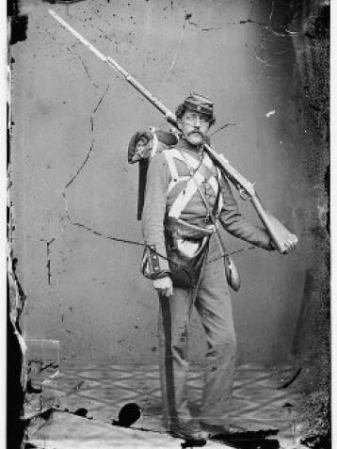
The North- The Union (⅓)
Soldiers were typically under 30 years of age
Many soldiers had been farmers before the war
Soldiers ranged in education- some went to college while others were illiterate (couldn’t read or write)

Slide 4
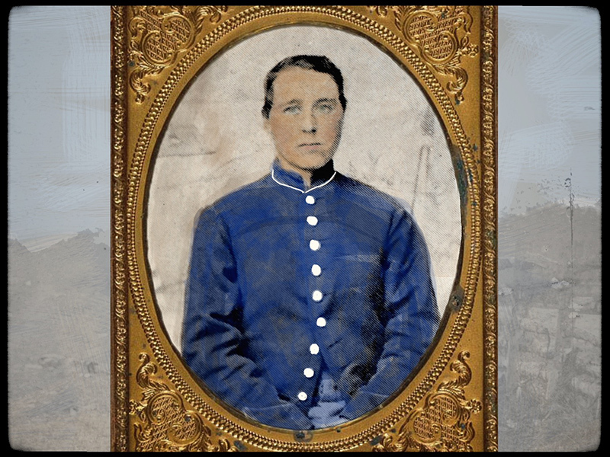
Union Continued (⅔)
Foreigners fought for the Union- Germans, Irish, Canadians, and English
Black men could fight for the Union
Some women dressed up like men to fight in the army- like Jennie Hodgers
Jennie Hodgers in disguise

Slide 5
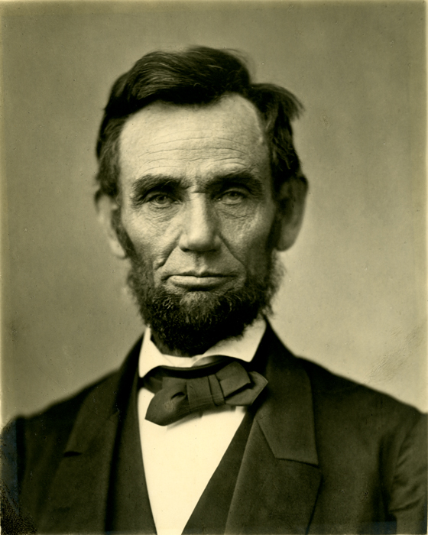
The Union (3/3)
Soldiers in the Union Army did not support slavery- they were fighting to end it
The North was also fighting to preserve the Union (keep the United States a whole country)
Union soldiers supported Abe Lincoln- the president is known as the “Great Emancipator” (emancipator: the freeing of someone from slavery)

Slide 6
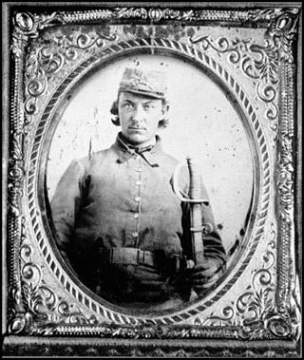
The South- The Confederacy (⅓)
Most Confederate soldiers were under 30 years of age
Many of the soldiers had been farmers before the war
Many soldiers ranged in education- from college education to being illiterate

Slide 7
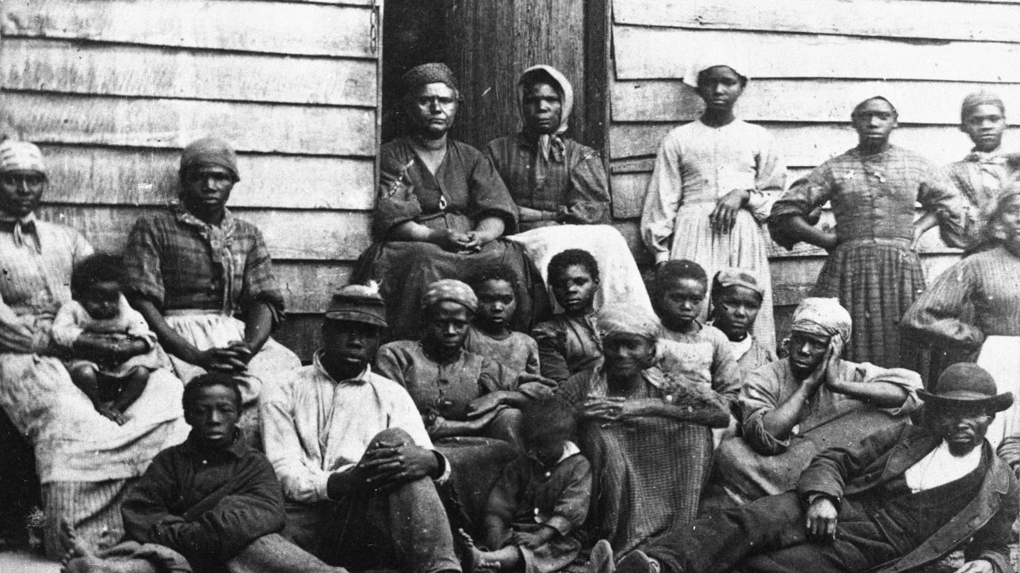
The Confederacy Continued (⅔)
Foreign men helped to fight for the Confederacy- Irish, Germans, French, Poles, and Canadians
Some black men helped the Confederacy as servants and laborers but, they were NOT allowed to fight

Slide 8
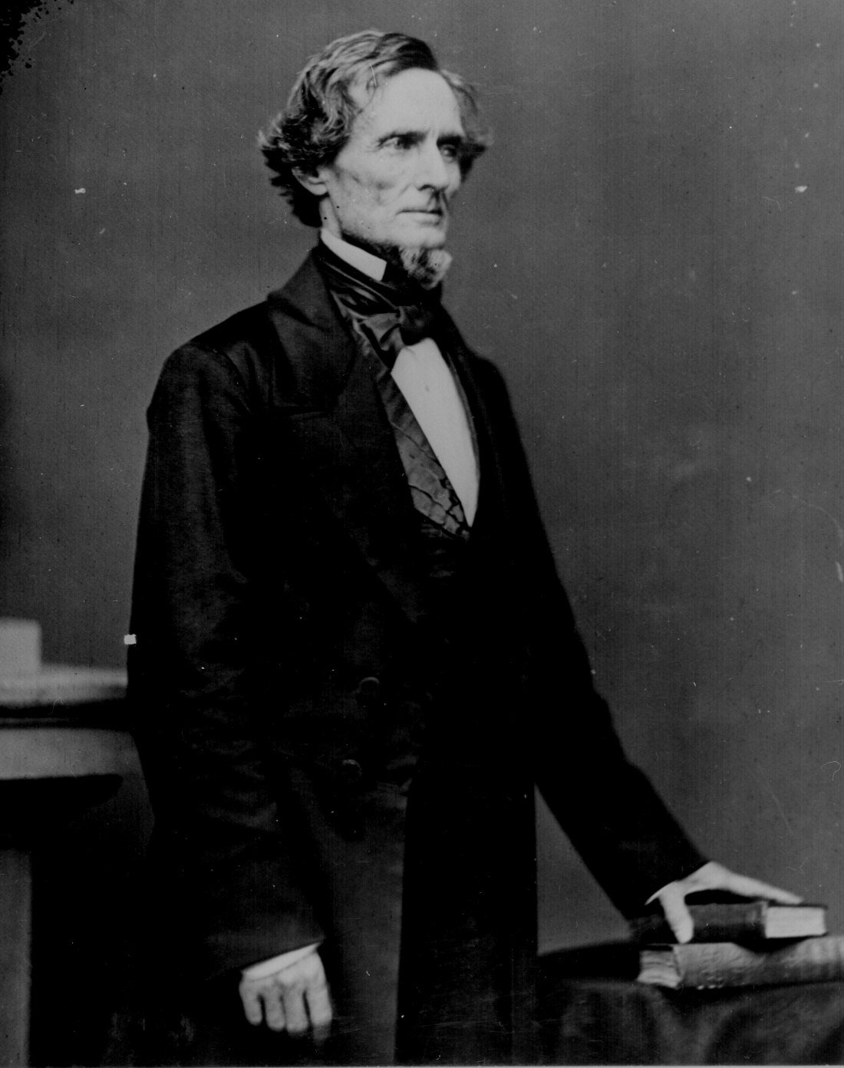
The Confederacy (3/3)
The South wanted to keep slavery- free labor on plantations
They also argued that they were fighting for state's rights
The South did not support Lincoln because he wanted to end slavery
Jefferson Davis was the President of the Confederate States

