Slide 1
Events Leading to the American Revolution

Slide 2
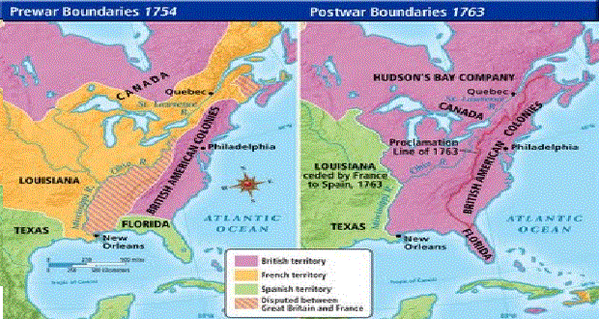
French and Indian War https://www.youtube.com/watch?v=Y2fjkNgQJTA
The two sides during this war were the French versus the British
Both sides had Native American allies (or help), but the French had more
Fought over the Ohio River Valley (land)
The British won, and forced the French out of the New World

Slide 3
Sugar Act
1764 Parliament (British government) passed the Sugar Act
Reason: to pay off the war debt from the French and Indian War
Taxed the sugar and molasses brought into the colonies
Cost colonists lots of MONEY

Slide 4
Stamp Act https://edpuzzle.com/assignments/5e4e25ef88050b40dcfee1f4/watch
1765 Parliament approved another tax
This act put a tax on many paper items in the colonies
Newspapers, legal documents, playing cards, and more had a special tax
Colonists were taxed without having a say- or without being represented

Slide 5
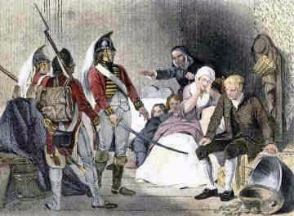
Quartering Acts
1765 (1st act)/ 1774 (2nd act)- Colonists had to allow British soldiers into their homes
Soldiers were able to stay at the homes- sleep and eat there
Colonists COULD NOT turn the soldiers away!

Slide 6
Boycott https://www.youtube.com/watch?v=GO_Ovq80buA
Colonists wanted these taxes to go away, so they held boycotts
Boycott-to stop using or buying a product
This caused the Stamp Act to be repealed
Repealed=taken away

Slide 7
Townshend Acts
1767 Parliament passed new tax laws called the Townshend Acts
This taxed glass, tea, paint, and paper that was brought into the colonies
England even hired more tax collectors!
The colonists were even more angry and boycotted more!

Slide 8
Boston Massacre
These new tax collectors were like British soldiers all over the colonies
The colonists didn’t like have these soldiers in their streets
They got so angry that fights would break out in the streets
On March 5,1770, a large crowd of colonists gathered around the soldiers and threw rocks and snowballs at them.
The soldiers fired their guns
Three colonists were killed on the spot and two others died later

Slide 9
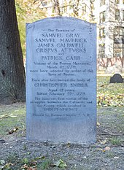
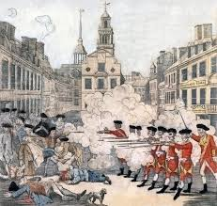
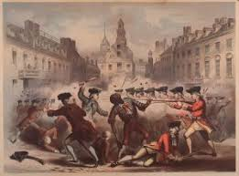
Boston Massacre

Slide 10
Boston Tea Party
1773 Parliament passed the Tea Act
This meant that colonist could only buy tea from England
The Sons of Liberty decided to dress up as Mohawk Indians and sneak onto the boats
Sons of Liberty-group of colonists who were mad about the new laws and wanted action!
They dumped 46 tons of tea into the Boston Harbor

Slide 11
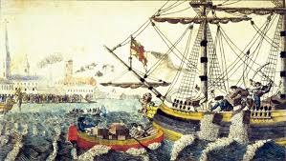
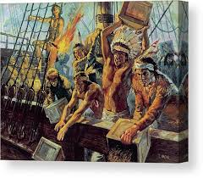
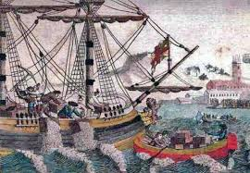
Boston Tea Party https://www.youtube.com/watch?v=TcDxSICplPE

