Slide 1
Native American Groups in North America

Slide 2
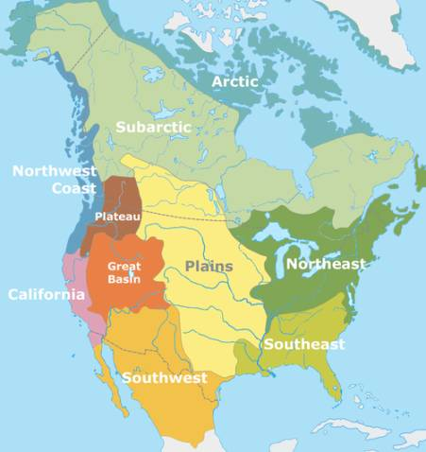
Different Regions:
The different regions in North America include:
Arctic/Subarctic
Northwest Coast/Plateau
California
Great Basin
Southwest
Great Plains
Southeast
Northeast

Slide 3
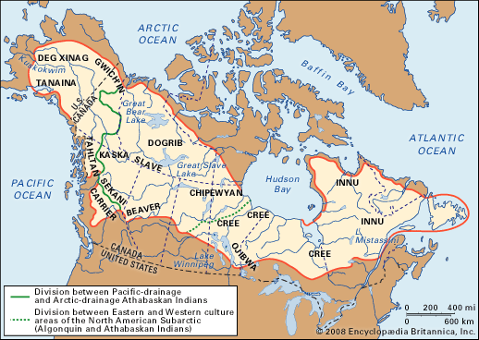
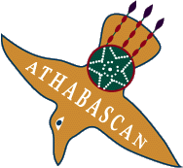
Arctic/Subarctic
Groups include:
Athabascan
Cree
Innu

Slide 4
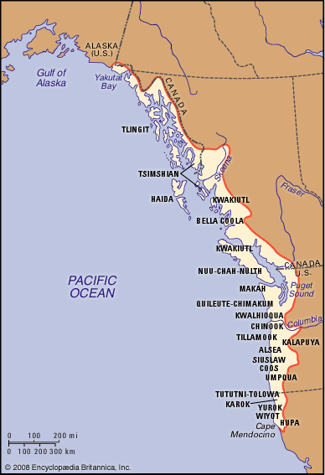
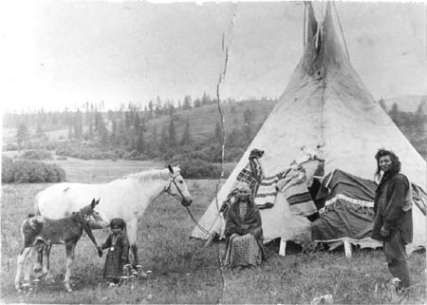
Northwest Coast/Plateau
Groups include:
Nez Perce
Salish
The Tlingit

Slide 5
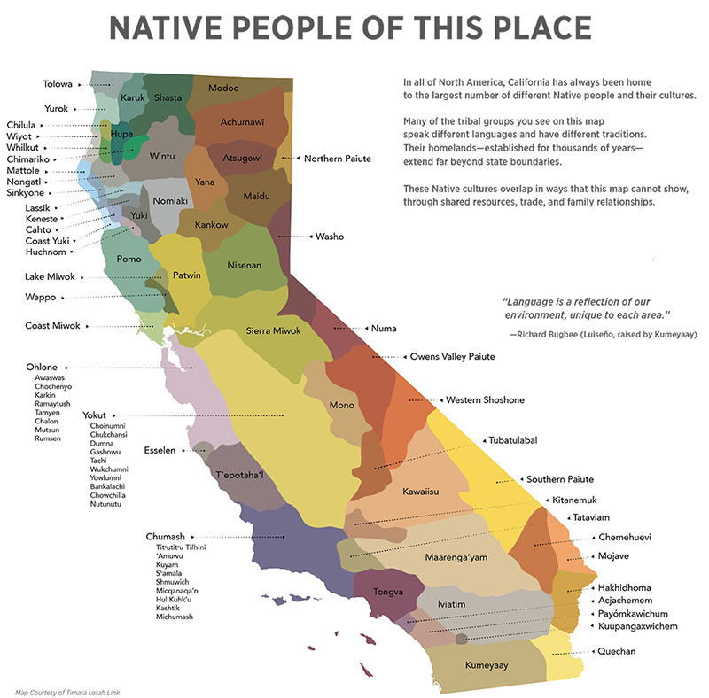
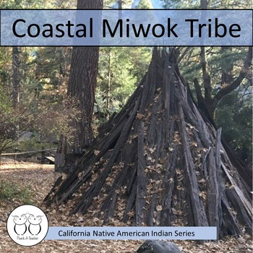
California
Groups include:
Mohave
Miwok

Slide 6
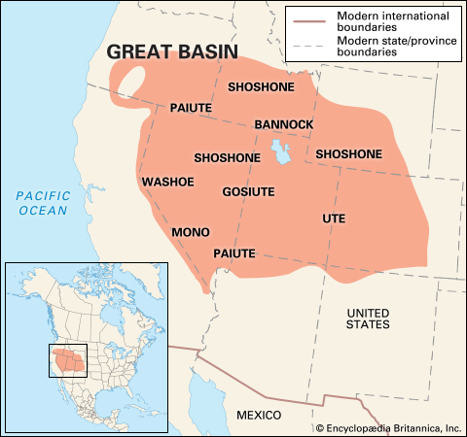
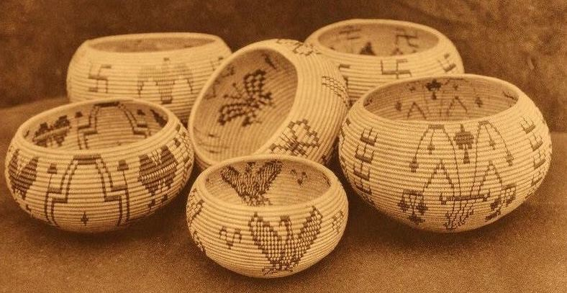
Great Basin
Groups include:
Washoe
Ute
Shoshone

Slide 7
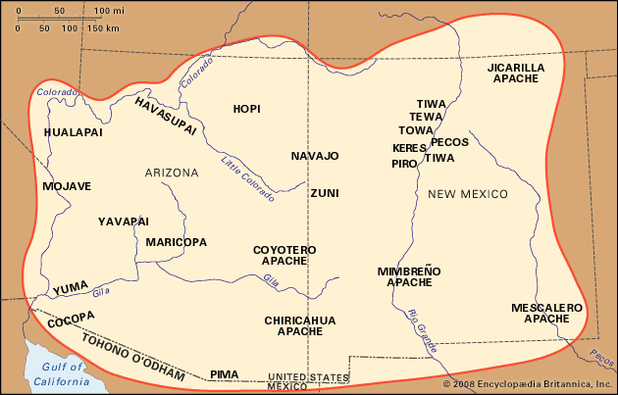
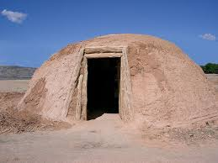
Southwest
Groups include:
Navajo Nation
Apache
Pueblo

Slide 8
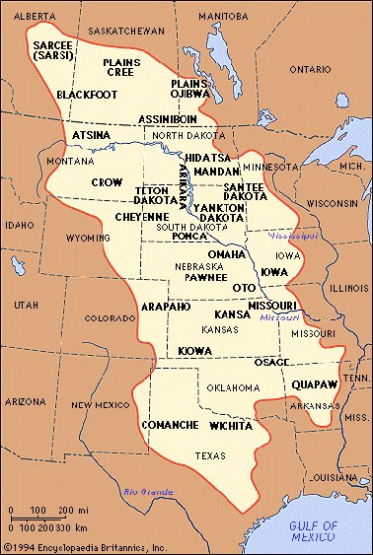
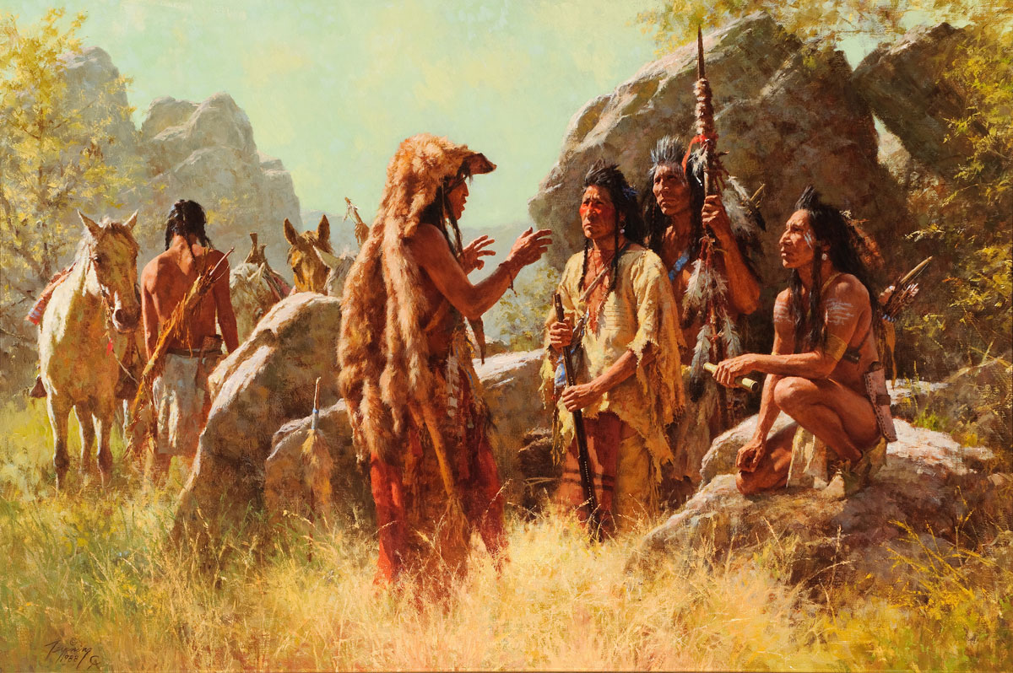
Great Plains
Groups include:
Blackfoot
Arapahoe
Cheyenne
Comanche
Crow

Slide 9
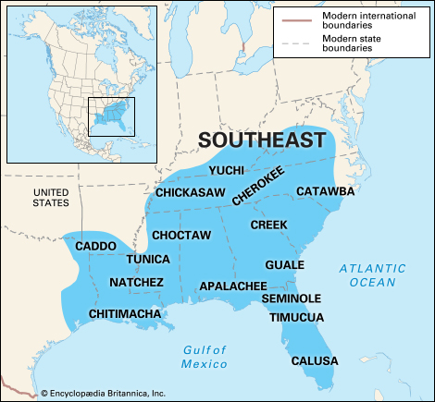
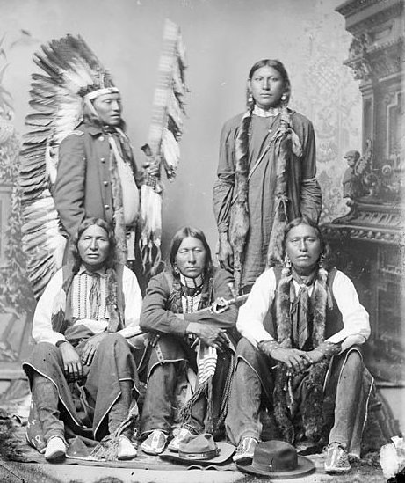
Southeast
Groups include:
Cherokee
Seminole
Chickasaw

Slide 10
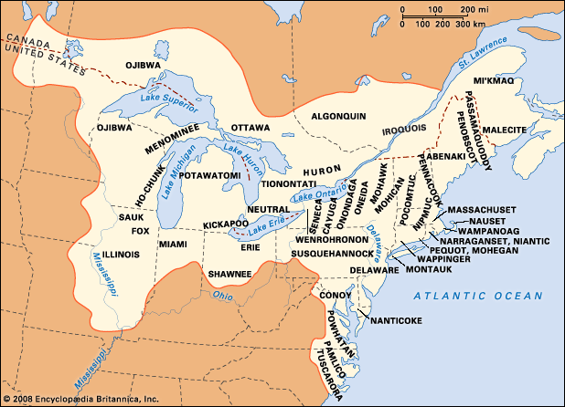
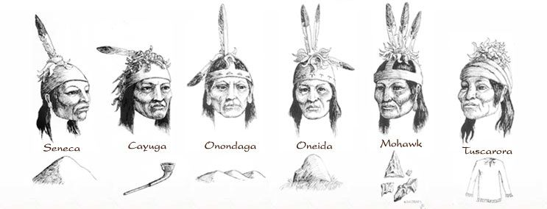
Northeast
Groups include:
The Iroquois
Wappani
Shawnee

Slide 11
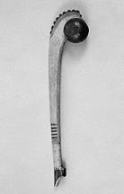
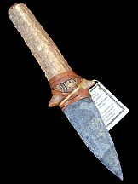
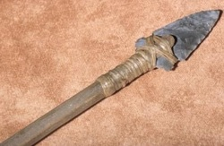
Tools
Various Native American groups used natural resources to create tools such as:
Animal bones
Wood from trees
Rocks

Slide 12
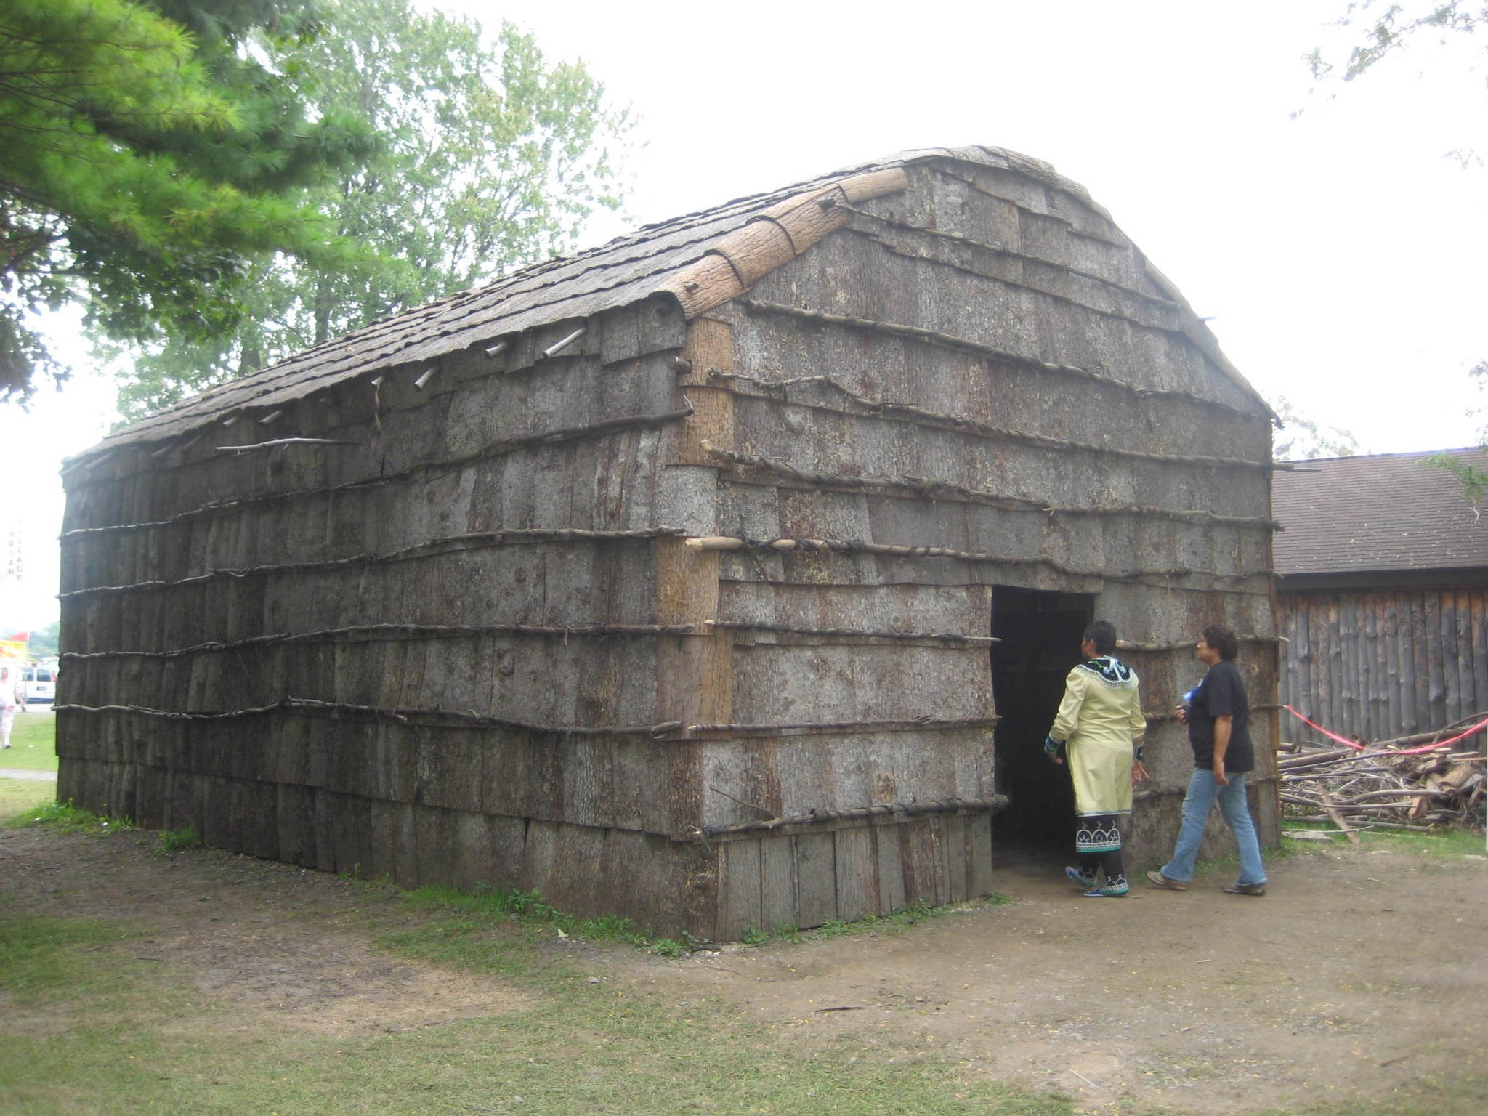
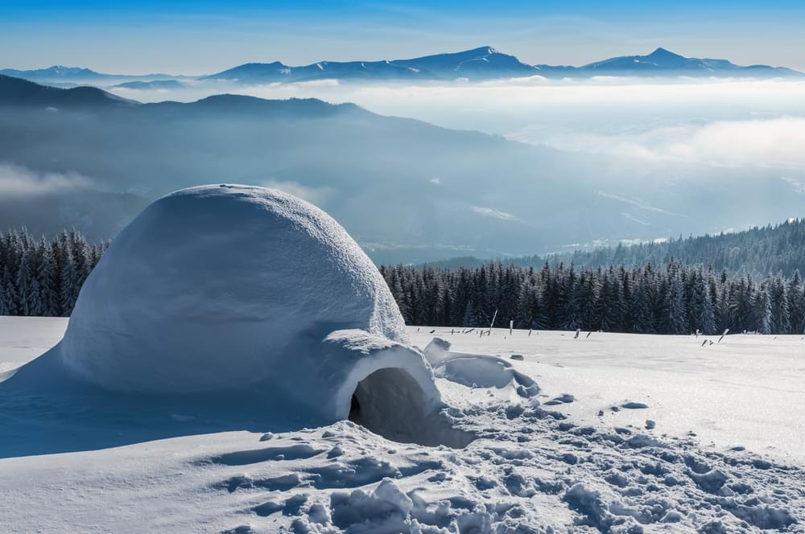
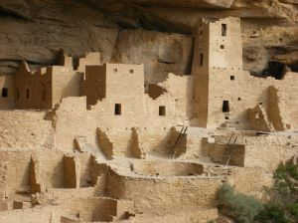
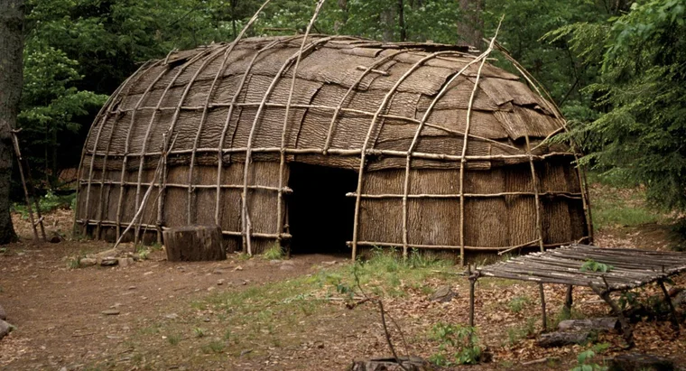
Shelter
Native Americans used their natural resources to create their homes. Resources include:
Tree bark/twigs
Dirt and mud
Clay
Animal hides
Snow and ice

Slide 13
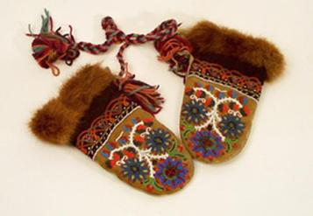
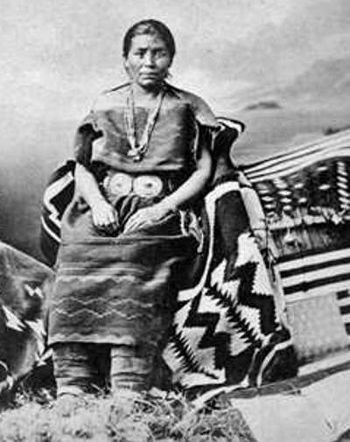
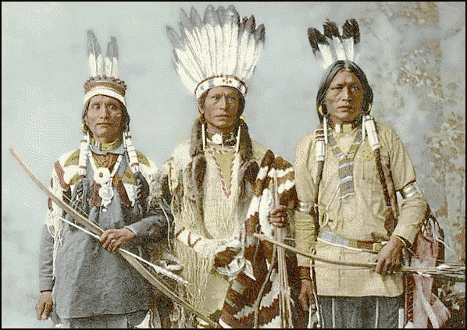
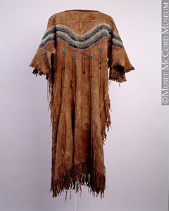
Clothing
Different Native American Groups used their natural resources to create their clothing. These resources included:
Animal hides
Deer
Caribou
Seal
Bison

Slide 14
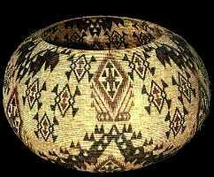
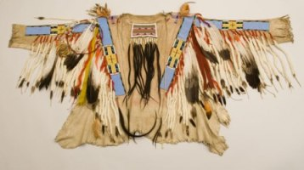
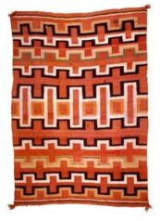
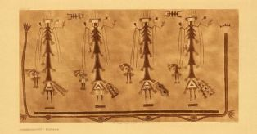
Artwork
Native American groups all created art in their own unique ways. Some art they created included:
Clothing
Masks
Totem poles
Paintings
Drawings
Blankets
Rugs
Baskets
Clay pots

Slide 15
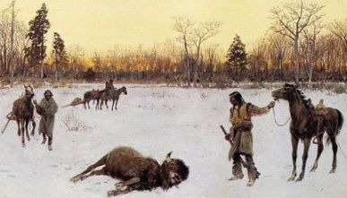
Food
Different Native American groups relied on their location for food. Some of the ways they had food included:
Hunting
Fishing
Farming
Gathering

