Slide 1
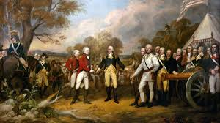
Road to Revolution

Slide 2
Review- https://www.youtube.com/watch?v=t-9pDZMRCpQ
Britain was in debt because of the French and Indian War
The colonists were expected to pay off the debt by paying taxes
Tensions between the colonists and the British grew as Parliament continued taxing the colonists without representation
Some of the taxes included the stamp act, tea act, sugar act, and townshend acts
These tensions led to fighting and eventually a war

Slide 3
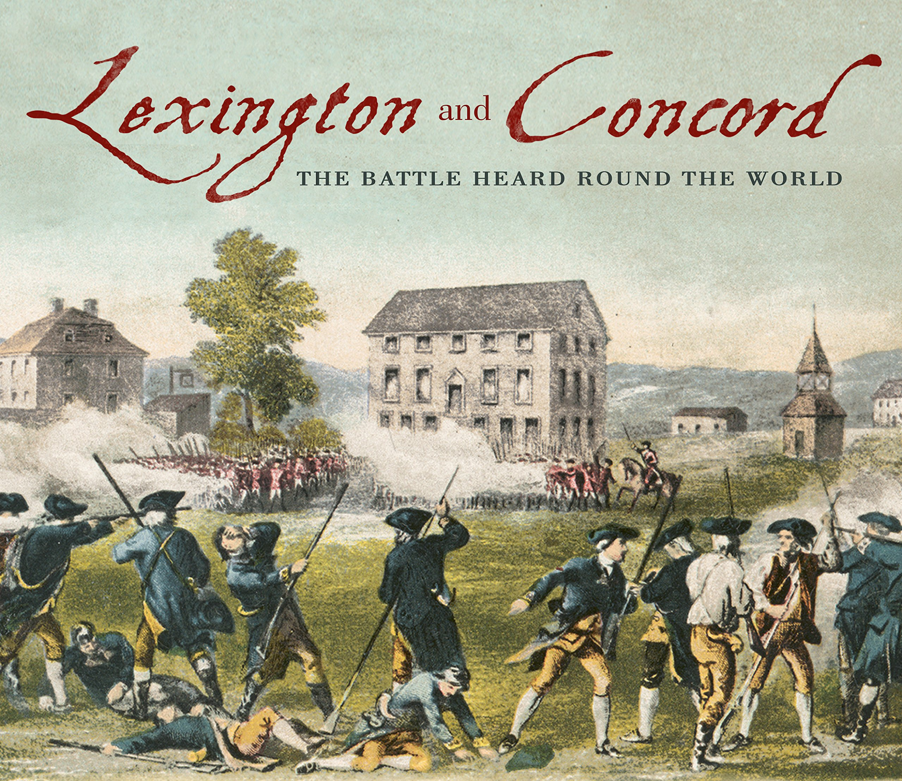
Lexington and Concord https://www.youtube.com/watch?v=rZMmPWTwTHc&t=41s
Fought 1775
First battles of the American Revolution
The British were pushed back to Boston by the colonists

Slide 4
Patriots, loyalists, and… others?
3 different groups of colonists:
Patriots- believed that the colonies needed to be independent from Britain
Loyalists- wanted to be ruled by Britain and were loyal to the king
Other…?- the last group were unsure of their feelings on independence. They were indecisive about what they wanted.

Slide 5
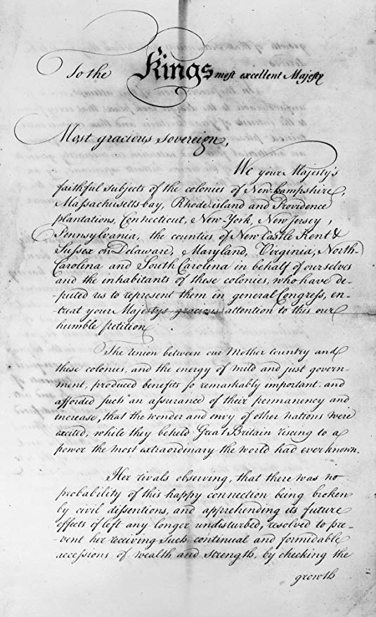
Olive Branch Petition
The colonists attempt to stop a full-blown war
In 1775 they send the Olive Branch Petition- a plea to the king asking for peace (as long as the colonists received representation and more rights)
The king never read the petition
This pushed the battles into a full war

Slide 6
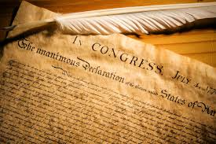
Declaration of Independence https://www.youtube.com/watch?v=gdZYyY7g8g4
July 4, 1776
The colonies officially state that they are independent from the British government
They state that they have certain rights such as the right to life, liberty, and the pursuit of happiness

Slide 7
Major people on the Patriot side https://www.youtube.com/watch?v=fcryFCpxrZg
George Washington- Commander in chief of the Continental Army
Benjamin Franklin- Wanted the colonies to work together in order to win the war
Benedict Arnold- General in the Continental Army

Slide 8
Major people on the British side https://www.youtube.com/watch?v=L6fOi_1fu80
King George III- king of England and ruler of the 13 colonies
...Benedict Arnold- was originally a patriot, but betrayed the patriots by selling battle plans to the British
General Cornwallis- general of the British army, surrendered to the colonists

Slide 9
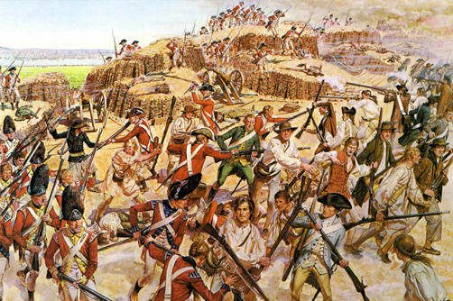
Major battles of the American Revolution
Lexington and Concord- 1775
Bunker Hill- 1775
Saratoga- 1777
Yorktown- 1781

